Slide 1

WSIST
Water Contellation FS report
Committee on Earth Observation Satellites
JAXA
GEO XIII GEOGLOWS side event
St. Petersburg, Russia
8th November 2016
Notes:
Thank you for this opportunity to present the WSIST (Water Strategy Implmentation Study Team) water constellation feasibility study report.
The report is on the home page and contains a list of contributors. I would like to thank the WSIST members and other many experts contributions to the report.

Slide 2



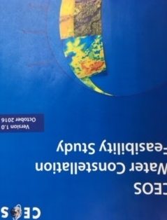

CEOS Water Strategy
and Water Constellation FS
The GEOSS Water Strategy renews the observational component of the community’s efforts to communicate the needs of the Water community within the framework of GEOSS.
CEOS Water Strategy Implementation Study Team (WSIST) prepared the CEOS Water Strategy to the GEOSS Water strategy recomendations.
CEOS Plenary 2016, Kyoto, decided on extention of WSIST for one year to implement the CEOS Water Strategy actions including the water constellation FS.
GEO Water Strategy
CEOS Response
IGOS Water
Theme report
April 2004
GEOSS 10 Year
Implementation Plan
February 2005
GEOSS Water
Strategy
January 2014
CEOS Water
Strategy
October 2015
CEOS Water
Constellation FS
October 2016
Notes:
Kyoto CEOS Plenary last year decided one year extention of the WSIST to implement the CEOS water strategy actions including the water constellation FS.

Slide 3
Proposed Major CEOS actions
Out of 55 recommendations of GEOSS Water Strategy, CEOS takes the lead in addressing “Advancing satellite data acquisition”.
C1: FS on Water Constellation
C2. C3 : participation in GEO water vapor and cloud activity
C4, C5: participation in the development of precipitation white paper
C6: coordinate LST missions toward improved ET estimation
C7, C8, C9 : CEOS agency activities already cover these.
C10: FS on hyperspectral satellite mission on water quality measurement
CEOS supports external activities, including:
E5: define soil texture map requirements and communicate them to IGWCO
E8: participate in GEO activities to define a global framework for surface water storage monitoring
Notes:
This shows the CEOS water strategy actions.
C1 and C10 have been taken care of.
Next steps for the remaining actions need to be considered.
Thank you for your kind attention.

Slide 4
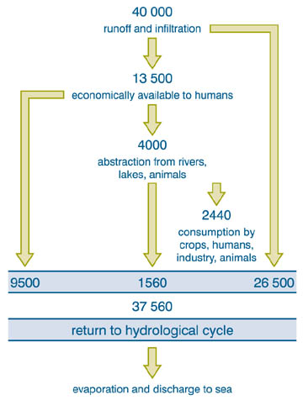
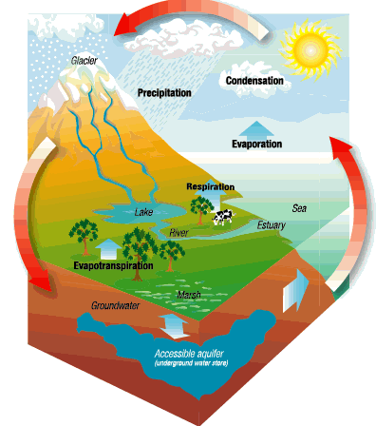
The GEO Water Strategy concluded that data requirements depend on water data use
Science
Water Management
Needed:
Resolution
Accuracy
Needed:
Resolution
Latency
10³ km³yr⁻¹
(courtesy of Massimo Menenti)
As an element of the natural system
As a contribution to economic productivity
Notes:
Page 3 shows water cycle and their components.
It is interesting to note scince attach importance to accuracy in additon to resolution, while water management requires latency.

Slide 5
Linkage with
major int’l agreements
Sendai Framework for Disaster Risk Reduction 2015-2030
  understanding global/regional/local risks
  support access to multi-hazard EWS particularly for floods and droughts
2030 Agenda for Sutainable Development
  Goal 6: Clean water and sanitation
  UN High Level Panel on Water agreed on an action plan for the SDG 6 including use of satellite based data (Sep 2016)
Paris Agreement
  Article 7 (Adaptation) calles for systematic observation of climate system and early warning systems
Notes:
FS contribute to responding to requirements of major international agreements including Sendai Framework for Disaster Risk Reduction, SDGs and Paris Agreement for Climate Change.

Slide 6
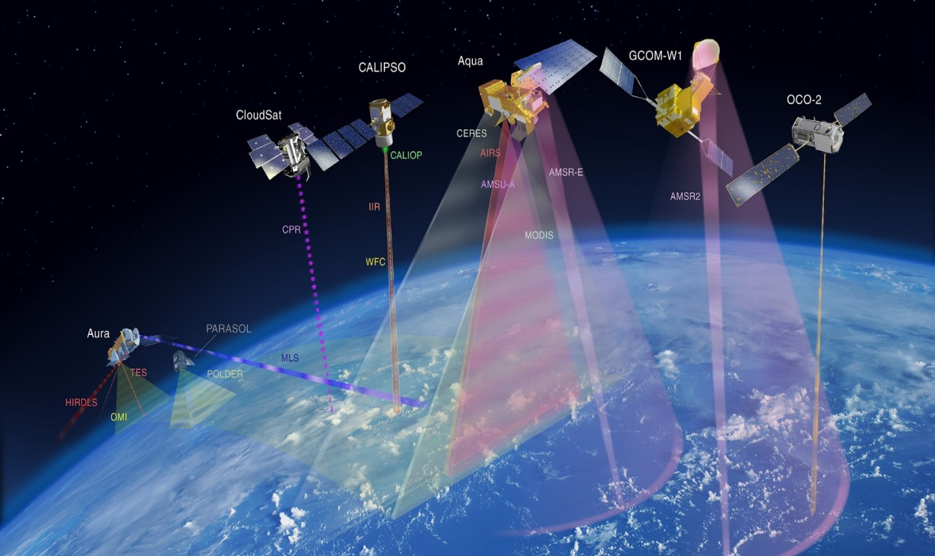
Water Constellation FS
GEO Water Strategy Recommendation C1:
The feasibility of developing a Water-Train satellite constellation should be assessed. This suite of satellites would be modelled after the A-Train, providing a space segment of an observation system that would capture all fluxes and stores of the water cycle using a diverse suite of platforms and instruments. This system would operate as a Virtual Water Cycle Constellation.
The A-Train
Notes:
GEO water strategy recommendation C1 calls for FS on developing a water-train satellite constellation.
It provides satellite observation system to capture all flexes and stores of water cycle, using diverse suite of platforms and instruments.

Slide 7
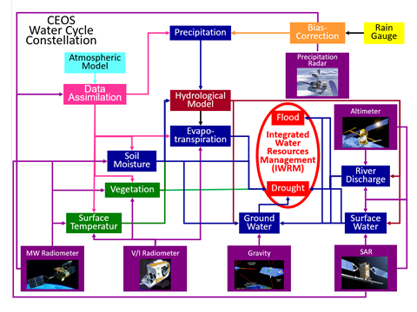
Integrated Water Observation System
Courtesy: Toshio. Koike
Notes:
Page 5 shows Prof. Toshio Koike’s integrated water observation system diagram.
In the FS, 6 high priority water variables were selected . They are precipitation, soil moisture, evaporatnspiration, river dischager, surface water storage and groundwater.
The diagram shows how these 6 variables are estimated by observation systems, models and data assimilation systems, demonstrating benefits of integrated water resource management.
The FS will contribute to realize and optimize the observation system in the diagram.

Slide 8
FS Skelton
FS Skelton for 6 parameters, i.e. precipitation, soil moisture, evapotranspiration, river discharge, surface water storage, groundwater has been developed.
Paramter A
Review
Requirements
Existing/
planned
capabilities
Identified
CEOS
missions
Gap
analysis,
Mission
coordination
Synergy
with other
parameters,
Mission
coordination
Paramter B - F
Review
Requirements
Existing/
planned
capabilities
Identified
CEOS
missions
Gap
analysis,
Mission
coordination

Slide 9
Requirements
Most recent user requirements “US-09-01a: Critical Earth Observations
Priorities-Water Societal Benefit Area” were reviewed.
In addition, GCOS-ECV requirements and WMO Statement of Guidance
(WMO-SOG) were reviewed.
Table 1.1. GEO Water SBA requirements for precipitation
Area | Horizontal Resolution | Time Resolution | Accuracy | Latency
Local | 1 km | 1 hour, or 0.08-0.5 hour | 0.1-1 mm/hour or 0.5-3 mm/hour | 0.1-6 hours or 3-24 hours
Regional | 10 km | 3 hour, or 1-12 hours | 0.5-5 mm/day | 1-2 days
Global | 50-100 km to 500 km | 1 day, or 1-3 days | 2-10 mm/day | 7-30 days
 | Also variably stated as 5-50 km |  | Also stated to be 0.1 mm or 5% of the amount | Also variably stated as RT or DT, depending on the application
Notes:
Considerable efforts were made to review the user validated requirements.
They are GEO Water SBA’s user requirements compiled by then GEO User Panel. In addtion to the GEO user requirements, GCOS ECV and WMO-SOG (Statement of Guidance) requiremetns are also reviewed.

Slide 10
Water Cycle observation status: requirements vs existing/future capabilities
Horizontal Resolution | Time Resolution | Vertical Resolution | Accuracy | Latency
L:1km R:10km G:50 to 100 km | L: 1hr R:3hr G:1d | N/A | 0.1mm/5% | 0.1h to 6hr
Green: satisfied
Blue: marginal
Red: not satisfied
Precipitation
Horizontal Resolution | Time Resolution | Vertical Resolution | Accuracy | Latency
L:0.1km to 1km R: 10km G:50 to 100km | L/R: 1 to 6 hrs R:1d to 3d G:1 to 30d to 3 months | 10cm Res. to 1m depth; | 0.02m³/m³ | NRT or 0.5d to 1d
Soil Moisture
Horizontal Resolution | Time Resolution | Vertical Resolution | Accuracy | Latency
L:1km R:10km G:50 to 100km | L:1 to 6 hrs R:1d G:1d to 1m | Surface(E), and LS veg cover or canopy ht f | 0.1mm or 5%. | RT
Evaporation/ET
Horizontal Resolution | Time Resolution | Vertical Resolution | Accuracy | Latency
L:1km-10km G: 50 km-200km | L:1 to 6 hrs R/G:1d-10d, | N/A | 5%10%;Units:m**3/sec. | Hourly to daily (NRT)
River discharge
Horizontal Resolution | Time Resolution | Vertical Resolution | Accuracy | Latency
L/R:1km-40km G:50km to 100km | 1wk to 1m Or 30d to 90d | N/A | 10cm-20cm(level);Or 5%. | L/R: 1w-1m R/G: 30d to 90d
Surface water storage
Horizontal Resolution | Time Resolution | Vertical Resolution | Accuracy | Latency
L/R:1km-10km R/G:50km to 100km | 1m to 3m to 1year | 0.1km;Variable--depth | 5%-7％(Depth to W-table) | 1m to 3m Also stated as TBD-
Groundwater
Notes:
This shows how the water requirements are met by existing and planned observation systems for six parameters.
In summary, it shows user requirements are met fragmentally and marginally.

Slide 11
MWI Mission Timeline
Notes:
Gap analysis was made for 6 prirotity paremters. This is for precipitation mission chart.
Bｌue bars are MWI (Microwave Imager) missions and green ones are MWS (Microwave Sounder) missions.
Gap of post GCOM-W/AMSR2 is now being studied by JAXA to be filled. It is recognized that post DMSP-SSMI for 5 to 9 pm, therefore 5 to 9 am also, will pose a seious gap if no countermeasures are taken.

Slide 12
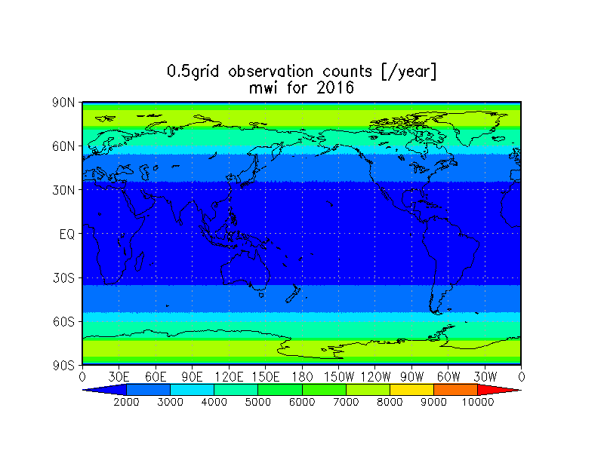
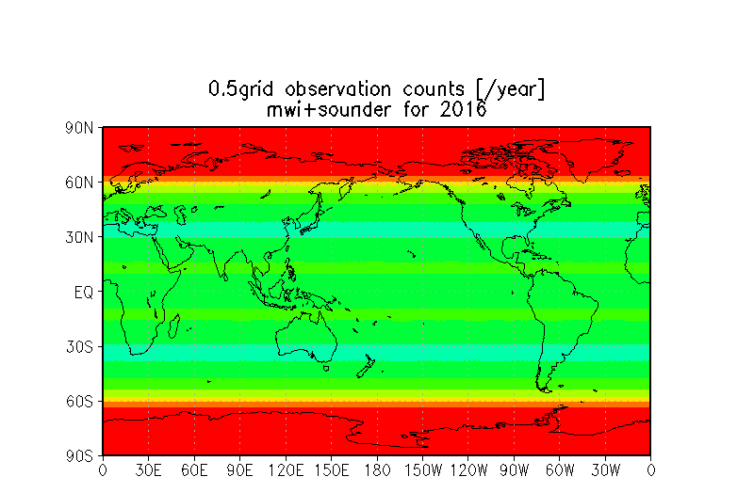
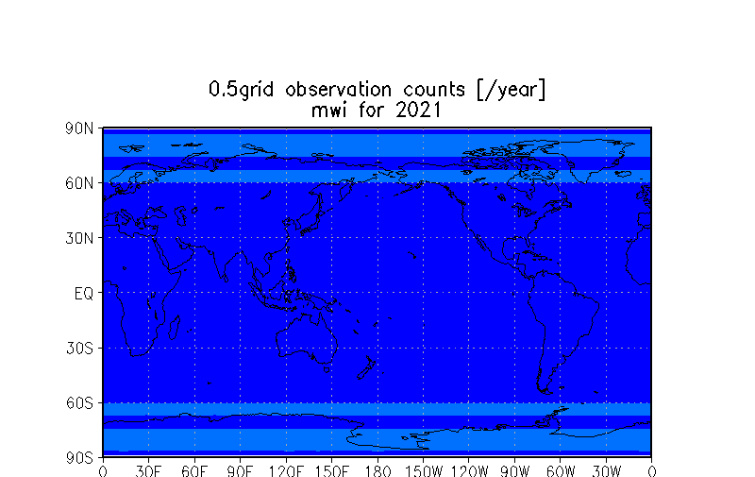
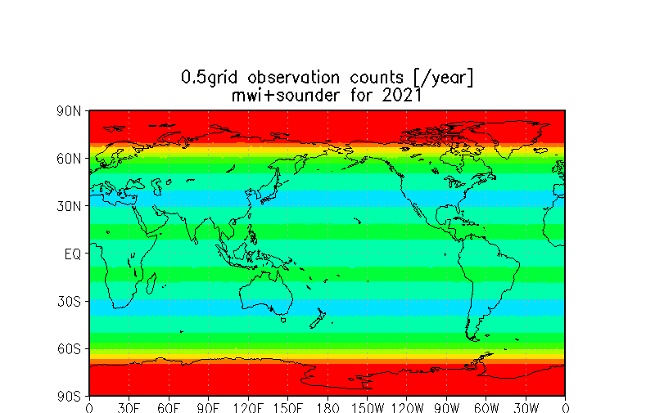
Sampling Analysis
Figure 3.1.2 Precipitation observation sampling analysis in 2016 and 2021.
MWI
MWI＋MWS
2016
2021
Notes:
Sampling analysis was made for precipitation and soil moisture.
Left side is samplling frequency of MWI (Microwaver Imager) which shows clear decline from 2016 to 2021.
Supplementing MWI with MWS (Microwave Sounders) in the right hand side improve the sampling frequency, but declining trend still remain.

Slide 13
Synergies among Variables
Precipitation (P)
  Very closely connected with soil moisture and evapotranspiration (ET)
  provides input to river discharge(RD), surface water storage(ST) and groundwater (GW)
Soil moisture (SM)
  Observation at 6 AM is ideal because of low land surface temperature
  37GHz MW data is critical to retrieve soil moisture from L/C/X band data
Evapotranspiration (ET)
  Indirectly observed by soil moisture and land surface temperature
  Pairs of cloud-free land surface temperature images are required
River discharge (RD)
  SWOT has a potential to provide river water level at major rivers
  Optical sensor and SARs are useful for flood extent monitoring
Surface water storage (ST)
  SWOT plans to monitor water levels of lakes and reservoirs.
Groundwater (GW)
  GW are connected with SM and ET in data assimilation
Notes:
Synergies among variables were studied.

Slide 14
Observation Synergies for
Water Resource Management
User needs benefitting from synergies
Sensors and technologies’ synergies |  | P | SM | ET | RD | ST | GW
 | P |  | Irrigation water allocation and scheduling | Water balance Irrigation water allocation and scheduling | Water allocation and treatment | Water allocation Dam operation | Water Recharge
 | SM | Radar LST MWI |  | vegetation growth | Discharge predict for allocation | Leakage from reservoirs | Aquifer water availability
 | ET | High res LST | High res LST LC Maps |  | TBD | Storage water loss | Aquifer water availability
 | RD | Radar | Radar | TBD |  | Storage change and refill strategy | In mountains, GW discharge
 | ST | Radar | Soil Type and profile map | Surface temp | Altimetry water level DEM |  | Aquifer recharge
 | GW | TBD | Data assimilation | Soil type and profile map | Soil type and profile map | Data assimilation
 | Observe vation synergies | Radar, High res LST, MWI | High res LST, LC Maps, Radar, Soil maps, Data assimilation | Surface temp/LST, LC maps, Soil maps, | Radar, Altimetry Soil type and profile map | Radar, soil maps, Surface temp. Data assimilation Altimetry | Data assimilation, soil maps
Notes:
Synergy of a water variable with other variables for water resource management were shown in the figure.
Green colored boxes have synergies.
Synergy in user needs are shown in upper right half, while synergies in sensors and tecnologies are shown in lower left half.
The lowest row shows overall sysnergies for the observation system.

Slide 15
Proposed Water Constellation
Instruments requirement for observing a water variables considering synergies of
other variable observations are shown in the following.
Instrument
 | PR | MWI | MWS | TIR GEO/ LEO | OPS MODIS/Landsat | Radar L/C/X band | Alti meter | Gravity | Remarks
P | 〇 | 〇 | 〇 | 〇 |  |  |  |  | MWI is strongly preferred than MWS and TIR.
SM |  | 〇 37GHz is critical |  | 〇 |  | 〇 Lband preferred |  |  | MWI+TIR, MWI+Radar can improve accuracy, resolution.
ET |  | 〇 |  | 〇 | 〇 |  |  |  | Pairs of cloud-free TIR images are needed.
RD |  | 〇 |  |  | 〇 | 〇 | 〇 |  | Improvement of altimeter revisit time is needed.
ST |  |  |  | 〇 | 〇 | 〇 | 〇 |  | ditto DEM is required to estimate water volume
GW |  |  |  |  |  |  |  | 〇 | SM and ET are closely related with GW in data assimilation.
Variable
Notes:
If we sort out the synergy information by sensor types, we can show what type of instruments are needed for water resource management.
This shows possible water constellation components for supporing water resource management.
PR, MWI and MWS component can be provided by current GPM constellation. TIR, optical and radar observation can be provided by current LSI VC with impoved coordination. Altimeter mission need to improve its revisit time.

Slide 16
Proposed Water Constellation (con’d)
Necessary components for water constellation already exist in
existing and future plans.
    MWI constellation is a key component for retrieving precipitation,
    soil moisture and ET. Prospective gaps of FO missions of AMSR-2,
    DMSP/SSMI, SMOS and SMAP need to be addressed.
    Next-generation precipitation radar and synergistic observation with
    EarthCARE should be made to study the process of aerosol, cloud and precipitation.
    TIR, optical and L/C/X band radars can be optimized for data aquisition and product generatio to contribute to observations of SM, ET, RD and ST.
    Revisit time of altimeter missions need to be improved for monitoring river discharge and surface water storage.
    GRACE type missions should be continued for groundwater monitoring.
    Data assimilation systems should be developed to use actual data in a more optimal way.
      It is recommended that CEOS maintain some form or a water activity or advisory group to ensure that the benefits of these studies are incorporated into future CEOS discussions and plans.
Notes:
Recommendations for each constellations and data assimilation sytem to employ more accurate data in a more optimal way are given.
Finally it is recommended to continue the water activities to reflect the FS outcomes to future CEOS missions.

Slide 17
Recommendations for
CEOS Plenary Decision
The 30th CEOS Plenary decided;
‐to endorse the CEOS Water Constellation FS report
- to consider next steps by the April 2017 CEOS SIT
meeting to address recommendations of the water cycle
FS and remaining CEOS Water Strategy actions (C2 to
C9)
Notes:
For the Plenary, the followings are reommended for the CEOS Plenary.
- first is to endorse the FS report
- and the second is to consider next steps by next SIT meeting to address remaining CEOS water strategy actions (C2 to C9)

