Slide 1

Earth Observations Contributing to
“The 2030 Agenda for Sustainable Development”
‐Perspective of Japan ‐
Shinichi Higuchi
GEO Principal Alternate of Japan
Ministry of Education, Culture, Sports, Science and Technology‐Japan
8 November 2016
Notes:
Thank you for giving me the opportunity to introduce Japan’s approach and activities on SDGs. Let me start from SDGs-related updates in the Government of Japan.

Slide 2
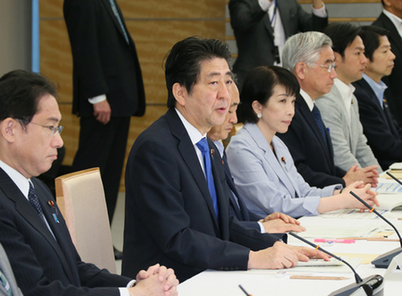
Mainstreaming of SDGs in Japan
SDGs Promotion Headquarter
- Established in the Cabinet on 20 May 2016
Headed by Prime Minister
Attended by all Cabinet Ministers
Senior official level steering committee
SDGs Implementation Guiding Principles
(Currently under discussion)
define Vision, Priority issues, Specific measures, Indicators, Follow-up mechanism etc.
Ensure coherence and inclusiveness of various measures by different Ministries
Each ministry is now mapping out its specific measures
Notes:
The first activity I will introduce is the mainstreaming of SDGs in Japan. In May, the Government of Japan established “SDGs Promotion Headquarters” consisting of all Cabinet Ministers. Prime Minister of Japan serves as the Chair. Its steering committee composed by senior level officials was also established to facilitate smooth inter-Ministerial collaboration.
We are now preparing the SDGs Implementation Guiding Principles under the guidance of the Headquarter. Vision, Priority issues, Specific measures, Indicators and Follow-up mechanism will be inscribed in the Guiding Principles. Each ministry is now mapping out its specific measures and will be organized in the Guiding Principles to ensure coherence and inclusiveness of various measures by different Ministries.

Slide 3

G7 Ise-Shima Summit, 26-27 May 2016
< SDGs >
- Commit to;
(1) advance the implementation of the 2030 Agenda, domestically and internationally
(2) support developing countries’ efforts to implement the 2030 Agenda
<Ocean Observation>
- Support scientific work to enhance global ocean observation and assessment for science-based management, conservation and sustainable use of marine resources.
* Ocean Observation supporting SDGs’ Goal 14 was also included in the “Tsukuba Communique” adopted at G7 S&T Ministers’ Meeting.
Notes:
Second, Japan hosted 2016 G7 Summit in Ise-Shima this May with kind cooperation from other G7 countries.
In the Leader’s Declaration, the commitments to advance the implementation of the 2030 Agenda domestically and internationally and to support developing countries efforts was included. In terms of earth observation, the enhancement of global ocean observation was included in the Leader’s Declaration, and Ocean Observation supporting SDG’s Goal 14 was in the Communique of the G7 S&T Ministers’ Meeting.

Slide 4









MEXT’s major activities on implementation of SDGs
Goals | Items | Outlines
 | R&D combating infectious diseases | - Implementing R&D projects on prevention, diagnosis, drug development, treatment of infectious diseases and Neglected Tropical Diseases (NTDs) in collaboration with local research institutes
 | HRD for STI and Int’l cooperation in S&T | - Various human resource development for STI - Bilateral and multilateral joint research programs such as “Science and Technology Research Partnership for Sustainable Development (SATREPS)”
 | R&D on Energy S&T | - Implementing R&D projects for creating, storing and saving energy, based on “National Energy, Environment Strategy for Technological Innovation”
 | R&D on Environmental S&T | - Implementing R&D projects on climate projection and climate risk assessment and “Data Integration and Analysis System (DIAS)” , contributing IPCC and GEO
 | R&D on Marine S&T and Ocean observation | - Ocean observation including polar region ,deep sea and sea bed - Marine science technologies underpinning the appropriate development, use, and management of ocean.
 | R&D for global challenges utlizing satellites | - Applying EO satellites data for addressing global challenges; forest monitoring, air quality monitoring , flood warning system and disaster monitoring, crop monitoring.
 | Education | - Enriching preschool education, primary and secondary education , higher education , vocational education and support for international students - Promoting “Education for Sustainable Development (EDS)” - Disseminating Japanese-style education overseas
 | Cultural heritage protection | - Implementing restore projects and capacity building in developing countries in cooperation with UNESCO etc.
Notes:
- Next, Let me brief my Ministry’s major activities on SDGs.
- Toward Goal 3 “health”, we are conducting R&D projects to combat NTDs and Infectious.
Toward Goal 9 “innovation”, we are implementing human resource development programme for science, technology and innovation and also implementing international S&T cooperation programme such as STREPS, joint progoramme of scientific research and development assistance.
Toward Goal 7 “Energy”, we are conducting R&D projects for creating, storing and saving energy.
Toward Goal 13 “Climate action”, we are conducting climate projection, climate risk assessment and development of Data integration and Analysis System (DIAS), contributing to IPCC and GEO.
Toward Goal 14 “Ocean” and 13, we are conducting ocean observation including polar region ,deep sea and sea bed and marine S&T development.
Toward Goal 11 “Cities” and Goal 15 “Ecosystem”, we are applying satellite data for addressing global challenges; forest monitoring, air quality monitoring , flood warning system and disaster monitoring, crop monitoring.
We are also providing educational service toward Goal 4 “Education” and tackling cultural heritage protection toward Goal 11.

Slide 5
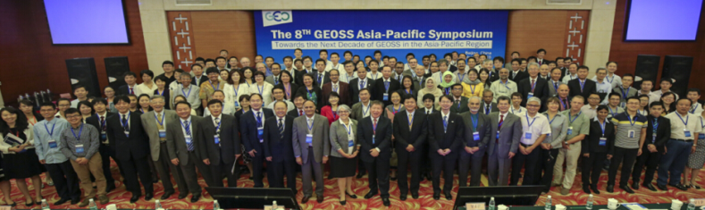
GEOSS Asia Pacific Symposium
To foster the community of researchers and to enhance shared understanding on environmental issues particular to the region.
Organized by Japan and GEO Secretariat annually since 2007 and convened total 1,617 participants.
The 9th GEOS Asia Pacific Symposium
- Earth Observations Supporting the Implementation
of the SDGs in the Asia Pacific Region -
1. Date: 11-13 January 2017
2. Venue: Tokyo International Exchange Center (Plaza Heisei), Tokyo
3. Thematic WGs: (1) Asian Water Cycle Initiative (AWCI)
(2) Asia-Pacific Biodiversity Observation Network (AP-BON)
(3) The GEO Carbon and GHG Initiative
(4) Ocean and Society
(5) Agriculture and Food Security (GEO-GLAM)
The 8th Symposium in Beijing
Notes:
- MEXT has been organising GEOSS Asia Pacific Symposium with GEO Secretariat for 9 years since 2007, to foster the community of researchers and to enhance shared understanding on environmental issues particular to the region.
The 9th Symposium is to be held in Tokyo on 11-13 January 2017, with subject of “ Earth Observations Supporting the Implementation of the SDGs in the Asia Pacific Region”. Five thematic WGs (1) Asian Water Cycle Initiative (AWCI), (2) Asia-Pacific Biodiversity Observation Network (AP-BON), (3) The GEO Carbon and GHG Initiative, (4) Ocean and Society and (5) Agriculture and Food Security (GEO-GLAM) is organized in the Sympsium.
We welcome a large number of participants inside and outside of AP region.

Slide 6
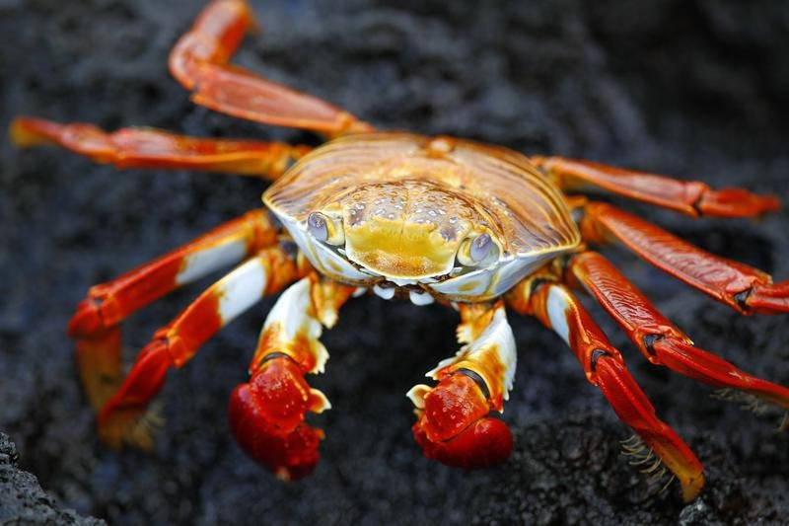


(Case) Monitoring Goal 14 and 13 by ocean observation
Goal 14
Conservation and sustainable use of the oceans, seas and marine resources
14.2 Ocean and coastal ecosystem De-Oxygenation and Chlorophyll A.
14.3 Ocean acidification pH and Carbon dioxide
Goal 13
Take urgent action to combat climate change and its impacts
Climate change and sea level rise
temperature, salinity etc.
Notes:
Ocean observation contributes to monitoring Goal 14 and 13.
The status of ocean and coastal ecosystem can be monitored by De-Oxygenation and Chlorophyll A, and ocean acidification can be monitored by pH and CO2 directly.
Monitoring sea temperature and salinity support to understand current status of climate change itself and sea level rise, one of the impact of climate change..

Slide 7
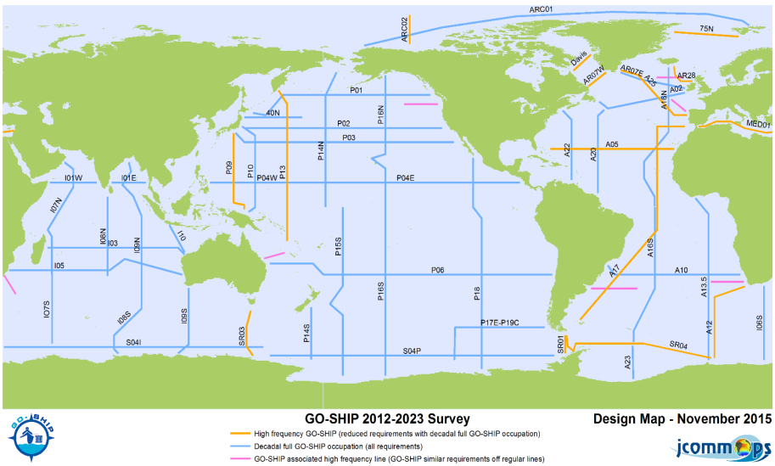
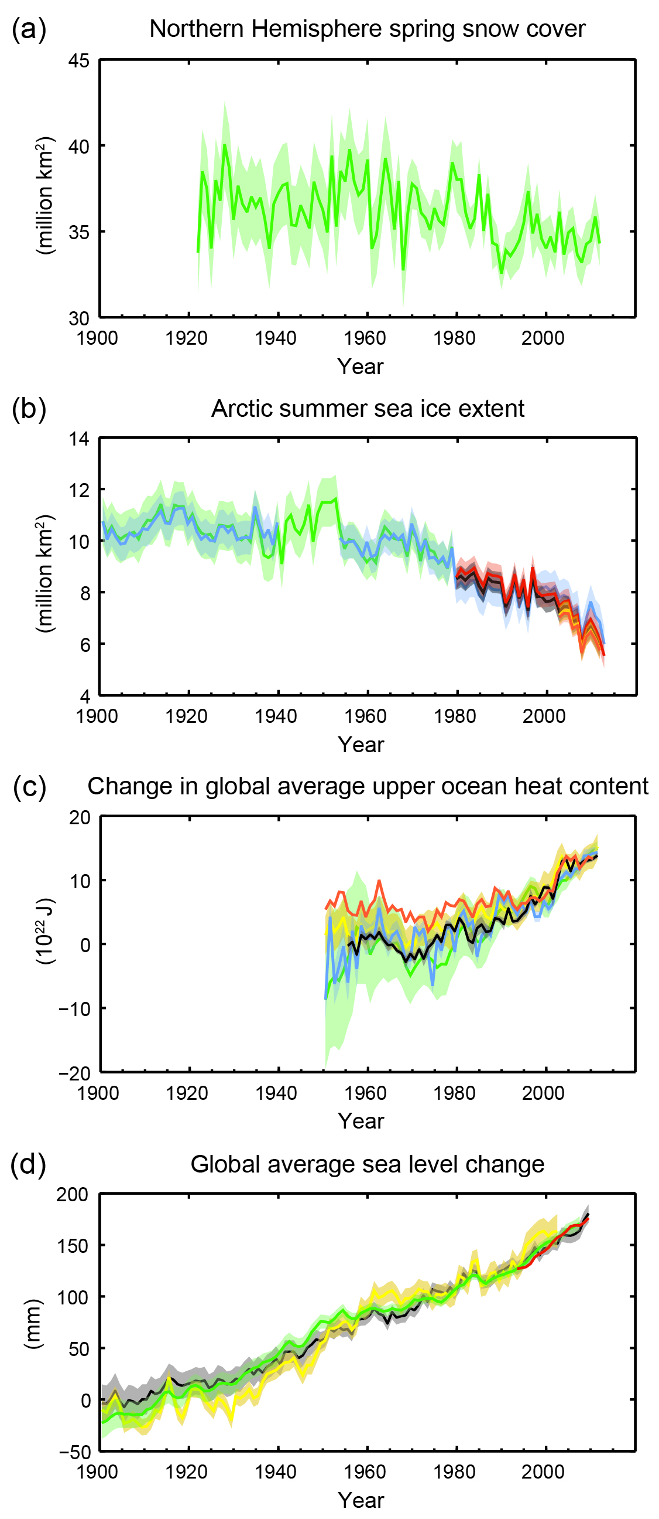
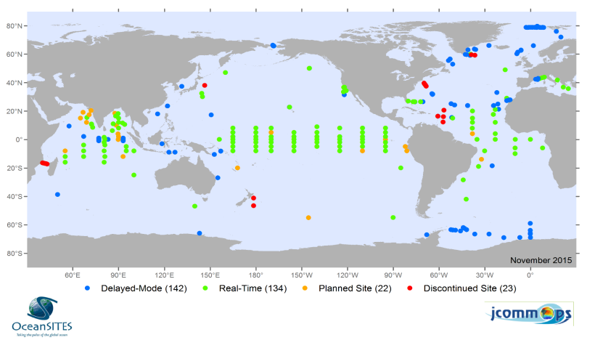
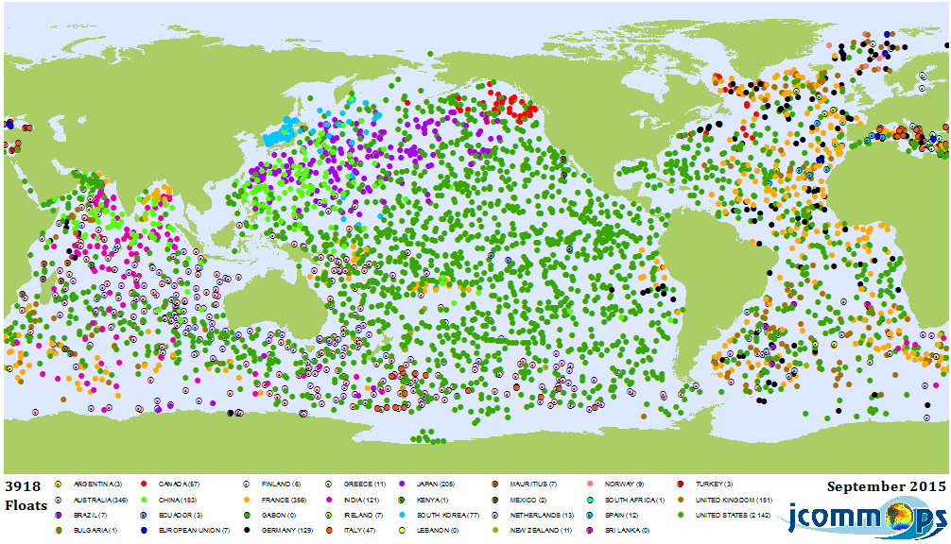

Three major ways of ocean observation
Japan
Ship-Based
Global ocean/climate observing system including physical oceanography, the carbon cycle, marine biogeochemistry and ecosystems.
Deep Water Warming
Moored buoy
Worldwide system of long-term, deepwater reference stations.
Stations K2, KNOT, S1, JKEO
TRITON
RAMA
Heat Content Change
Drifting Float
Argo is a global array of more than 3,000 free-drifting profiling floats that measures the temperature and salinity of the upper 2000 m of the ocean.
Japan
Sea Level Rise
from IPCC AR5
Notes:
Under international collaboration, ocean observations are conducted in three major ways; ship-based, moored buoy and drifting float are three major ways.

Slide 8
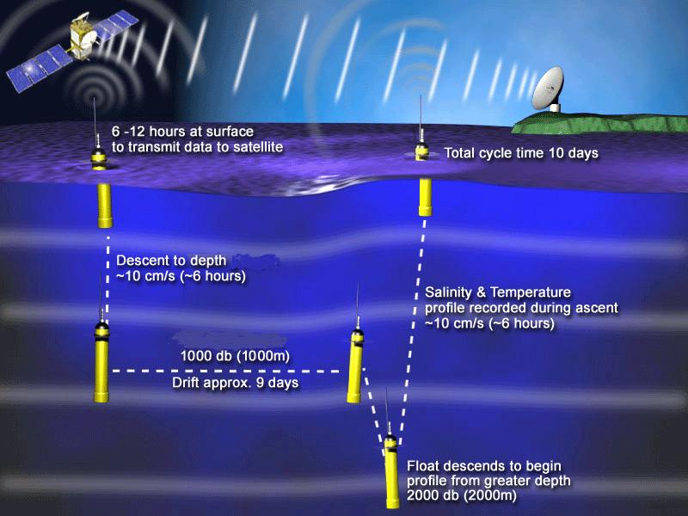
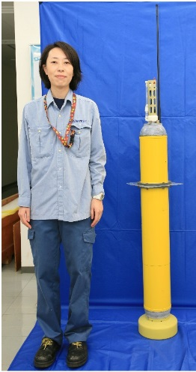
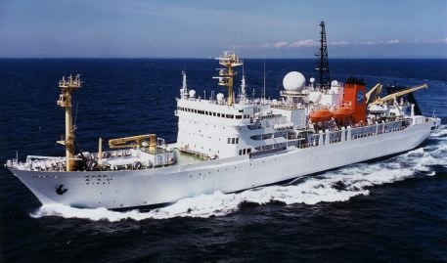
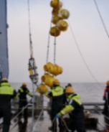
New generation floats can provide data we need
 | Threats to our oceans
 | ・Sea level rise ・ Warming etc. |  | Acidification etc. | ・Marine Biodiversity & Ecosystem ・De-Oxygenation etc.
Data we need | Temperature, Salinity |  | pH, CO2 | DO, Chl.a
Drifting Float | Precision | ○ | ○ | ○
 | Temporal resolution | ○ | ○ | ○
 | Spatial resolution | ◎ | × | ×
Ship Based | Precision | ◎ | ◎ | ◎
 | Temporal resolution | × | × | ×
 | Spatial resolution | △ | △ | △
Moored Buoy | Precision | ○ | ○ | ○
 | Temporal resolution | ◎ | ◎ | ◎
 | Spatial resolution | × | × | ×
TS-Argo float
JAMSTEC runs Pacific Argo Data Center
Need to be
developed
Ship based observation is essential to studying ocean processes and to benchmark data from autonomous systems
Need more
frequency
Moored buoy is useful for monitoring specific areas
Need more
installation
Notes:
As you can see in this table, three observation ways has its strengths and weakness.
To Enhance global ocean observation and to develop far stronger scientific knowledge necessary to assess the ongoing changes, it is necessary to develop new generation drifting floats and to increase the frequency of ship based observation and the number of moored buoy with international cooperation.

Slide 9
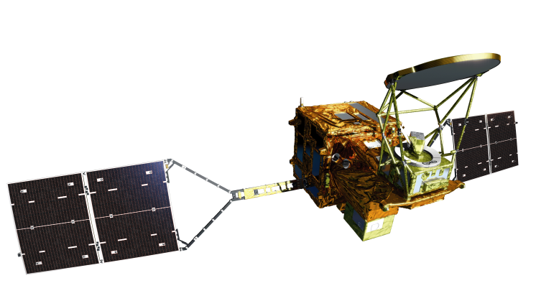
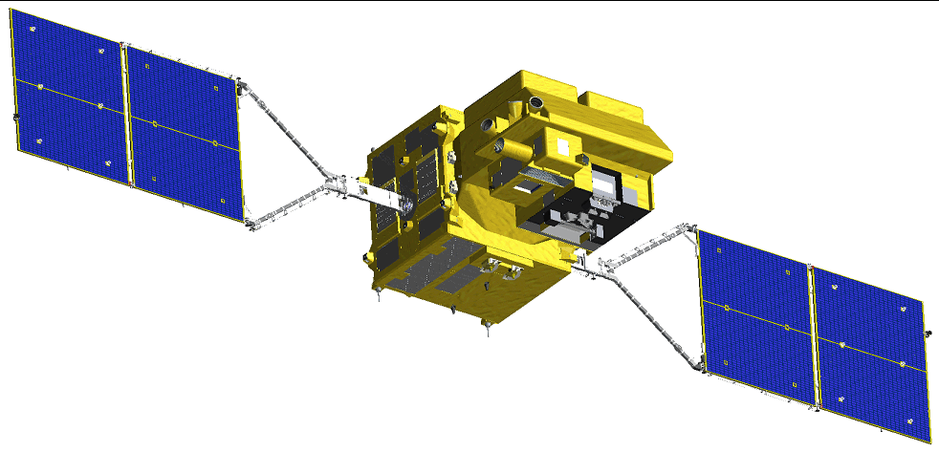
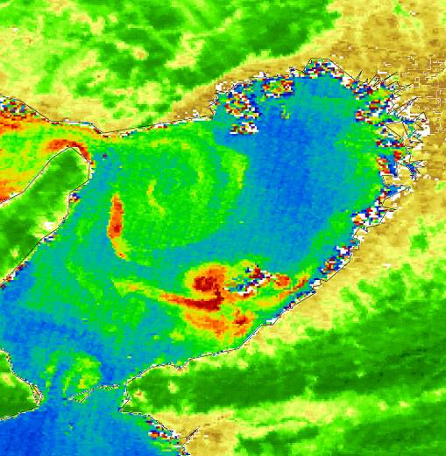

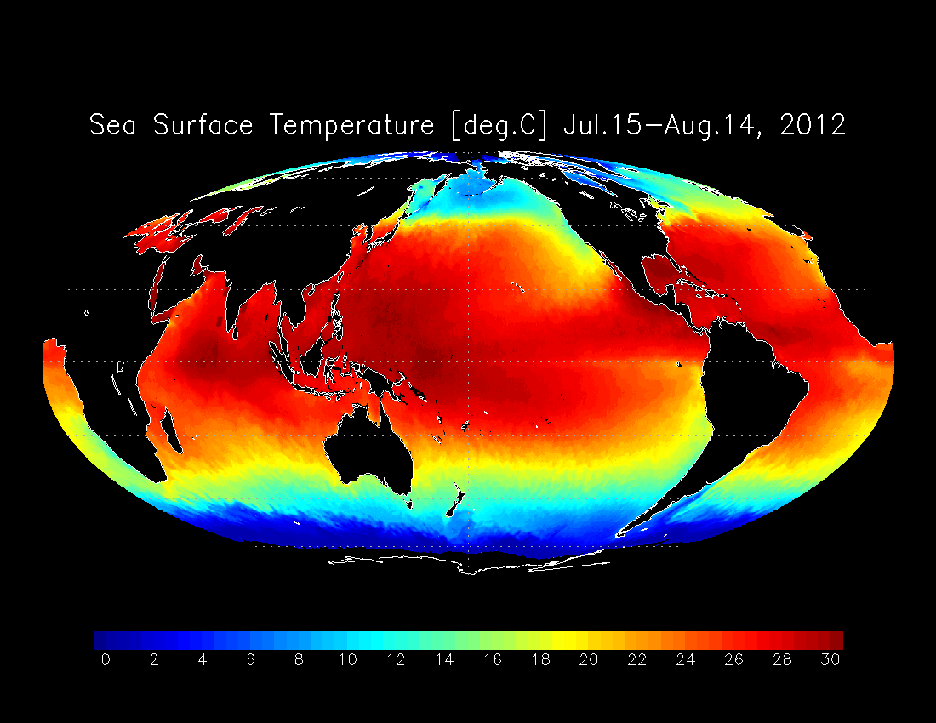
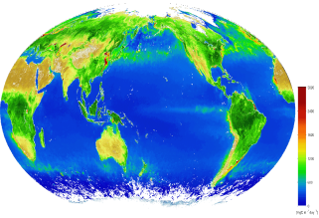
Ocean observation by GCOM
GCOM-W (Water)
Launched in 2012
GCOM-C (Climate)
To be launched in 2017
Arctic sea
ice extent
Chlorophyll a
concentration
Sea Surface
Temperature
Notes:
- Ocean can be also observed by satellites. The Advanced Microwave Scanning Radiometer (AMSR) has been monitoring sea ice extent of the Arctic Sea. GCOM-W with AMSER 2 has observed the lowest sea ice extent in 2012. GCOM-W can monitor Sea Surface Temperature as well.
GCOM-C, which is scheduled to be launched in 2017 can monitor concentration of Chlorophyll a in the sea as wall as on the land.

Slide 10
Conclusion and Expectations
Earth Observations can contribute to monitoring the implementation of the SDGs.
Expectation to GEO with “convening power”
1. To strengthen engagement of observation communities such as those of space based, ocean, and in-situ observations.
2. To promote collaboration with international organizations and frameworks addressing the global challenges
Expectation to the new Initiative in service of 2030 Agenda
Further collaboration with
1. UN organizations like Statistical Commission
2. Other GEO Tasks related to SDGs (GEOGLAM, GEO-BON,
GFOI, Blue Planet, GEOGLOWS etc.)
Notes:
As I have shown in this presentation, earth observations can largely contribute to monitoring the implementation of SDGs.
GEO, the international organization dealing with earth observations, also can definitely play an important role. We expect GEO to take strong initiative and leadership and to fully demonstrate its convening power to align with the two kinds of stakeholders; (1) various observation communities like space based, ocean, and in-situ observations for integrated monitoring of the implementation of SDGs, (2) international organizations and frameworks addressing the global challenges.
We expect the new Initiative to strengthen collaboration with UN Statistical Commission and UN’s expert organizations and institutions dealing with implementation and monitoring of the SDGs. We also expect the Initiative to establish interface for collaboration with other GEO Tasks related to SDGs, like GEOGLAM on Goal 12, GEO-BON on Goal 15, GFOI on Goal 13 and Blue Planet on Goal 14.
Thank you very much for your attention.

Slide 11
(Supplemental slides)

Slide 12
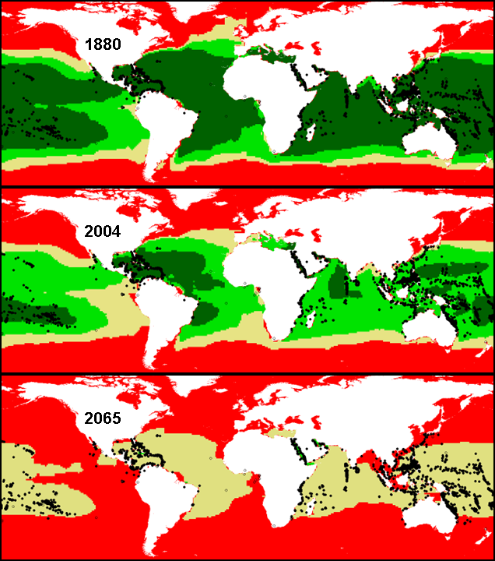
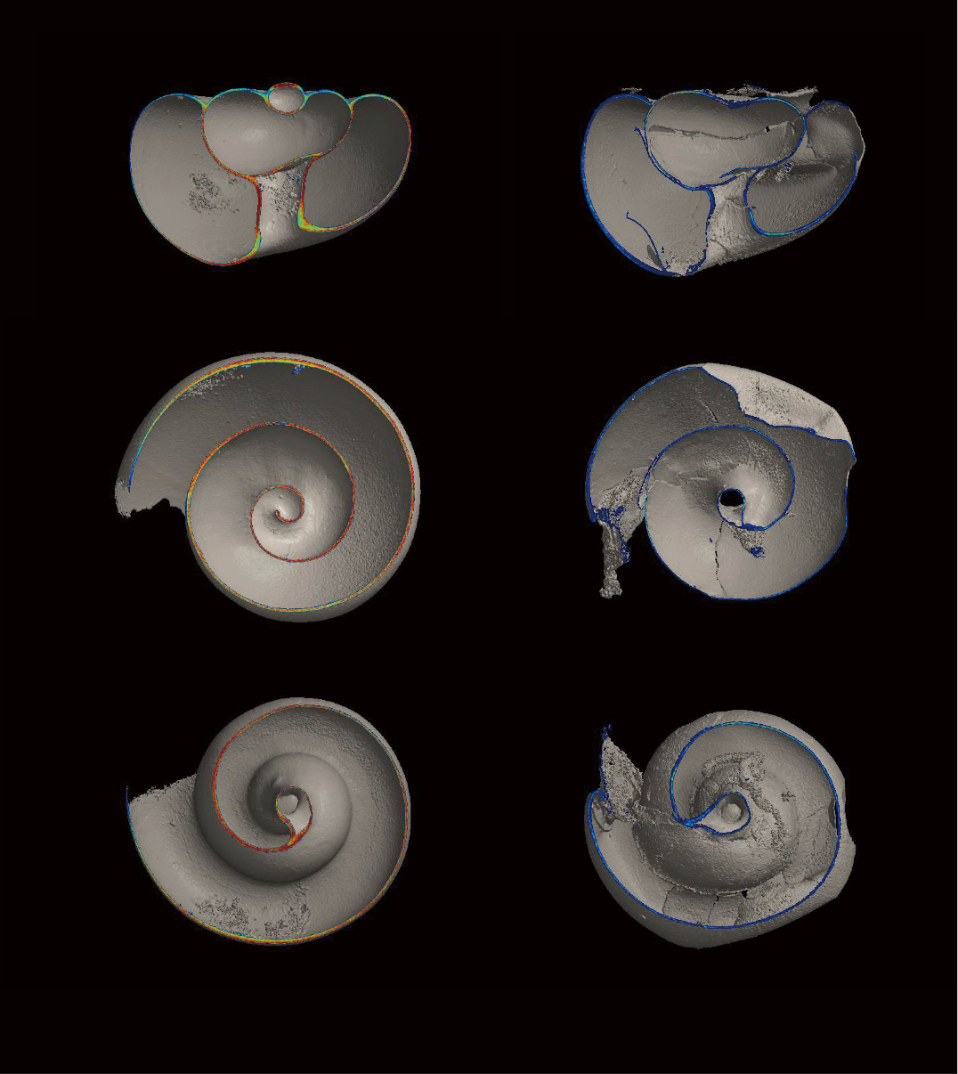

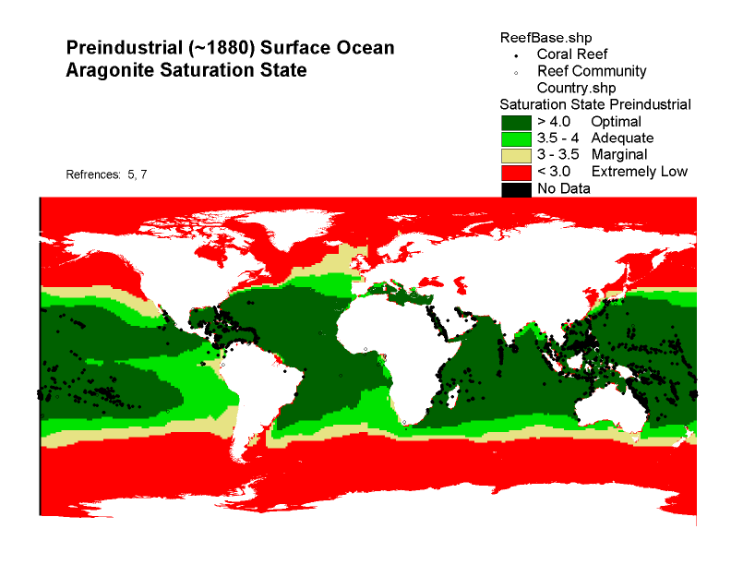
Future Threats on Ocean: e.g. Ocean Acidification & Sea Level Rise
Ocean Acidification Projection
Impact of Ocean Acidification
Shell density
High
1200
CT value
Non-damaged shell
Damaged shell
600
Shell density
Low
Global average sea level rise
www.iobis.org
Future projection says there will be no adequate area for coral growth in 2065
Over the period 1901 to 2010, global mean sea level rose by 0.19 [0.17 to 0.21] m
(IPCC AR5 WG1 Figure SPM.3)
Notes:
The seas and oceans are changing rapidly, with overuse and destruction of marine habitats, warming, increased ocean acidity and depleted oxygen. The health of the oceans is a crucial economic development issue, but many parts of the ocean interior are not sufficiently observed.
Ocean Acidification is one of the most important issue in the SDGs. As the left picture, It is projected that adequate area for coral growth will disappear in 2065. The impact to ocean lives is not just predicted but has already appeared. As shown in the upper right picture, the density of shells are affected by ocean acidification.
The lower right picture shows that sea level rise has increased around 150 mm for a century. Sea level is highly related to resilience and adaptation to climate disasters.

Slide 13
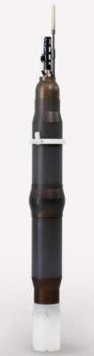
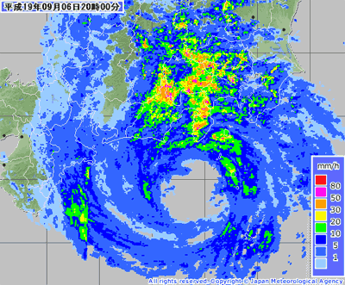


Argo ; Representative of Drifting Floats
The broad-scale global array of temperature/salinity profiling floats
JAMSTEC is developing Smart-Float for Arctic, Small BGC Float and sensors(e.g. Dissolved Oxygen(DO), photosynthesis activity, pH, turbulence etc.) with small and medium-sized companies.
Extend
Argo Project Office
Current Status of Deep-Argo in the world
Current Status of BGC-Argo in the world
More data
BGC-Argo float
(new generation Argo float)
Deep NINJA
（4000m depth profiling float: THE TSURUMI SEIKI Co., LTD.)
Creating of high value-added data
Notes:
JAMSTEC is developing Smart-Float for Arctic, Small BGC Float and sensors to observe Dissolved Oxygen(DO), photosynthesis activity, pH, turbulence and so on. This float will upgrade ocean observation capacity of Argo Programme.

