Slide 1
Data Roadmaps for Sustainable Development
Aditya Agrawal
November 2016
GEO Plenary
St. Petersburg, Russia
1

Slide 2
The Global Sustainable Development Goals
MDGs
(2000-2015)
SDGs
(2015-2030)
Developing country focused
Universal
Social
Social, Economic, and Environmental
Foreign Aid
Domestic Investment, Private Flows, and Aid
Official Statistics and Administrative Data
Big Data, Citizen Generated Data, Geospatial and Earth Observation Data, Open Data, and more
2

Slide 3
17 Goals, 169 Targets, 230 Indicators = Huge Data Needs

Slide 4
THE CHALLENGES:
Data are not available, dynamic, disaggregated, high quality, useable, accessible, open, or used effectively.
Data on entire groups and key issues are unavailable.
Data are not dynamic or disaggregated.
Data quality is poor and major gaps remain.
Data that exist are often not useable.
Data that are useable are not accessible or open.
Data that are accessible are often not used effectively.
DATA CHALLENGES LEAVE TOO MANY BEHIND
4

Slide 5
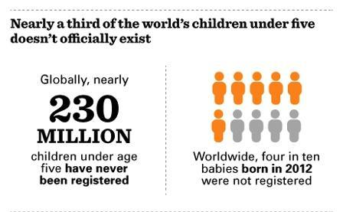
Civil Registration and Vital Statistics
Achieving sustainable development is only possible if we know where people living in poverty are and what they need. One in three children aged five years or younger have not had their births registered. Therefore, officially, these children do not exist in the system.
5

Slide 6
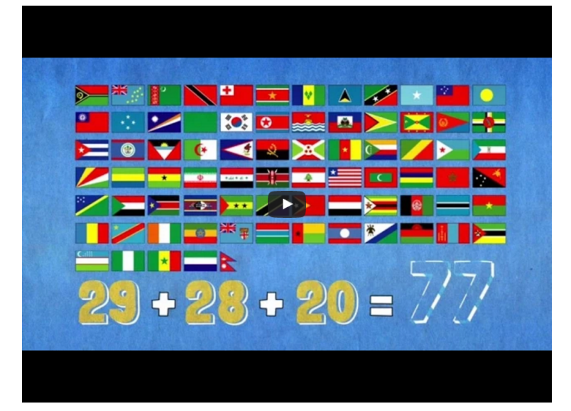
Data on Poverty are Scarce
77 countries lack sufficient data on those living in poverty. Without frequent data, we cannot monitor whether countries are reducing poverty or not.
Source: http://www.worldbank.org/en/news/video/2015/07/09/my-favorite-number-77-reasons-we-need-poverty-data
6
6

Slide 7
DATA FOR WHAT?
Improved Decision-Making and Policy
Increased Citizen Empowerment
Increased Innovation and Entrepreneurship
To Achieve and Monitor
Sustainable Development
7

Slide 8
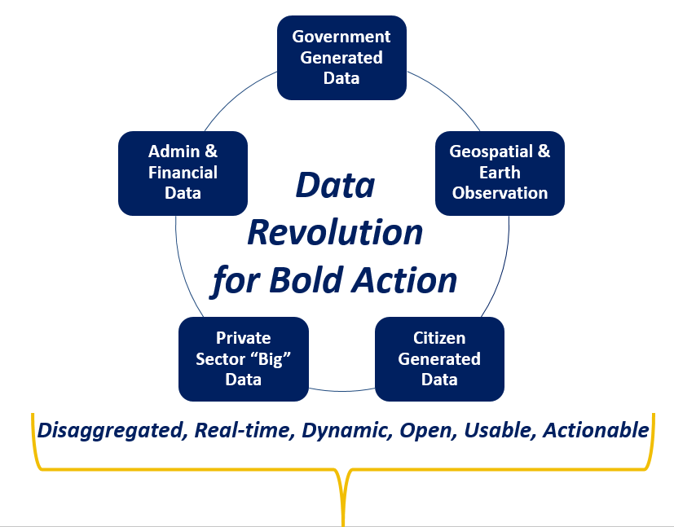
Harnessing the Data Revolution
“Data is the Oil of the 21st Century”
Supporting and complementing government and civil society efforts to generate data for statistics for the formal SDG monitoring framework
Unleashing innovation in production, accessibility and use of real-time, dynamic, disaggregated data from multiple sources
8
Notes:
And it’s happening along two major tracks. 1) it supports and complements efforts already underway to generate data for statistics for the formal SDG monitoring framework; and 2) unleashing innovation on the use of real-time, dynamic, disaggregated data from multiple sources

Slide 9
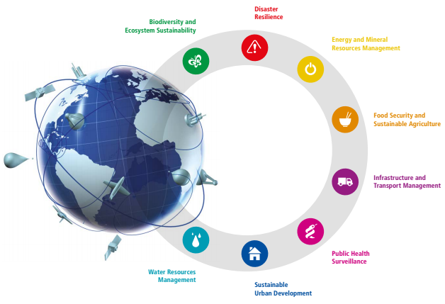
Earth Observation Data

Slide 10
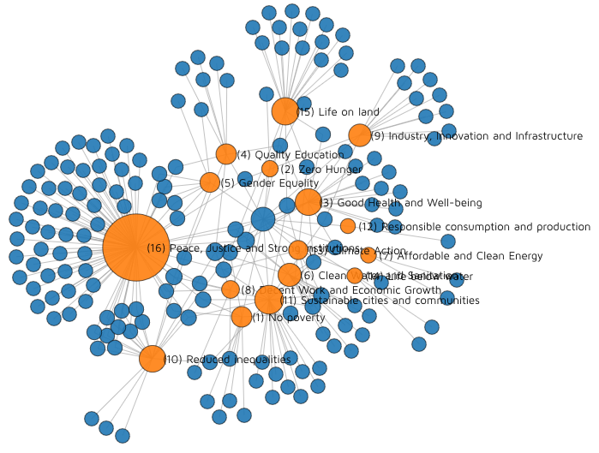
Citizen-Generated Data
http://staging.winguweb.org/2015/datashift/
10

Slide 11
Privately Held (Big) Data
ex: Provide mobility information every hour for security staffing
ex: Provide real-time personal health risk to users in mobility
Faster:
monthly…daily…
« Real Time »
Operation
Management
Customer Time (Velocity)
ex: Optimise hospital location for density of population
ex: Optimise distribution of drugs in function of diseases geography, calendar events,…
Policies &
Consulting
SLOWER
Data refresh
(yearly, quarterly)
Single Data
source
Multiple data
sources
11
Variety of Sources for Data Analysis
11

Slide 12
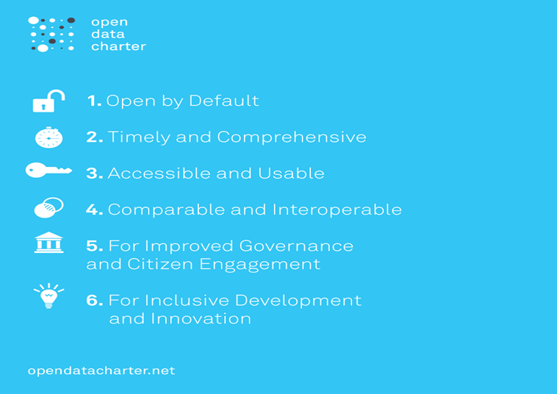
Open Data
12
Notes:
The Six Principles at a glance.

Slide 13
better, more accessible, and usable data to help end poverty, fight inequality and injustice, and combat climate change.
WE CONVENE
WE CONNECT
WE CATALYZE…
13
Notes:
Put the

Slide 14
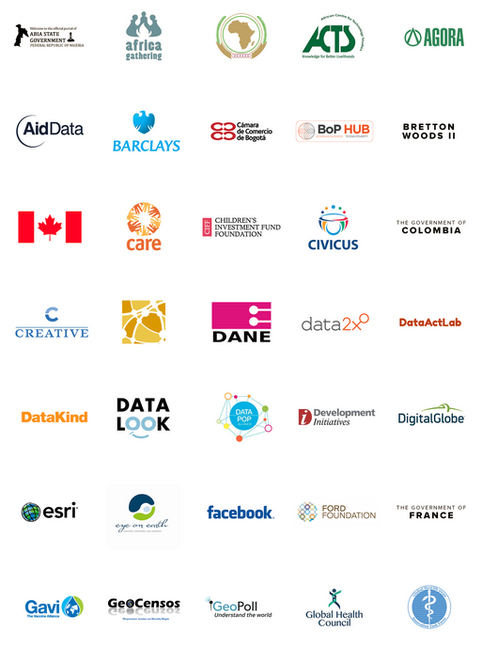
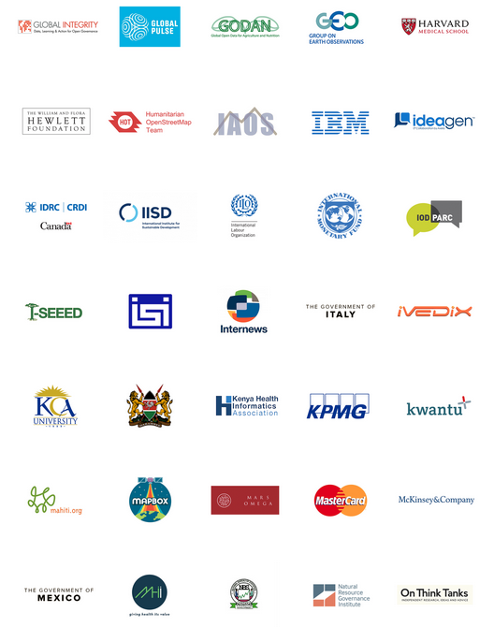
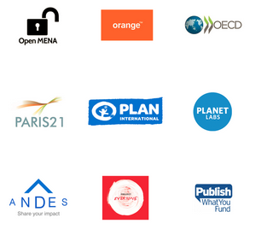
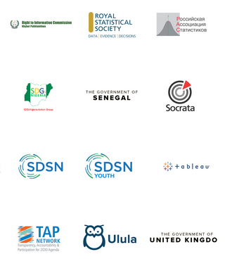
The Global Partnership has 150+ Data Champions
14

Slide 15
Convening, Connecting, Catalyzing
Country Data Roadmaps
Data Events & Fora
Data Architecture, Products, & Platforms
Overall objective:
Stakeholders
in every country have the
best data at the right time
to achieve the
Global Goals
Filling Data Gaps
Resource Alignment & Mobilization
Data Principles & Protocols
15

Slide 16
Data Roadmaps for Sustainable Development
Support countries at national and sub-national levels to develop and implement whole of government and multi-stakeholder data roadmaps for harnessing the data revolution for sustainable development, with particular emphasis on the SDGs and local priorities articulated in national plans.

Slide 17
What are Data Roadmaps in the Context of the Data Revolution for Sustainable Development?
It’s an action plan with short and long-term goals for addressing specific data needs and priorities in regards to SDG implementation.
A data roadmap is ideally developed by governments at local, subnational or national levels according to local context and priorities:
Multi-stakeholder involvement
Situation assessment
Priority Mapping
Data/technology gaps assessment
Requirements analysis
Commitments to Action
A data roadmap is part of an iterative and adaptive planning process.
Notes:
So how do we think about data roadmaps in the context of the data revolution for sustainable development?
For one, a data roadmap is an action plan with short and long-term goals addressing specific data needs and priorities for SDG implementation.
It’s ideally led by governments at multiple levels but takes into account the range of stakeholders and actors using a multi-stakeholder approach. It addresses the current situation, maps local priorities, conducts a data and technology gaps assessment, and uses the above to develop requirements and commitments to action.
Finally, a data roadmap is iterative and adapts to the planning process. It’s an evolution.

Slide 18
Country Led Approaches
The Data Roadmaps for Sustainable Development approach is iterative, based on experiences and implementation models from partner countries
Colombia
Philippines
Sierra Leone
Kenya
Tanzania
Senegal
USA
UK
Egypt
Mexico
SDG Goals and Targets
National Plans and Priorities
Localized Framework

Slide 19
Colombia

Slide 20
Egypt

Slide 21
Egypt

Slide 22
Data for Action
Official Data for Planning and Monitoring
Geospatial Data
Citizen Generated Data
Privately Held Data
Open Data
More informed and data driven decision making
Fill data gaps more efficiently, frequently and cost effectively
Real-time, dynamic, disaggregated data
Official and non-official data
Use innovative approaches and range of stakeholder to solve problems

Slide 23
A Toolbox to Support Subnational and National Stakeholders
Toolbox
Many processes are already in place.
Tools and methods have been developed or are being developed.
A data roadmap process acknowledges good practice, lessons learned, and tools applied from peers to inform its development.
Technology, Innovation and Analysis
Principles and Standards
Operational Considerations
Capacity and Resources
Multi-stakeholder
Situation Assessment
Priority Mapping
Gaps Assessment
Requirements Analysis
Governance and Leadership
Roadmap Development Process
Notes:
So how does a toolbox fit within the roadmap development process and the operational factors it needs to consider? A toolbox is meant to support subnational and national stakeholder by taking into account process already underway. Tools and methods have already been developed or are being developed. The data roadmap acknowledges good practice, lessons learned and tools applied from peers to inform its development

Slide 24
SDG Data Roadmaps Toolbox: Framework and Approach
This framework will iterate and adapt based on further learning through national workshops and expert feedback.
Intent is to provide a set of resources, some of which is already available through partner organizations, that support countries and subnational units in their SDG roadmap process.
Meant to align with national strategies in place, be country led, based on local priorities.
Supportive of SDG monitoring and dynamic data in the context of the data revolution.
Phased releases at HLPF and UNGA

Slide 25
SDG Data Roadmaps Toolbox: Categories
Getting Started with Data Roadmaps for Sustainable Development
Data for Action
Official Statistics for SDGs
Institutional, Financial and Capacity Foundations

Slide 26
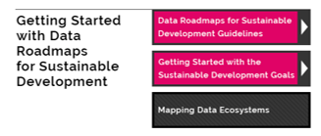
Toolbox: Getting Started with Data Roadmaps for Sustainable Development

Slide 27
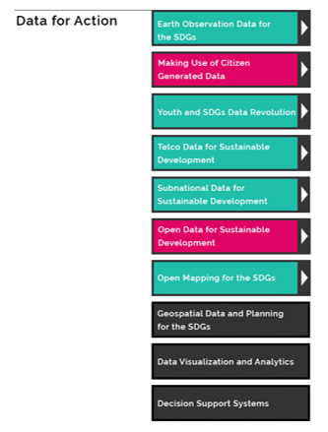
Toolbox: Data for Action

Slide 28
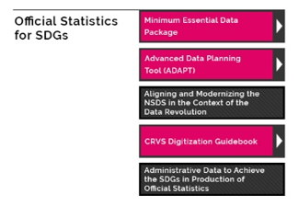
Toolbox: Official Statistics for SDGs

Slide 29
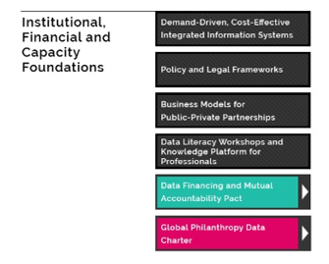
Toolbox: Institutional, Financial and Capacity Building Needs

Slide 30
Geospatial and earth Observations
Data Roadmaps and Data4SDGs Toolbox

Slide 31
A Few Country Observations
Countries are conducting baseline assessments to understand what data they have and don’t have. Countries we have been working with are at 50-65% range.
A clear need for support on Tier II and III indicators
Better disaggregation of data for decision making
Better means for developing public-private partnerships to support access to new data sources
Capacity and resources continue to be a challenge

Slide 32
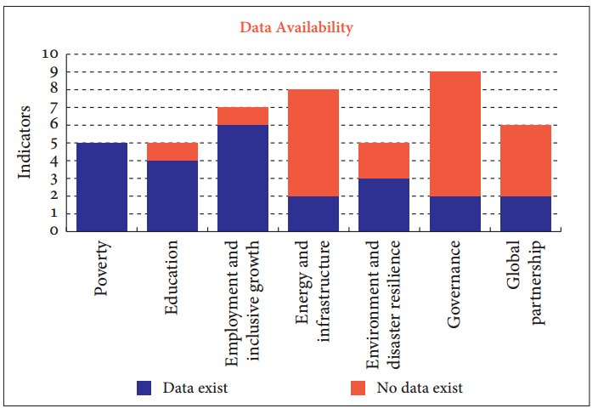
Sierra Leone
Source: Post-2015 Data Test
www.post2015datatest.com
Post-2015 “Data Test” study confirms gaps, But timeliness is biggest pain point
Notes:
Data cannot be a historical record of what happened in the past
Paper based surveys every 2-3 years
Census every 10 years
Etc
Quality must improve!

Slide 33
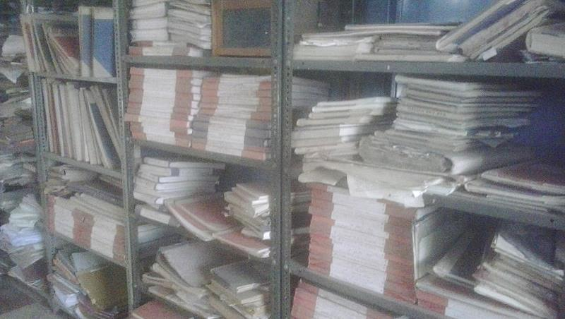
Government can’t go it alone – too many indicators, not enough $$ and staff
By Ganesh Dhamodkar from Nagpur, India (Files in Government Office) [CC BY 2.0 (http://creativecommons.org/licenses/by/2.0)], via Wikimedia Commons
Notes:
Funding and capacity is a huge issue: government can’t go it alone – need participation from all sectors: faith based NGO gov’t private sector etc

Slide 34
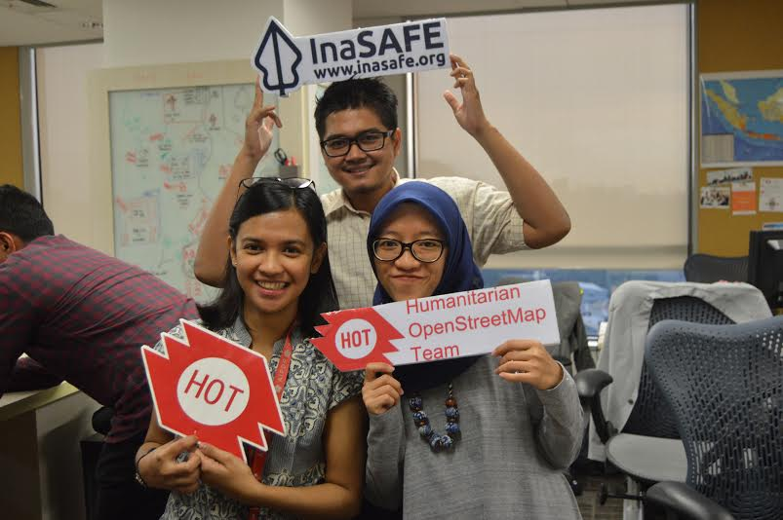
The SDGs are new – but open mapping communities have been helping for years…
Notes:
MapKibera supporting the White House mapathon on July 7 2016 – photo provided by MapKibera

Slide 35
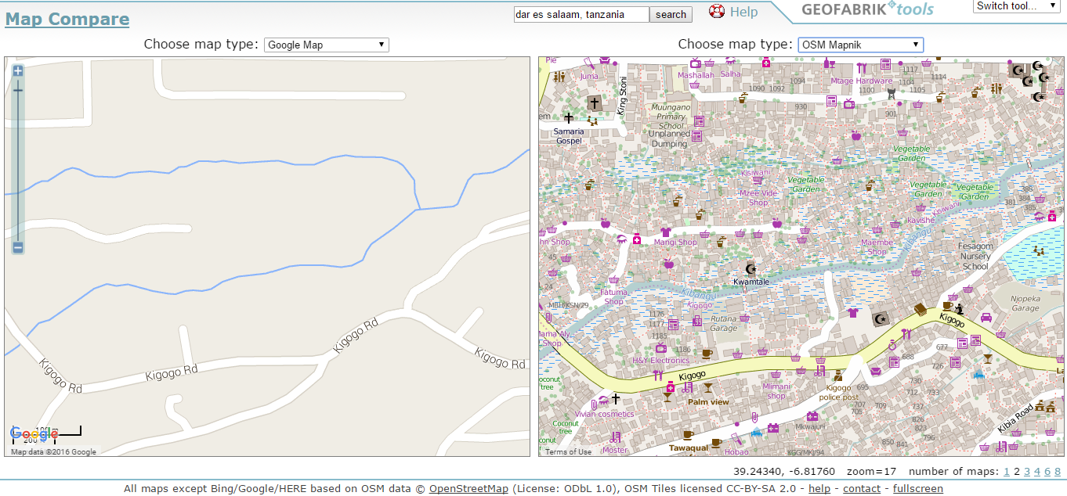
So what might OSM be good for?
1. Filling gaps, monitoring progress of the SDGs
Notes:
1. Monitoring progress == more frequent data, easier to monitor and report more frequently instead of waiting 2 years

Slide 36
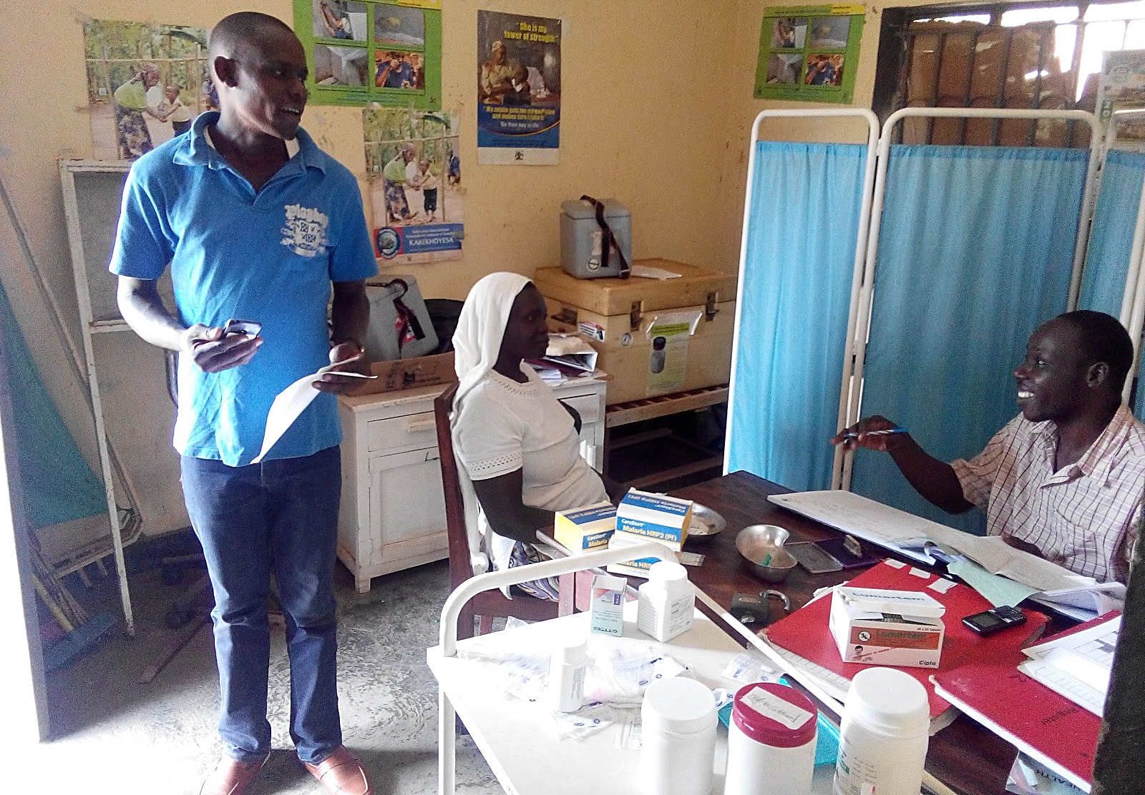
Target 3.8 Achieve universal health coverage, including financial risk protection, access to quality essential health-care services and access to safe, effective, quality and affordable essential medicines and vaccines for all
Multiple Indicators (e.g. 3.c.1 Health worker density and distribution)
Notes:
Mapping a health facility in Mbale district, Uganda
OSM data serves as a starting point for analyzing population and catchment areas
Systems built using OSM data such as HealthSites.io can help

Slide 37
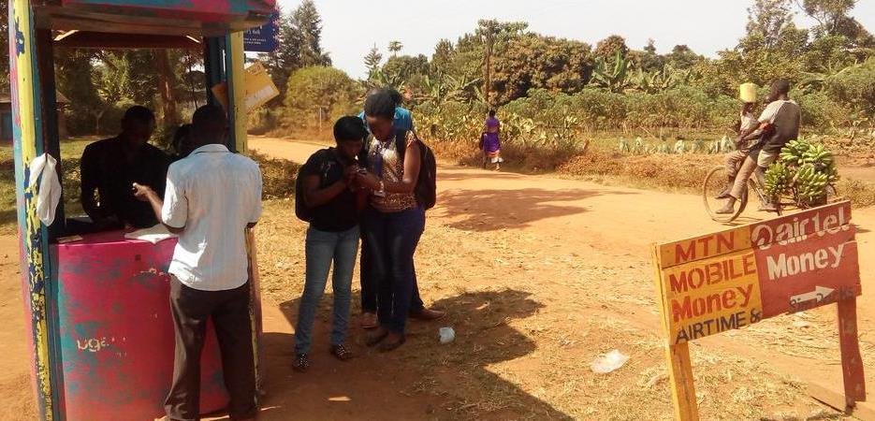
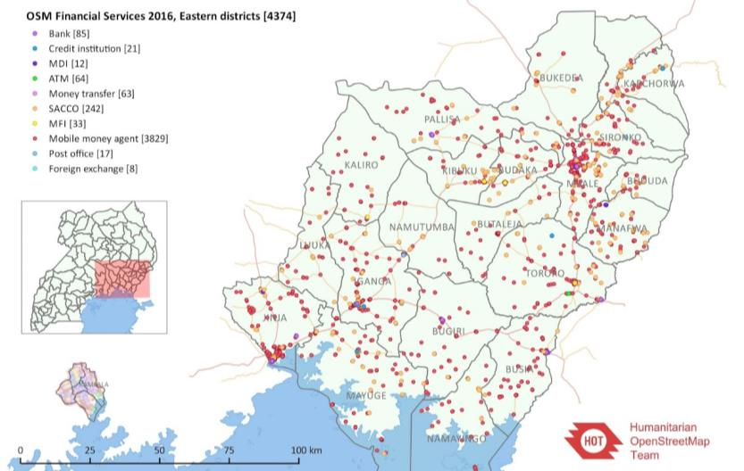
Target 8.10
Strengthen the capacity of domestic financial institutions to encourage and expand access to banking, insurance and financial services for all
Indicator 8.10.2
Proportion of adults (15 years and older) with an account at a bank or other
financial institution or with a mobile-money-service provider
Notes:
Mapped around 30,000 financial service locations in Uganda using OSM

Slide 38
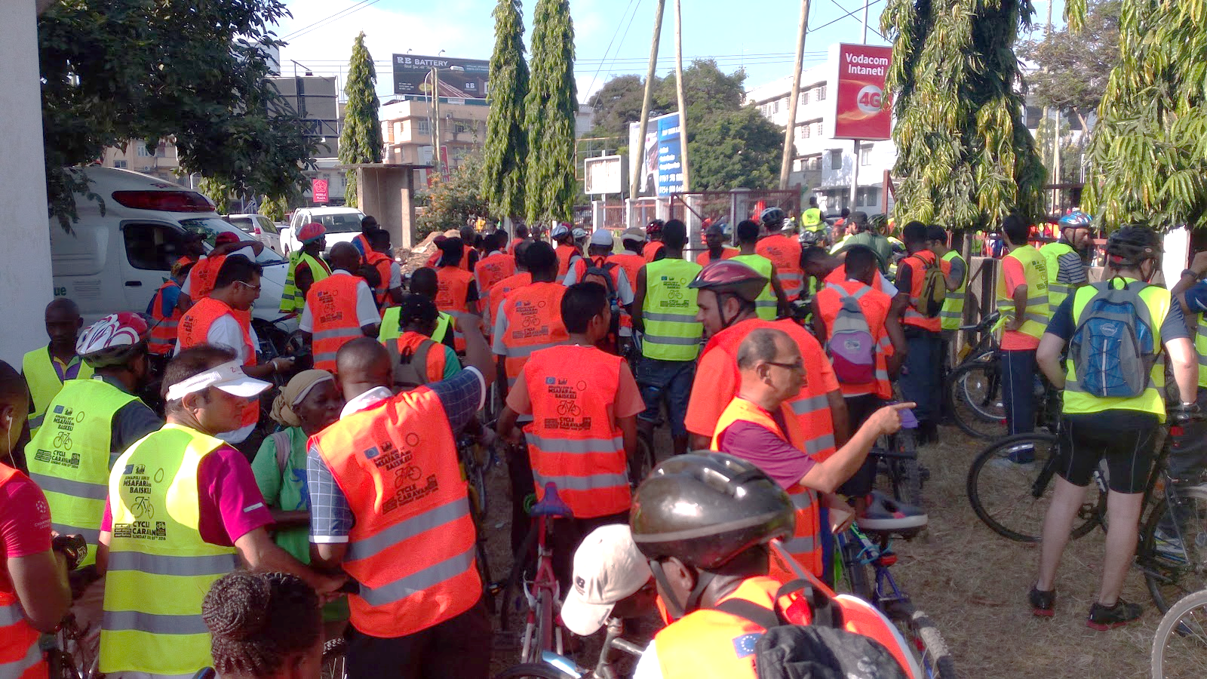
Target 11.2 By 2030, provide access to safe, affordable, accessible and sustainable transport systems for all…
Indicator 11.2.1 Proportion of the population that has convenient access to public transport, disaggregated by age group, sex and persons with disabilities
Notes:
Dar es Salaam’s Cycle Caravan on World Environment Day, June 5th.

Slide 39
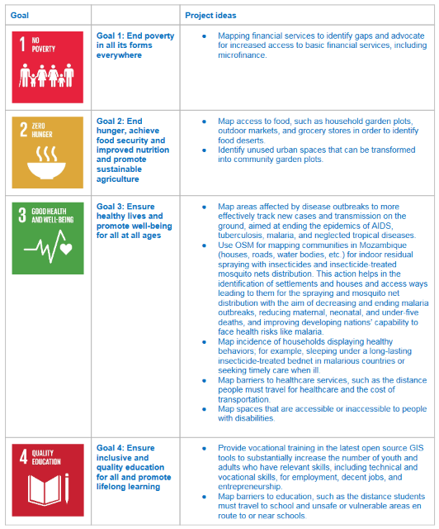
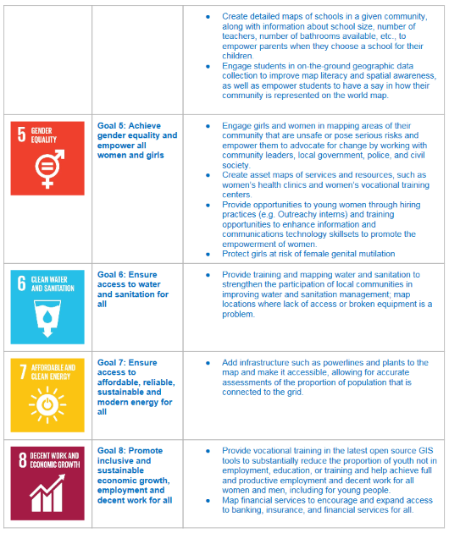
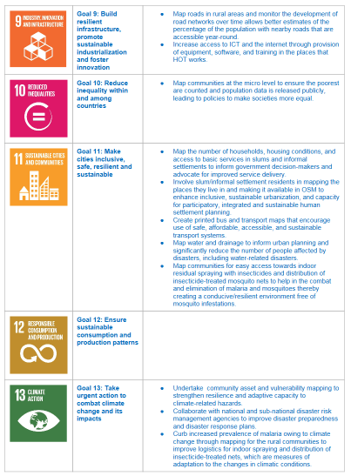
Open Mapping Potential Across the SDGs

Slide 40
Earth Observation Data Module
What is Earth observation data and information?
How can EO data be accessed and used?
What are some of the methodological and technical approaches for applying these data to the SDG implementation?
What are some of the case studies (country-level examples) of methods to integrate EO in monitoring, planning, and reporting the SDGs?
How can the use of earth observation data be mapped specifically to the SDG global indicator framework to provide actionable information for informed decision making – and what about data gaps, or instances where data could give more information than the indicators require?
What is the technical, human and other capacity needed to implement successfully?
Are there institutional arrangements, public-private sector models or other models that should be considered to organize these efforts?

Slide 41
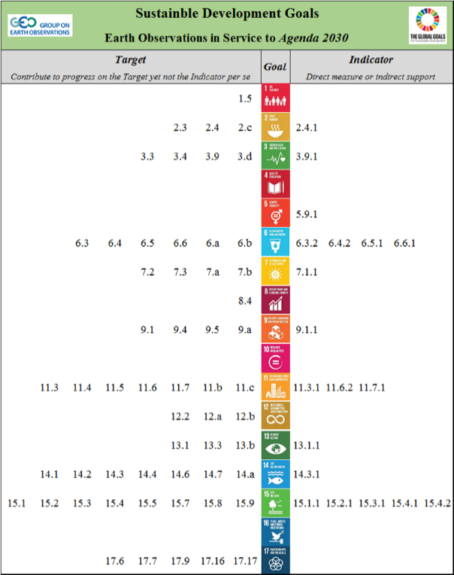
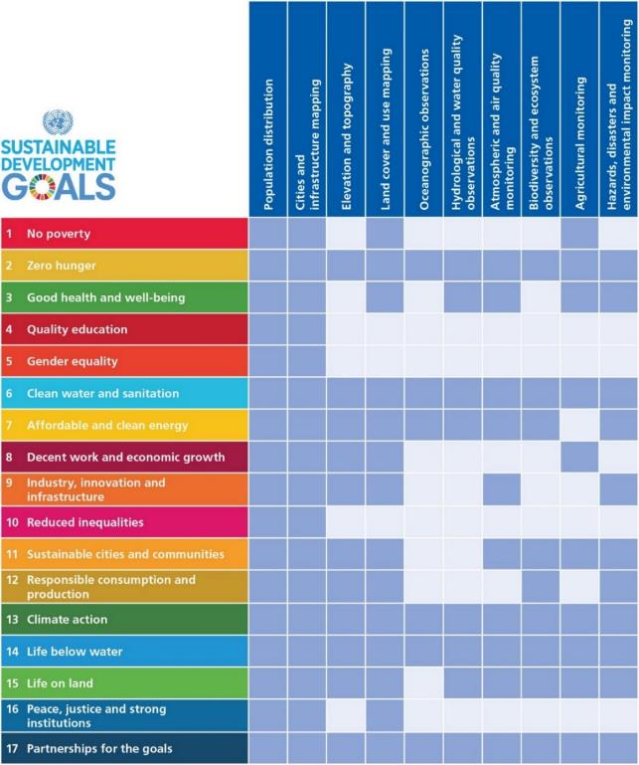
GI-18: Draft Implementation Plan
Focus Preliminary Assessments guiding GI-18 implementation.
Most likely Targets and Indicators that Earth obs. can contribute to (directly or indirectly)
Alignments of the Goals with specific types of Earth obs. and geospatial info.
draft
Notes:
This can be included in the Extra Slides (or at the end of this session)

Slide 42
GI-18: Taking it to scale . . .
Next Steps
Work with statistical agencies to ensure the methods are sound for use with Indicators and Targets
Ensure the methods and solutions are available for all to use
Support countries and stakeholders to use the methods and build capacity
others
Notes:
Global Partnership for Sustainable Development Data
strengthen the inclusivity, trust, and innovation in the way that data is used to address the world’s sustainable development efforts.
Sustainable Development Solutions Network (SDSN)
Develops research themes around various “solutions” topics globally.
Reports on the SDG framework as well as the associated monitoring indicators, and it seeks to play a significant role in their implementation and in the associated processes.
International Institute for Sustainable Development (IISD)
Provides practical solutions to the challenge of integrating environmental and social priorities with economic development.

Slide 43
Take-away messages
Earth Observations can contribution substantially to the achievement of the SDGs and to the monitoring of the progress against the agreed targets.
GEO can provide
Strong advocacy of Open Data policies
Access to Earth observation data through GEOSS DAB
A framework and pilot projects for actual use of EOs to achieve or monitor the SDGs.
GEO seeks partners in Africa especially statistical agencies to develop and test EO methods for SDG Targets and Indicators

Slide 44
Creating a Data Ecosystem
API Highways and Digital Marketplace

Slide 50
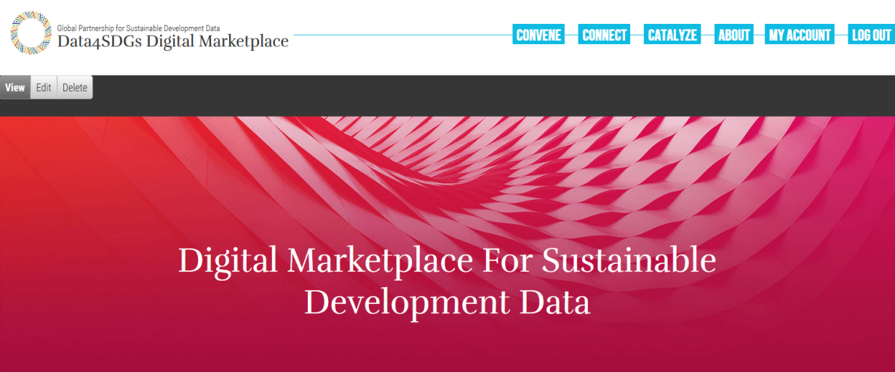
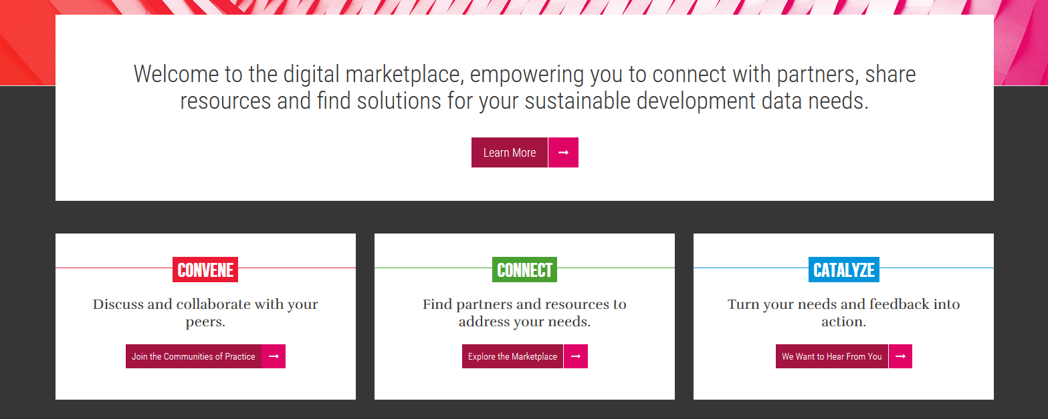

Slide 51
