Slide 1


The GEO Geohazard Supersites initiative: promoting Geohazard Science and its fast uptake in Disaster Risk Reduction
Stefano Salvi
Chair of the GSNL Scientific Advisory Committee

Slide 2










The GEO-GSNL initiative
A voluntary international partnership aiming to improve, through an Open Science approach, geophysical scientific research on seismic/volcanic hazard over specific interest areas called Supersites, supporting Disaster Risk Reduction activities.
The partnership
The scientific community
The in situ data providers
The satellite data providers

Slide 3
GSNL 1.0 (2007-2014)
In-situ data
Science Team #1
Science Team #2
Science Team #3
CEOS Satellite data
Science Product
Science Product
Science Product
Scientific literature

Slide 4
GSNL 2.0: how it works
Open access to data and results
In-situ data
Science Team #1
Science Team #2
Science Team #3
CEOS Satellite data
Science Product
Science Product
Science Product
Virtual
repository
Scientific information
Collaborative knowledge processing
(compare, validate, model, report)
Collaborative
process
coordinated
by local
scientists
Risk Managers & Decision Makers
Consensus product generation
(hazard model, predictive scenario, etc.)
User needs

Slide 5
GSNL 2.0: how it works
Coordination and collaboration
In-situ data
Science Team #1
Science Team #2
Science Team #3
CEOS Satellite data
Science Product
Science Product
Science Product
Virtual
repository
Scientific information
Collaborative knowledge processing
(compare, validate, model, report)
Collaborative
process
coordinated
by local
scientists
Risk Managers & Decision Makers
Consensus product generation
(hazard model, predictive scenario, etc.)
User needs

Slide 6
GSNL 2.0: how it works
Dissemination to Decision makers
In-situ data
Science Team #1
Science Team #2
Science Team #3
CEOS Satellite data
Science Product
Science Product
Science Product
Virtual
repository
Scientific information
Collaborative knowledge processing
(compare, validate, model, report)
Collaborative
process
coordinated
by local
scientists
Risk Managers & Decision Makers
Consensus product generation
(hazard model, predictive scenario, etc.)
User needs

Slide 7
GSNL 2.0: how it works
Open Science Process
In-situ data
Science Team #1
Science Team #2
Science Team #3
CEOS Satellite data
Science Product
Science Product
Science Product
Virtual
repository
Scientific information
Collaborative knowledge processing
(compare, validate, model, report)
Collaborative
process
coordinated
by local
scientists
Risk Managers & Decision Makers
Consensus product generation
(hazard model, predictive scenario, etc.)
User needs

Slide 8
Supersite set up
  Proposals submitted by scientific teams (with institutional support).
  Different categories:
  Permanent Supersites (long-term, one or few faults/volcanoes)
  Natural Laboratories (larger areas with multiple hazard sources)
  Event Supersites (large earthquakes or eruptions, short term)
Proposals evaluated by Advisory Committee (SAC) and space agencies (CEOS-DCT).
Data provision commitments are taken by local monitoring agencies and by space agencies. Data are open for the scientific community.
Funding and resources are obtained externally, leveraging on the Supersite framework.

Slide 9
Permanent Supersites
 | Supersite | Coordinator | Institution
1 | Hawaiian volcanoes | M. Poland | USGS-HVO
2 | Icelandic volcanoes | F. Sigmundsson, K. Vogfjord | Univ. of Iceland Iceland Met. Office
3 | Etna volcano | G. Puglisi | INGV - Catania
4 | Campi Flegrei volcano | S. Borgstrom | INGV - Naples
5 | Western North Anatolian Fault | S. Ergintav, | KOERI
6 | Taupo Volcano | I. Hamling | GNS Science
7 | Ecuador volcanoes | P. Mothes | Instituto Geofísico, EPN
8 | Corinth Gulf/Ionian Is. | A. Savvaidis | ITSAK
Tbc | San Andreas Fault NL | C. Wicks | USGS
All Supersites are managed by institutions which have a formal mandate for providing scientific support to local DRM agencies

Slide 10
How to access Supersite data
Satellite data are normally distributed through data portals, e.g. https://supersites.eoc.dlr.de/ for TerraSAR X data
The in situ data are distributed through specific Supersite infrastructures (e.g. http://medsuv_portal.ct.ingv.it), or through local or regional data infrastructures (UNAVCO, IRIS, EPOS, etc.)

Slide 11
Open SAR data (2014-2016)
 | COSMO-SkyMed | TerraSAR X | Radarsat 1 | Radarsat 2 | ALOS 1 | ALOS 2
Hawaii | 450 | 190 | 500 | 268 | 414 | 50
Iceland | 1100 | 500 |  | 320
Etna | 650 | 260 |  | 60
Vesuvio | 650 | 260 |  | 60
Marmara | 800 | 500 |  | 60
Ecuador | 400 | 260
New Zealand | 400 | 260 |  | 100

Slide 12
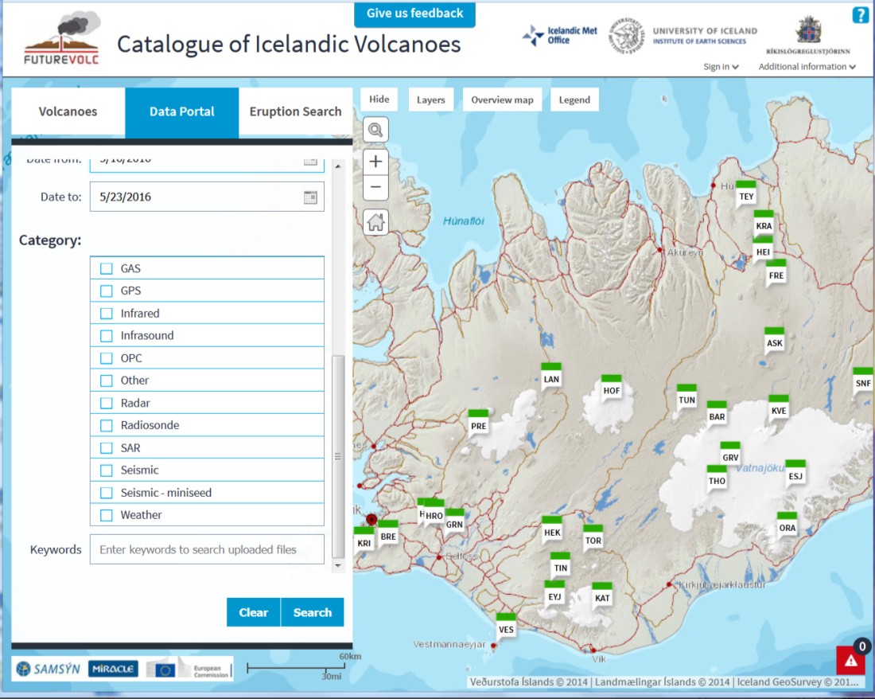
Open in situ data (Iceland Supersite)

Slide 13
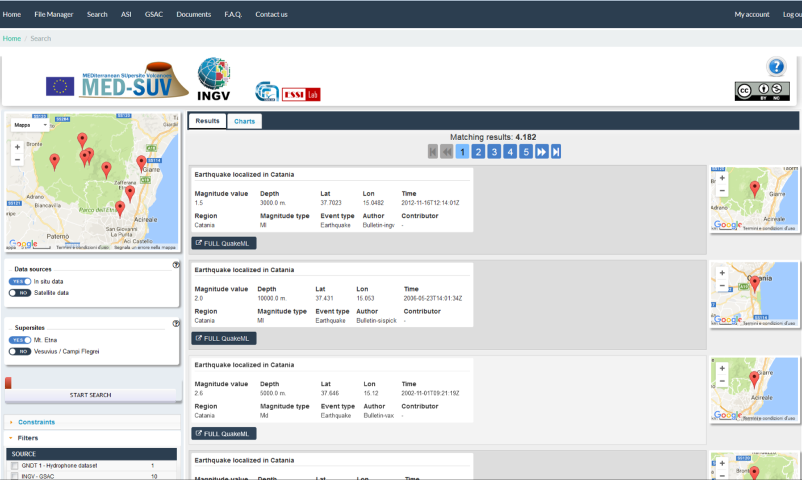
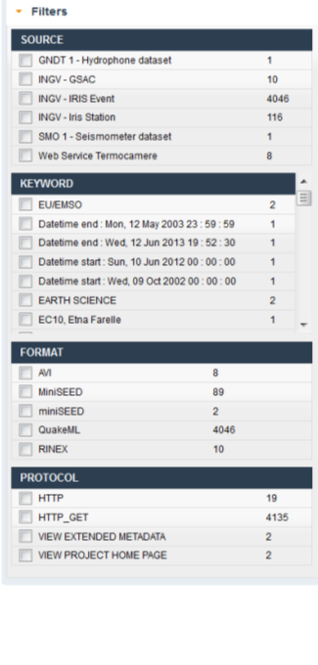
Open in situ data (Mt.Etna Supersite)

Slide 14
Further services
The ESA Geohazard Exploitation Platform provides remote InSAR processing services to the Supersite scientific community.
The H2020 EVER-EST project is developing a Virtual Research Environment to support the Supersite scientific community with a wide range of e-collaboration services, including remote processing, citation manager, information sharing through Research Objects.
Univ. Reno Nevada & UNAVCO provide no-cost services for generating high precision GPS position time-series (not specifically for GSNL).

Slide 15
End-Users receiving scientific information
Permanent Supersite | End-user
Hawaiian volcanoes, USA | Hawaii County Civil Defense, Hawaii Volcanoes Natl Park
Icelandic volcanoes | Icelandic Police - Dep.t of Civil Protection and Emergency Management, Environmental Agency of Iceland, Directorate of Health
Mt.Etna volcano, Italy | National Department of Civil Protection, Regional Civil Defense
Campi Flegrei & Vesuvius volcano, Italy | National Department of Civil Protection, Regional Civil Defense
Marmara Fault, Turkey | Istanbul municipality
Ecuadorian volcanoes | Secretariat for Risk Management, Regional governments, Municipalities
Taupo volcanic zone, New Zealand | Ministry of Civil Defence and Emergency Management, Department of Conservation, Regional councils, MetService
Corinth Gulf/Ionian Is. | Greek Civil Protection

Slide 16
Scientific information to support
Hazard Assessment and Risk Prevention
active fault maps and parameters
estimates of fault slip rates,
high resolution strain rate maps,
earthquake hazard and damage scenarios,
models and maps of volcano plumbing systems,
scenarios for volcanic hazards, as lava flows, flank collapses, lahars, ash falls, etc.
up to date high precision topographic maps,
up to date land use and exposure maps
etc.

Slide 17
Scientific information to support
Disaster Response
maps and parameters of the earthquake source,
maps of co-seismic effects on the natural and built environments: fault scarps, ground deformation, triggered landslides, collapsed building, infrastructure damage, etc.
identification and characterization of magma chambers during eruptions,
mapping of lava domes;
estimates of mass eruption rate, plume heights, ash fall, etc.
maps of the effects of volcanic eruptions, as fractures, collapses, pyroclastic flows, lahars, lava flows, and their interaction with the built environment,
etc.

Slide 18
Examples of Supersite scientific results supporting hazard assessment
(exploiting TerraSAR X data)

Slide 19
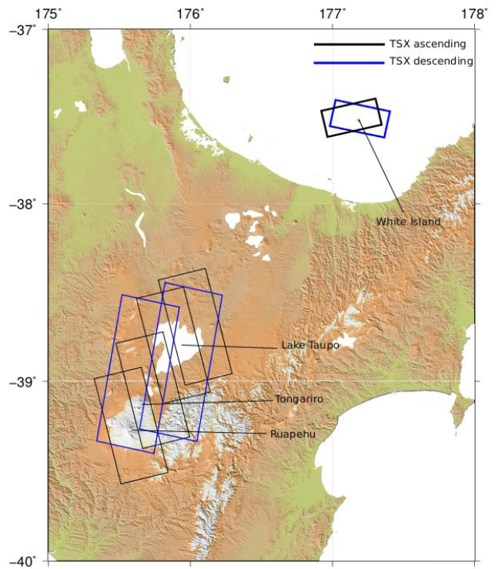
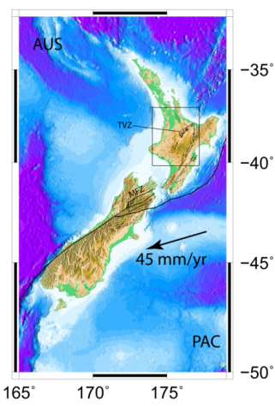
The New Zealand Supersite
(Taupo and White Island volcanoes)

Slide 20
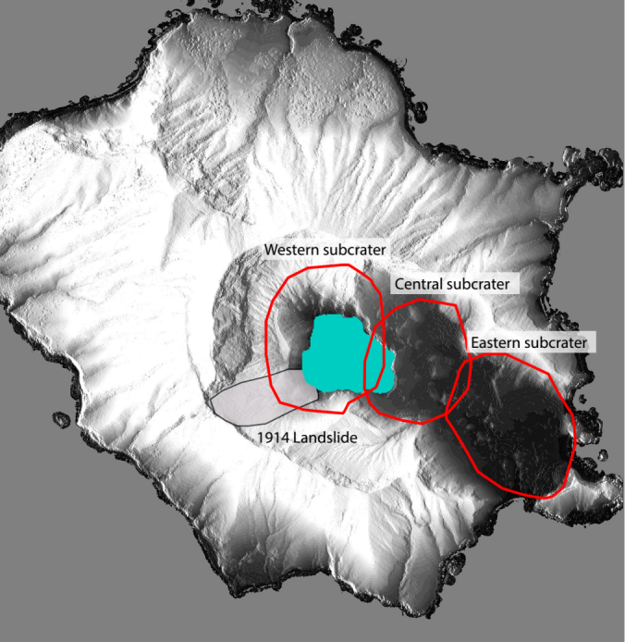
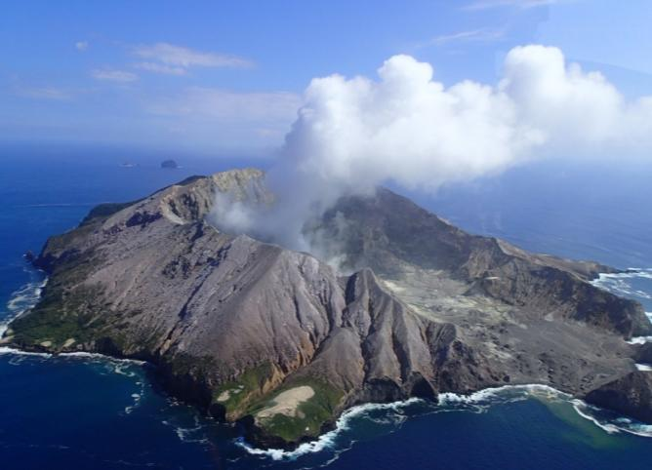
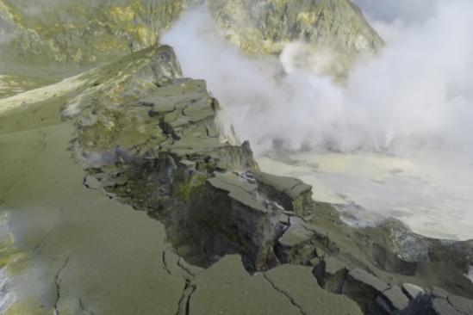
TSX monitoring of White
Island, New Zealand Supersite
The most frequently erupting volcano in New Zealand.
Scene of New Zealand’s worst volcanic disaster with death of 11 miners in 1914 when SW crater wall collapsed into lake.
Most recent eruption on 27th April 2016
Courtesy of I. Hamling, GSN-Science)
Notes:
Photos show the collapse of lake wall into the lake which led to the eruption on 27th April

Slide 21
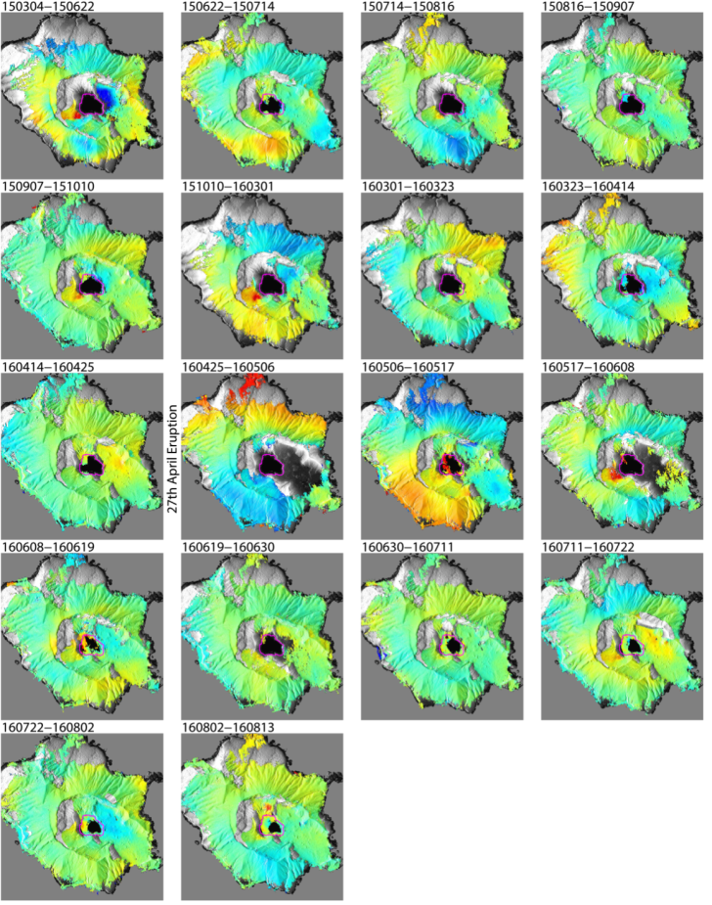
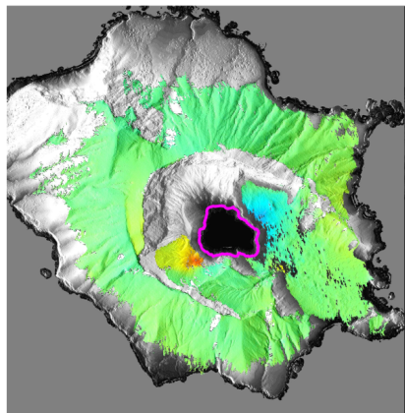
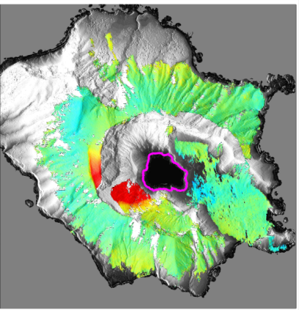
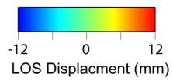

New Zealand Supersite
TSX Spotlight Ascending time-series
Pre eruption
Post eruption
TSX data reveal that the SW crater wall still moves at rates of up to 200 mm/yr
Notes:
InSAR has indicated that the SW crater wall is sliding towards the lake. This was not previously recognised due to lack of ground observations which have typically focussed on the crater floor. Data also shows periods of crater floor uplift, probably related to pressurization of the shallow hydrothermal system.

Slide 22
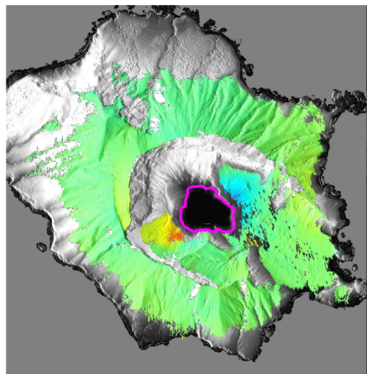
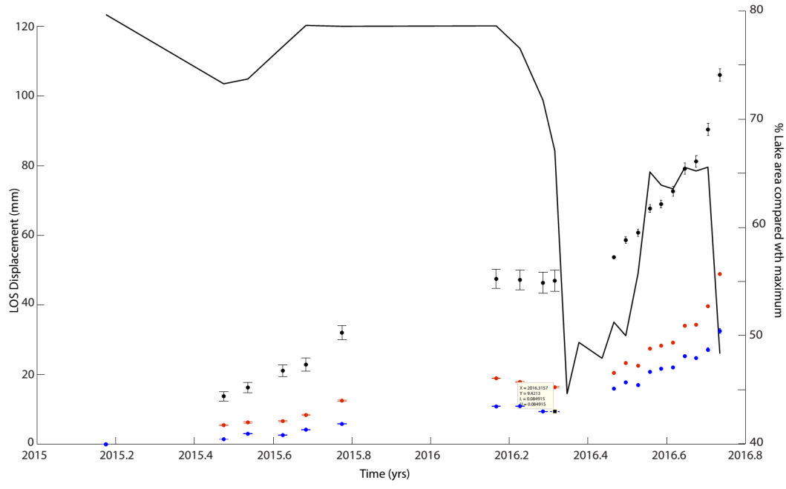
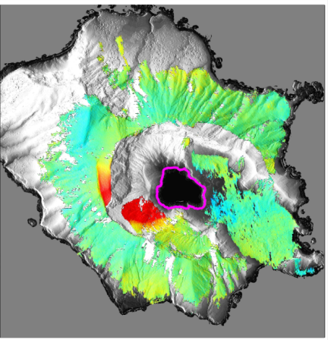
Since April, the SW crater wall is moving at ~ 200 mm/yr
Motion appears to be linked to the rapid removal of water from the lake.
A second lake emptying event occurred on 21st September and led to an acceleration of the slope.
Lake level
Pre eruption
Pre eruption
Post eruption
Notes:
As the lake level drops there appears to be an acceleration in the slope. Black line shows the change in the area of the lake based on the amplitude images. The black, red and blue points are the timeseries for points at the base, middle and top of the landslide.

Slide 23
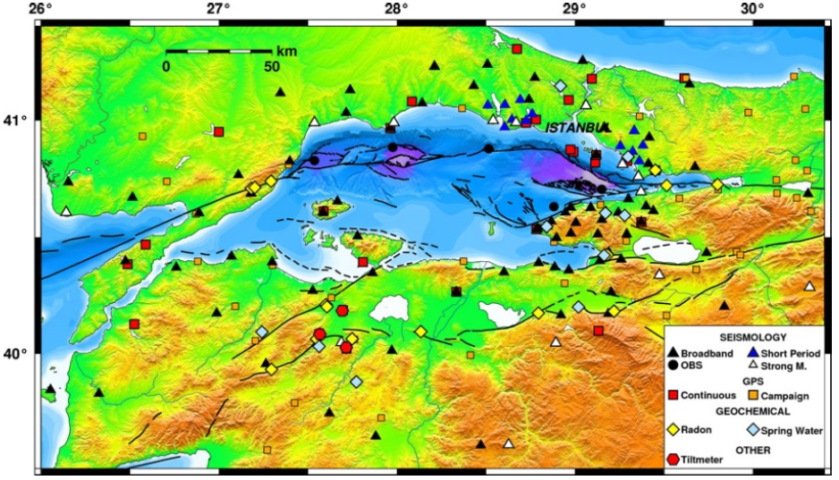
The Marmara Supersite

Slide 24
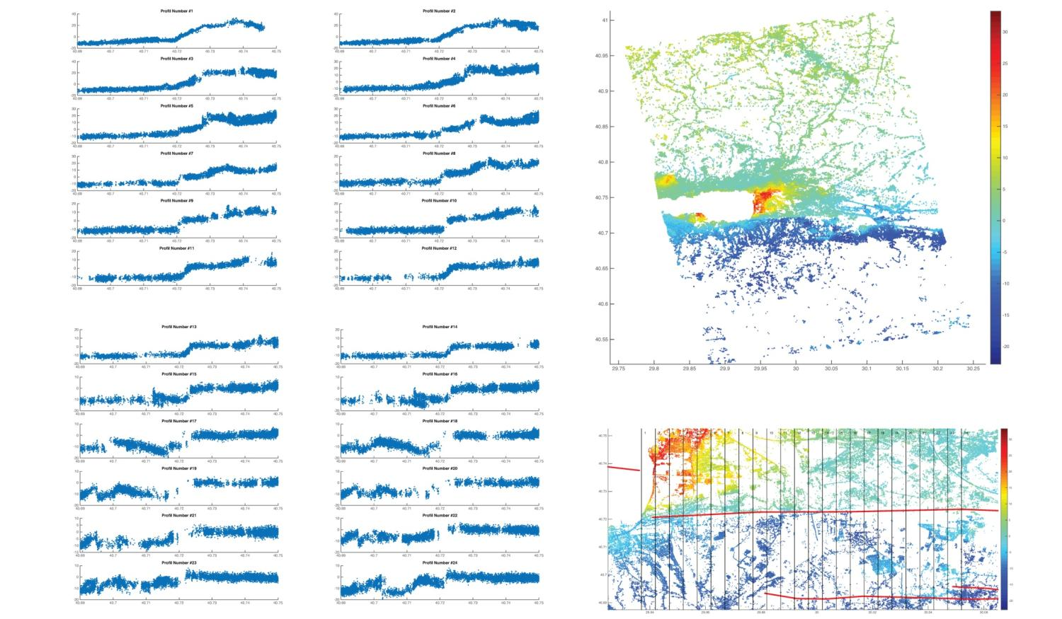
Marmara Supersite
2010-2015 TSX data show steady fault creep along the Izmit segment of the North Anatolian Fault
Courtesy of S. Ergintav, KOERI)
Notes:
Webcams around the Island are frequently obscured by steam and cloud making it hard to monitor the lake. Amplitude images acquired by both ascending and descending spotlight images help to track the amount of water in the lake. On the left is a webcam photo taken just before the April eruption with the corresponding SAR image below. On the right is the post eruption image and shows the emptying of the lake and collapsed region (red line)

Slide 25
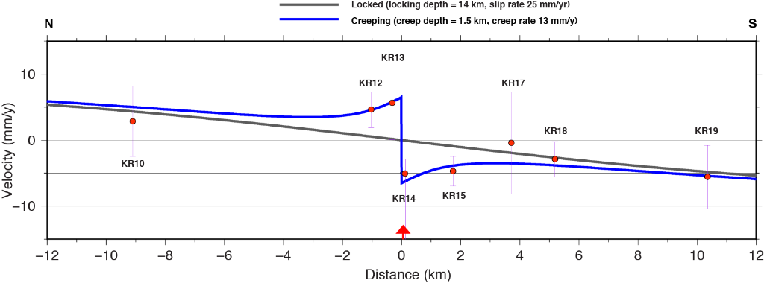
Marmara Supersite
InSAR in very good agreement with GPS
Data allow to model a steady, shallow fault creep
Courtesy of S. Ergintav, KOERI)
Notes:
Webcams around the Island are frequently obscured by steam and cloud making it hard to monitor the lake. Amplitude images acquired by both ascending and descending spotlight images help to track the amount of water in the lake. On the left is a webcam photo taken just before the April eruption with the corresponding SAR image below. On the right is the post eruption image and shows the emptying of the lake and collapsed region (red line)

Slide 26
Conclusions
Permanent Supersites have demonstrated to be able to strongly improve data availability, and thus promote geohazard research and scientific support services for DRR.
Supersites can effectively demonstrate the advantages of an Open Science approach to promote rapid uptake of new scientific information by decision makers at the local scale.
Supersites provide a framework for better international collaboration and capacity building and can be leveraged to increase research funding.

Slide 27


Join the Supersite community, make great science, and help support Disaster Risk Reduction !
For info: stefano.salvi@ingv.it
http://www.earthobservations.org/gsnl.php

Slide 28

Event Supersites
Gorkha, 2015 – EO data: ASI, ESA, DLR, CSA
Napa Valley, 2014 – EO data: ASI, ESA, DLR, CSA
Sinabung, 2014 – EO data: ASI, CSA
Tohoku-oki, 2011 – EO data: ESA, JAXA, DLR, ASI– In situ data: seismic, CGPS
Van, 2011 – EO data: ESA, DLR – In situ data: seismic, SM GPS & CGPS
Eyjafjallajökul, 2010 – EO data: ESA - In situ data: seismic, SM GPS
Haiti, 2010 – EO data: ESA, JAXA – In situ data: seismic, SM GPS
Chile, 2010 – EO data: ESA, JAXA – In situ data: seismic, SM GPS & CGPS
Yushu, 2010 – EO data: ESA – In situ data: seismic
Sierra El Major, 2010 – EO data: ESA – In situ data: seismic, SM GPS & CGPS
Wenchuan, 2008 – EO data: ESA – In situ data: seismic

Slide 29
Access to open research products
The research products should be distributed in digital form through specific Supersite infrastructures, or through local or regional infrastructures (UNAVCO, IRIS, EPOS, etc.)
Proper attribution and citation is ensured through DOIs and licensing
This task is still in a development stage!

Slide 30
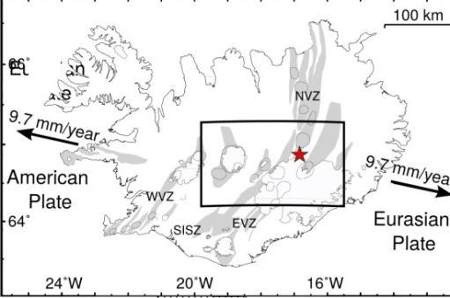
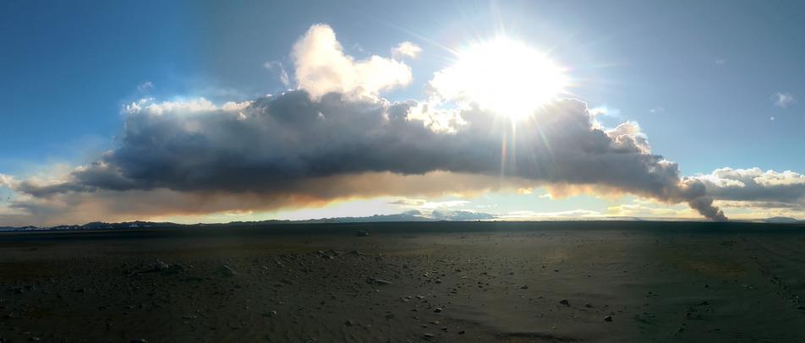
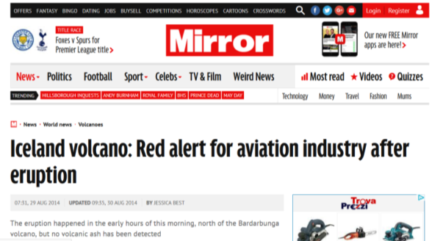
The 2014 Bardabunga eruption
Eruption starts August 16, 2014 under a 800 m - thick ice cap.
The possibility of a disastrous eruption as for Eyjafjallajokull in 2010, prompted for red alert.

Slide 31
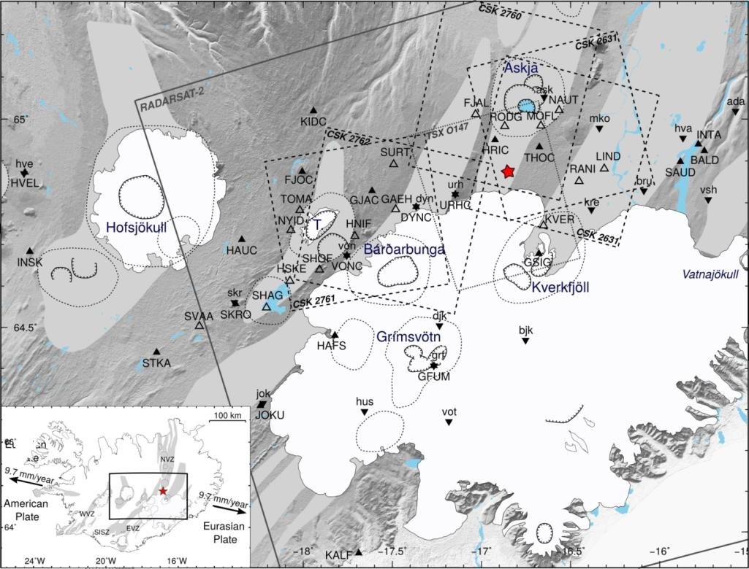
Supersites results: the Bardabunga eruption
Very good EO data coverage through the Supersite

Slide 32
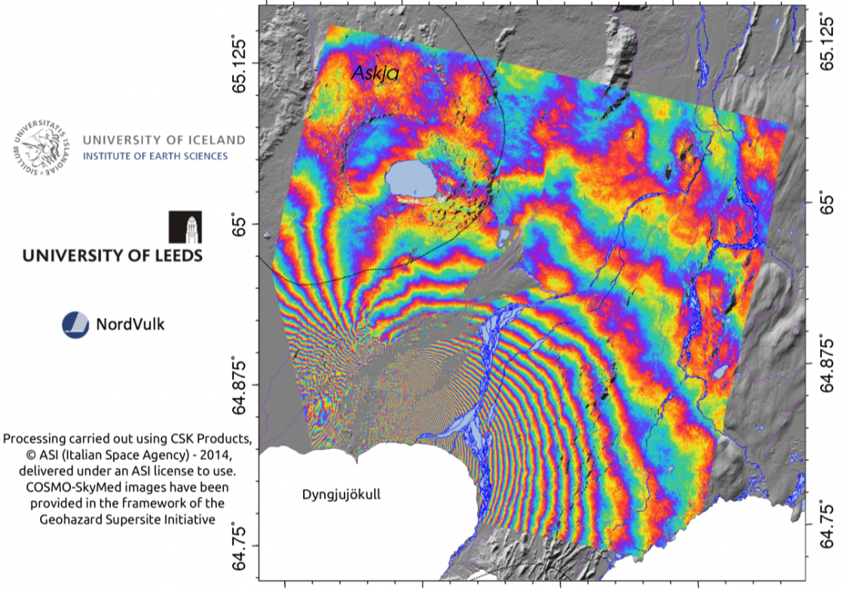
Satellite data monitor the eruption
Radar data show the magma is migrating out of the ice cap

Slide 33
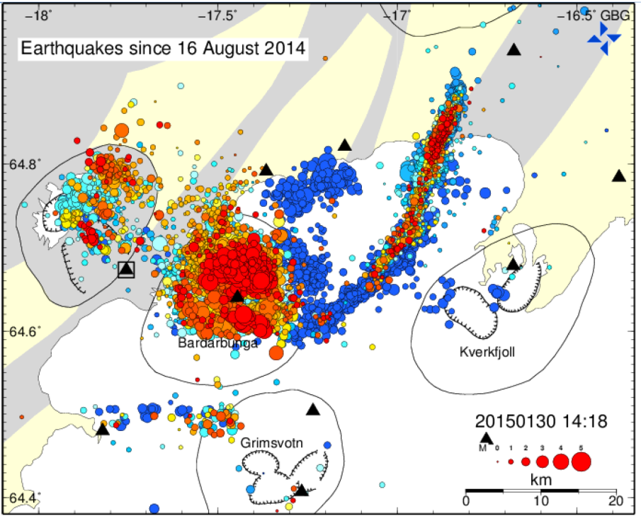
A team work
The international scientific team of the Iceland Supersite analysed many different datasets, and eventually confirmed that magma was moving outside of the ice cap.
This strongly reduced the risk of high ash clouds.
Alert level soon moved from red to orange.

Slide 34
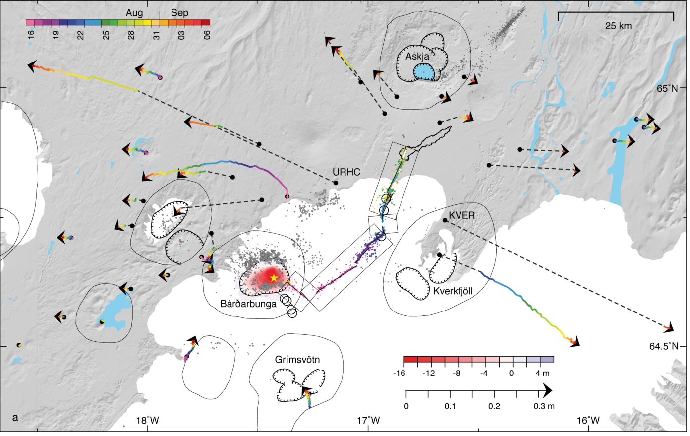
GPS and InSAR allowed modeling of the source
Notes:
in-situ data providers (mostly national agencies, but also international projects),
satellite data providers (CEOS space agencies),
the global scientific community (knowledge providers)
the local DRM community (end-users)

Slide 35
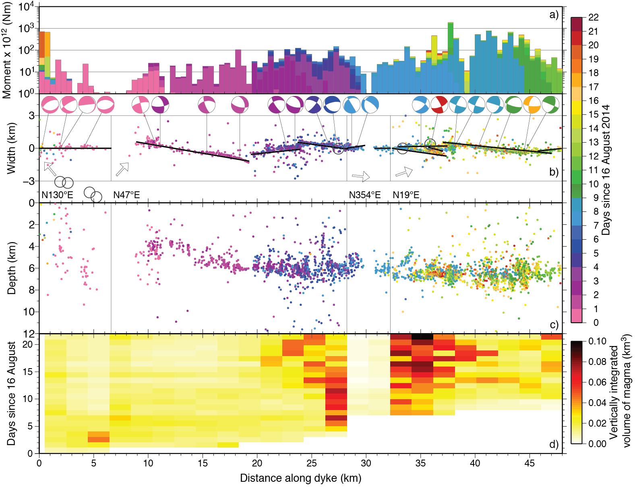
Energy
Dyke mapping
Depth
Magma volume

Slide 36
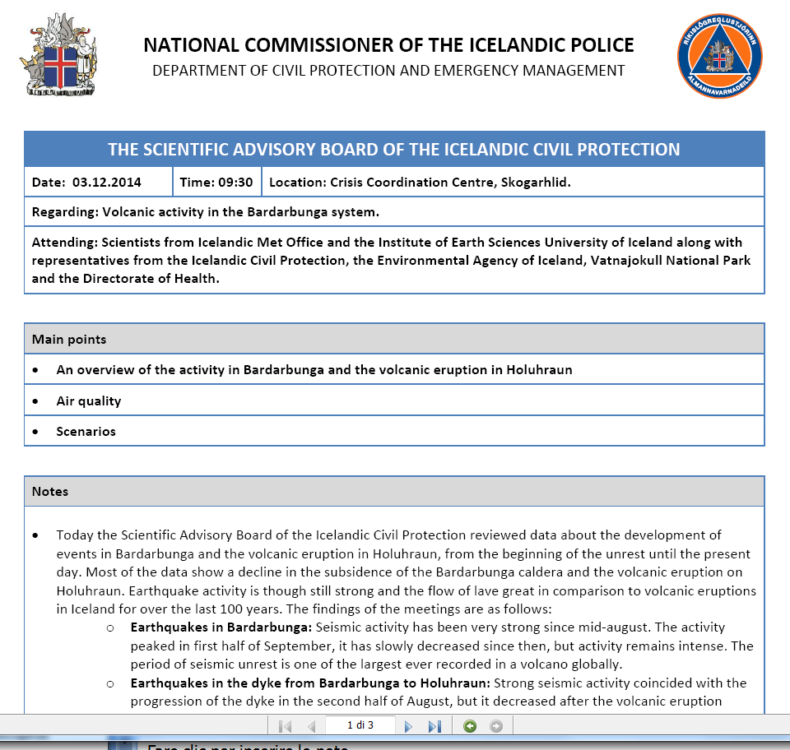
Operational support to Bardabunga eruption response

Slide 37
Scientific information for the Bardabunga eruption
Main decision-making agency: Iceland Police, Dept. of Civil Protection
Scientific institutions in charge: Iceland Meteorological Office, University of Iceland, University of Leeds, University of Bristol
Main benefits/decisions
The Supersite EO data allowed to provide important information for the situational awareness, as the update of the alert level for aviation.
Scientific information was also disseminated to the public through the University of Iceland website.

