Slide 1
Land Cover Side Event: A new path forward for generating products
GEO-XIII Plenary St. Petersburg Russian Federation
Gary Geller & André Obregón GEO Secretariat
8 November 2016
Notes:
Side Event Purpose:
A follow up to last year’s side event on LC and a 2 day workshop in May exploring new paths forward for generating LC products.
Goals:

Slide 2
Side Event Goals
Bring you up to date
Convey results of Rotterdam workshop and follow-on discussions
Hear your thoughts
Notes:
Purpose: A follow up to last year’s side event on LC and a 2 day workshop in May exploring new paths forward for generating LC products.

Slide 3
Agenda
 | Welcome (5) (Gary Geller) Side event purpose and agenda overview
 | Introduction (10) (André Obregón) Policy Needs for LC GEO LC Activities Key Points from GEO-XII LC Side Event
 | Overview of current Land Cover approach (10) (Brice Mora) Products available now Users and uses Limitations—what are the unfulfilled needs?
 | Rotterdam workshop outcome and synthesis (30) (Gary Geller) Workshop format and outcome Possible system architecture Challenges Path forward Role for GEO
 | Discussion (25) (all)
 | Wrapup (5)

Slide 4
Rotterdam Workshop Outcome and Synthesis: A new path forward
GEO-XIII Plenary St. Petersburg Russian Federation
Gary Geller & André Obregón GEO Secretariat
8 November 2016
Notes:
Side Event Purpose:
A follow up to last year’s side event on LC and a 2 day workshop in May exploring new paths forward for generating LC products.
Goals:

Slide 5
Rotterdam Meeting
23-24 May 2016
Follow-on to GEO Plenary XII side event
Basic premise
Many LC products…still unmet needs
Advances in S&T can support a new approach
Explore ways to meet this vision:
An operational system
that can meet varied user requirements
Notes:
Advances:
More data available
Improved algorithms (esp. multitemporal)
Greatly increase processing capability
Vision: A sustainable operational system that generates land cover datasets according to specific user requirements for geographic scope and the number and types of classes; datasets can be generated on a regular basis using consistent methods and with needed accuracy.

Slide 6
Rotterdam Meeting
23-24 May 2016
Follow-on to GEO Plenary XII side event
Basic premise
Despite many LC products, many needs still unmet
Advances in S&T can support a new approach
Explore ways to meet this vision:
An operational system
that can meet varied user requirements
What would such a system look like?
What are the challenges to building it?
Notes:
Advances:
More data available
Improved algorithms (esp. multitemporal)
Greatly increase processing capability
Vision: A sustainable operational system that generates land cover datasets according to specific user requirements for geographic scope and the number and types of classes; datasets can be generated on a regular basis using consistent methods and with needed accuracy.

Slide 7
Good News
Recent advances in science and technology
Rotterdam workshop
>40 people, many LC experts
Four breakout groups
Notes:
LCMAP is just an example that proves that the suggested approach is possible
Note that accuracy is probably more dependent on good data and good reference data than on new algorithms

Slide 8
Meeting Outcome
General agreement on an overall approach
On-demand system
Automated
“Data cube-like”
Lots of data
Reference data--integral part of any system
Many challenges—key ones identified
Finalizing “synthesis paper”
Notes:
Advances:
More data available
Improved algorithms (esp. multitemporal)
Greatly increase processing capability

Slide 9
User Need Categories
Classes
Temporal frequency and regularity
Latency
Consistency (time and space)
Spatial location and extent
Spatial resolution
Accuracy
Control / trust in the process
But: user survey needed

Slide 10
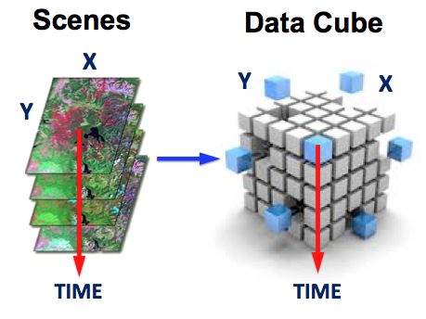
Data Cube
Infrastructure: simplify application of satellite data
Pixel--not scene--based
Stack of data with every pixel aligned
Basic processing done → “Analysis Ready Data”
CEOS “Data Cube in a Box”
Different flavors exist

Slide 11
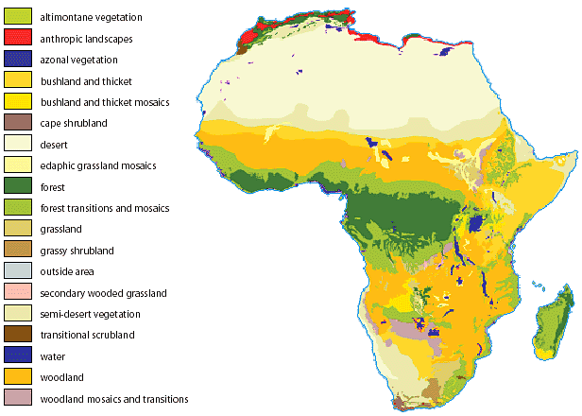
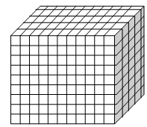
Generalized Architectural Concept
Multisensor
datastream
Pre-Processing
Land Cover
Generation
Data
ARD
ARD is Analysis-Ready Data,
e.g., which has been
atmospherically corrected

Slide 12
Generalized Architectural Concept
User input
Specifics of user’s
request, eg
desired classes or
area of interest
Multisensor
datastream
Pre-Processing
Land Cover
Generation
Data
ARD
User-defined
map
ARD is Analysis-Ready Data,
e.g., which has been
atmospherically corrected

Slide 13
Generalized Architectural Concept
User input
Specifics of user’s
request, eg
desired classes or
area of interest
User-provided
training data
Multisensor
datastream
Pre-Processing
Land Cover
Generation
Data
ARD
User-defined
map
ARD is Analysis-Ready Data,
e.g., which has been
atmospherically corrected

Slide 14
Generalized Architectural Concept
User input
Specifics of user’s
request, eg
desired classes or
area of interest
Training data
database
Multisensor
datastream
Pre-Processing
Land Cover
Generation
Data
ARD
User-defined
map
ARD is Analysis-Ready Data,
e.g., which has been
atmospherically corrected

Slide 15
Generalized Architectural Concept
User input
Specifics of user’s
request, eg
desired classes or
area of interest
Reference
database
Multisensor
datastream
Pre-Processing
Land Cover
Generation
Validation
Data
ARD
User-defined
map
Validated
map
ARD is Analysis-Ready Data,
e.g., which has been
atmospherically corrected

Slide 16
Generalized Architectural Concept
User input
Specifics of user’s
request, eg
desired classes or
area of interest
Reference
database
Multisensor
datastream
Pre-Processing
Land Cover
Generation
Validation
Data
ARD
User-defined
map
Validated
map
ARD is Analysis-Ready Data,
e.g., which has been
atmospherically corrected

Slide 17
Generalized Architectural Concept
User input
Specifics of user’s
request, eg
desired classes or
area of interest
Reference
database
Multisensor
datastream
Pre-Processing
Land Cover
Generation
Validation
Data
ARD
User-defined
map
Validated
map
LC Change
products
ARD is Analysis-Ready Data,
e.g., which has been
atmospherically corrected

Slide 18
Challenges
Need good reference data
Share it
Develop curated database
Develop sharing tools
Data volume (for large areas)
Downloading impractical
Cloud-based approach
Processing resources
Technically do-able
Notes:
LCMAP is just an example that proves that the suggested approach is possible
Note that accuracy is probably more dependent on good data and good reference data than on new algorithms

Slide 19
Challenges
Accuracy of automated methods
High quality training data
Lots of input data
Validation
Non-technical challenges
Funding
Capacity
Cultural
Notes:
LCMAP is just an example that proves that the suggested approach is possible
Note that accuracy is probably more dependent on good data and good reference data than on new algorithms

Slide 20
Should We Be Optimistic?
YES!
USGS LCMAP system
Tsinghua automated processing system
Single layer products
Forests: Hansen/UMD/GEE/WRI
Water: JRC/GEE
Urban
CEOS Data Cube in a Box
More data
Improved algorithms
Increased computing capabilities
Is this easy?

Slide 21
Conceptual Implementation Scenarios
Top down, centralized approaches
Global or coordinated regional
Bottom up, organic approaches
Multiple, independent organizations and people
Option to use CEOS “Data Cube in a Box”
Combination

Slide 22
Path Forward
Incremental expansion
Address challenges one at a time
Socialize the concept → broad buy-in
Bring players together: discuss the future
Notes:
Expansion occurs on multiple fronts: spatial, classes, accuracy, availability—and is inevitable—already happening.

Slide 23
Expansion on Multiple Fronts
Single Layer
Forests
Water
Urban
USGS
LCMAP
CEOS
Data Cube
GADC
Tsinghua
Portal
Others
China?
EC?

Slide 24
Coordinated Approach: One Possibility
Consortium of
organizations
Standards
& agreements
For example…
Region a
Region d
Region c
Independent,
coordinated
systems
...
Region b
Region n
Large-area,
combined
product?
+
+
+
+

Slide 25
Another Possibility
Consortium of
organizations?
Standards
& agreements?
For example…
Region a
Region d
Region c
Independent,
coordinated (?)
systems
...
Region b
Region n
Multiple sources
for
global products?

Slide 26
Some Specific Steps
Develop coordinated LC reference database
Develop shared validation tools
Utilize CEOS Data Cube in a Box
Discuss
ESA WorldCover2017 (14-16 March)
ISRSE 2017 (8-12 May)
Convene another workshop?
Continue current activities
Single layer products
High resolution maps
Hybrid maps
Other good work

Slide 27
Role for GEO
Facilitate development of reference database
Facilitate buy-in and expansion
Help coordinate approaches
One last thing…moving beyond land cover

Slide 28
Generalized Architectural Concept
User input
Specifics of user’s
request, eg
desired classes or
area of interest
Reference
database
Multisensor
datastream
Pre-Processing
Land Cover
Generation
Validation
Data
ARD
User-defined
map
Validated
map
LC Change
products
ARD is Analysis-Ready Data,
e.g., which has been
atmospherically corrected

Slide 29
Beyond Land Cover
User input
Specifics of user’s
request, eg
desired classes or
area of interest
Reference
database
Multisensor
datastream
Algorithm
warehouse
Pre-Processing
Product
Generation
Validation
Data
ARD
User-defined
map
Other Products
(indicators, etc)
Validated
map
LC Change
products
ARD is Analysis-Ready Data,
e.g., which has been
atmospherically corrected

Slide 30
Summary
Science and technology adequate
Possible to better meet user needs
Organic growth already happening
Reference data not ready
Large areas: challenging
Coordinated systems?
Data cube approach: supports many products

Slide 31
Discussion Questions
Your response? Like it? Hate it?
What’s missing?
Would your country or organization benefit?
Role for your country or organization?
Role for GEO?
Convene another workshop with key LC players?

Slide 33
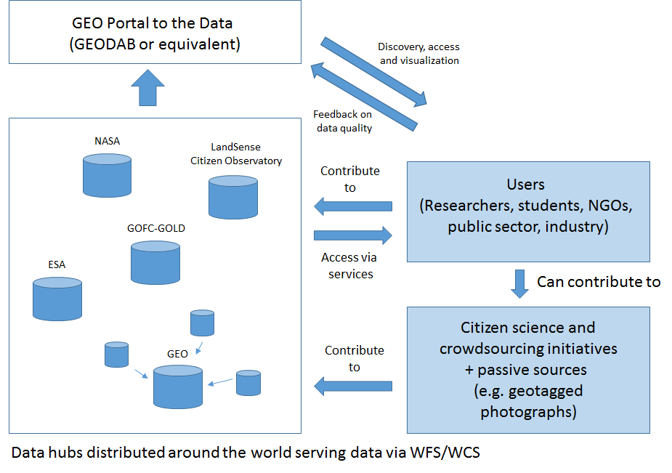
Curated Reference Database

Slide 34
Rotterdam Meeting
Full vision:
“A sustainable operational system that generates land cover datasets according to specific user requirements for geographic scope and the number and types of classes; datasets can be generated on a regular basis using consistent methods and with needed accuracy”
Notes:
Advances:
More data available
Improved algorithms (esp. multitemporal)
Greatly increase processing capability
Vision: A sustainable operational system that generates land cover datasets according to specific user requirements for geographic scope and the number and types of classes; datasets can be generated on a regular basis using consistent methods and with needed accuracy.

