Slide 1

Earth Observation for Agricultural Monitoring and Food Security in Asia and Capacity Development Experiences
Dr. Fan Jinlong, National Satellite Meteorological Center
Prof. Chen Zhongxin, Chinese Academy of Agriculture Science

Slide 2

Outline
1
EO Program in support of AG monitoring
Chinese EO data for SIGMA sites
3
Chinese EO data for CB in Asia
4
Chinese EO data for AG monitoring
2
Notes:
-from 4 aspects to introduce this presentation

Slide 3
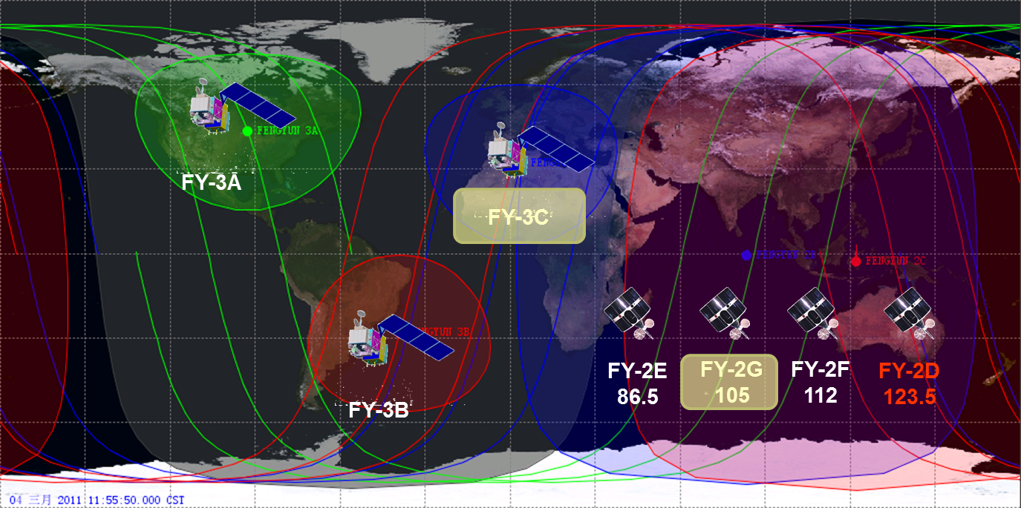
EO: Fengyun Satellite Program
Notes:
FY meteorological Satellite program includes the polar orbiting satellite system and geostationary satellite system
FY3 is the second generation of polar orbiting satellite system.
Up to date, FY3A/B/C have been launched in 2008,2010 and 2013 respectively. All are working well so far in orbit.
FY2 is the first generation of Chinese geostationary satellite. Up to date, FY 2E/F/G are still working in orbit.

Slide 4

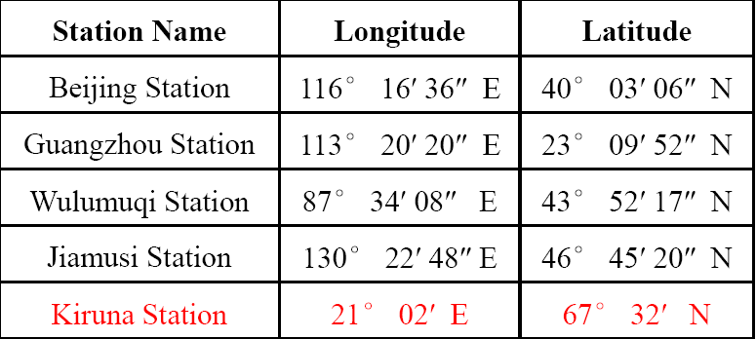
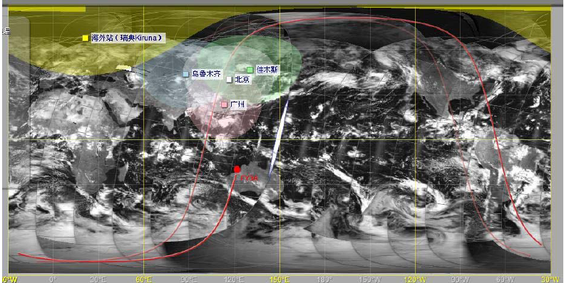
Global coverage in 4 hours
Notes:
For the polar orbiting satellites, NSMC (national satellite meteorological center) is running 4 ground stations in China and an overseas station in Kiruna which is the cooperation station with Swedish space corporation.
Trough these 5 station, all global satellite data may be sent back to NSMC within 4 hours.

Slide 5
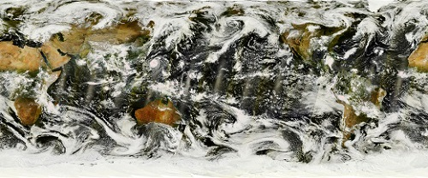

Two sensors for AG monitoring
FY-3C VIRR globle mosaic
Instruments onboard FY-3A,3B and 3C:
VIRR (Visible and Infrared Radiometer)
MERSI (Medium Resolution Spectral Imager)
IRAS (Infrared Atmospheric Sounder)
MWTS Ⅱ (Microwave Temperature Sounder Ⅱ)
MWHS Ⅱ (Microwave Humidity Sounder Ⅱ)
SBUS (Solar Backscattering UV Sounder)
TOU (Total Ozone Unit)
MWRI (Microwave Radiation Imager)
ERM (Earth Radiation Measurement)
SEM (Space Environment Monitor)
SIM Ⅱ (Solar Irradiation Monitor Ⅱ)
GNOS (GNSS Occultation Sounder)
FY-3C MERSI globle mosaic
VIRR: Visible and Infra-Red Radiometer 1km (10 ch)
MERSI: Medium Resolution Spectral Imager 250m(5)/1km(15)
Notes:
There are two sensors on board FY3 satellite that are very useful for agricultural monitoring.
VIRR likes the AVHRR on board NOAA series polar orbiting satellites but with 10 channels.
MERSI likes the MODIS but with only 20 channels among which 5 are in 250m and 15 are in 1 km.
The other sensors on board FY3 are designed for the weather forecasting.

Slide 6
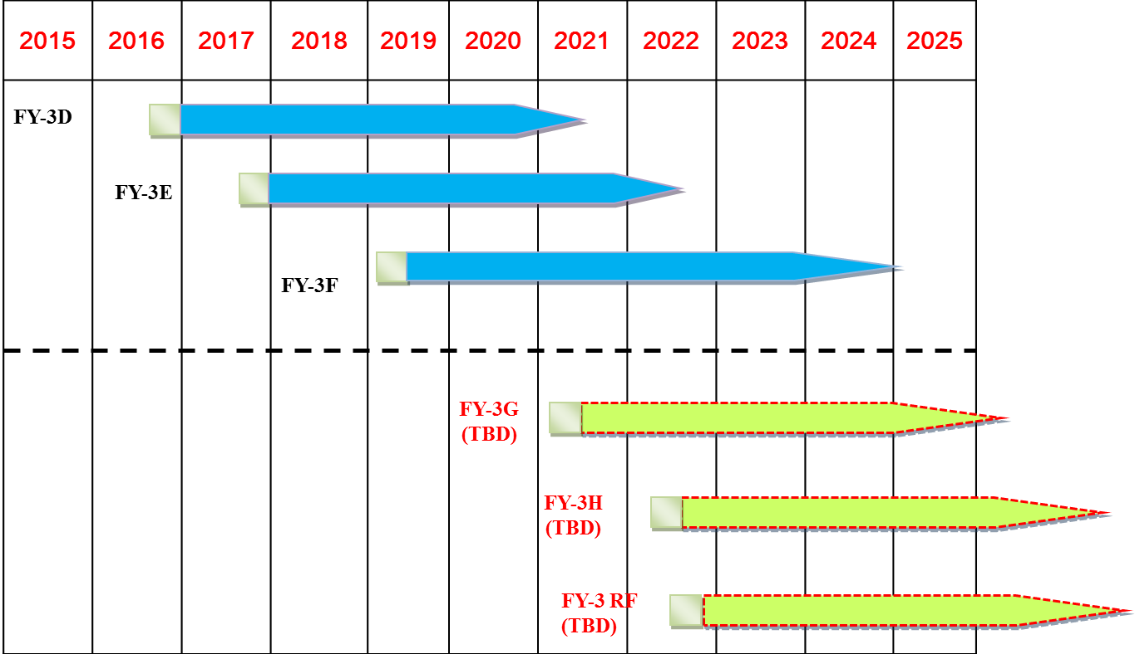
FengYun Program Plan by 2025
Notes:
The roadmap before 2025 of the FY meteorological satellite program has been approved by the central government.
By 2025 more polar orbiting satellite will be launched. Data continuity will be secured in the next 10 more years.
FY3D was supposed to be launched in the end this year and but was postponed to next year.

Slide 7
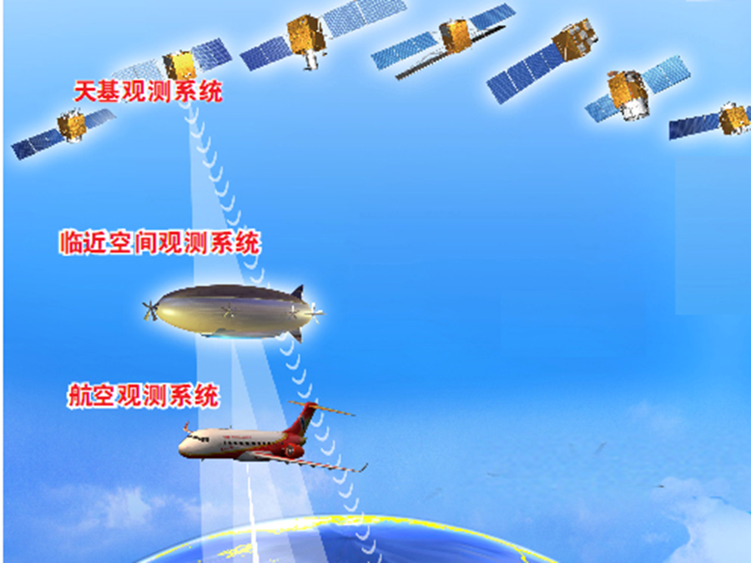
China High-resolution Earth Observation System (CHEOS)
Space-born
Stratosphere
Air-born

Slide 8

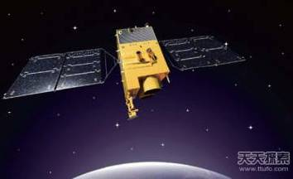
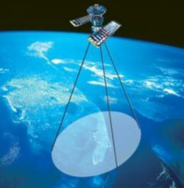
Space-system of CHEOS
2013/04/26，GF-1
2014/08/19，GF-2
2015/12/29，GF-4
2016/08/10, GF-3
2017(?), GF-5
2018(?), GF-6

Slide 9
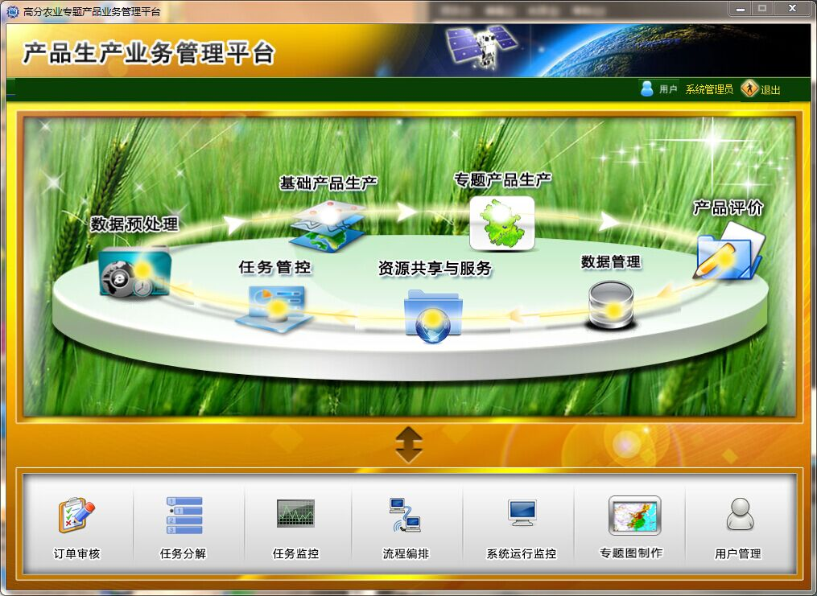
CHEOS Agricultural Application System
Data Pre-processing
Basic data-products
Thematic data-products
Data-product evaluation
Task management
Data sharing
Process 4 category 19 thematic ag data products and 15 basic data products based on CHEOS satellite data

Slide 10

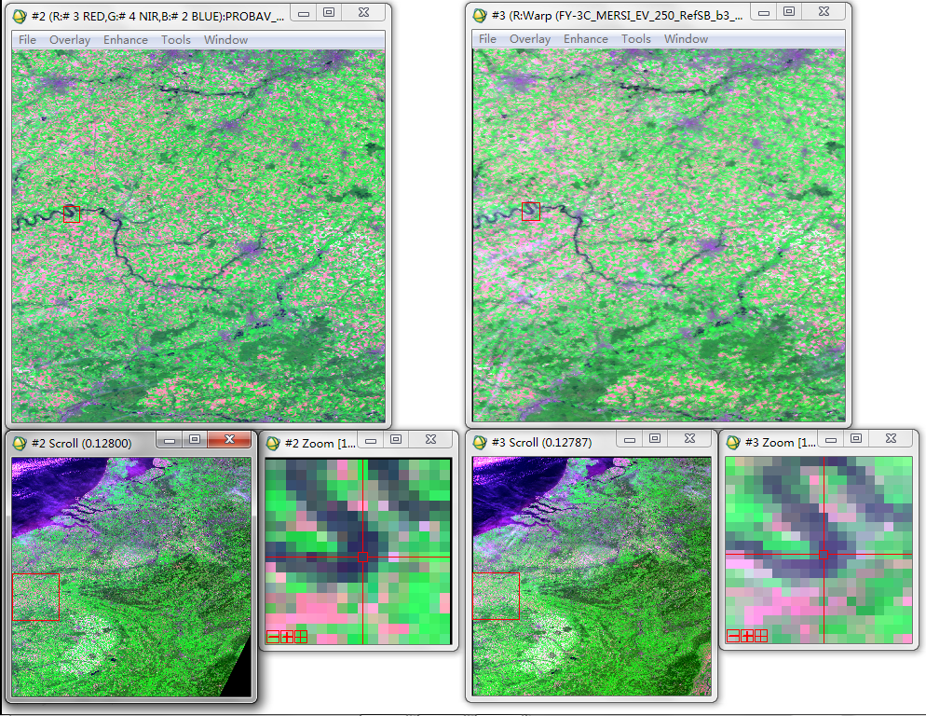
Chinese EO for
SIGMA Belgium Site
Notes:
For the SIGMA project, the FY3 datasets for 15 sites are prepared.
In order to validate the quality of FY3C MERSI data, the comparison between the PROBA-V and FY3C MERSI for some sites was conducted.
This one is the case of Belgium site. The left group of figures is proba-v data. The right group is FY3C MERSI data. Both data were acquired at the same day.
The both RGB (red, near inferred and blue) images look quite similar. In terms of the geolocation of FY3C MERSI, it is also fine.

Slide 11
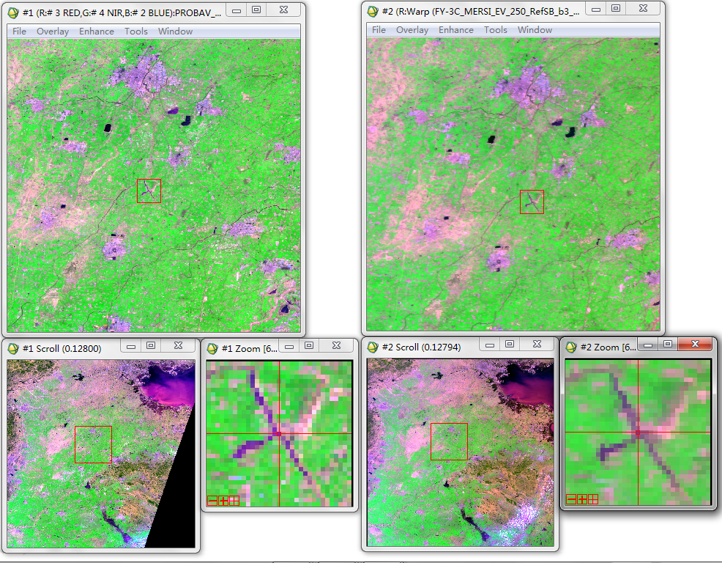
Chinese EO for
SIGMA Shandong Site
Notes:
this one is another example in china. The same as the previous one, the left group of figures is proba-v data. The right group is FY3C MERSI data. Both data were acquired at the same day.
The both RGB (red, near inferred and blue) images look quite similar. In terms of the geolocation of FY3C MERSI, it is also fine.

Slide 12
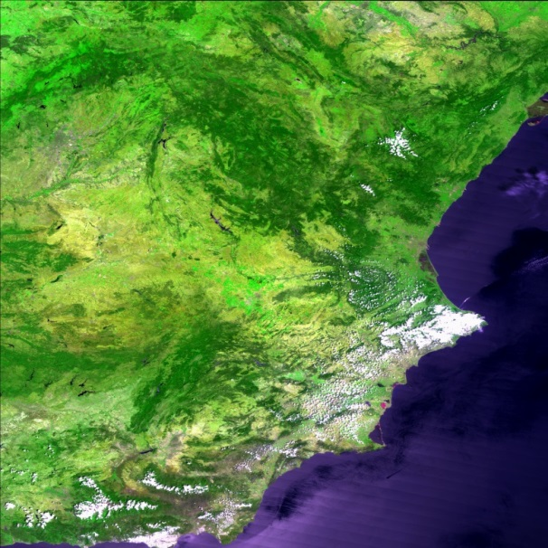
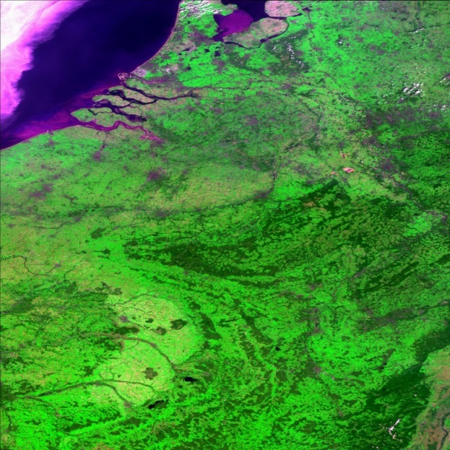
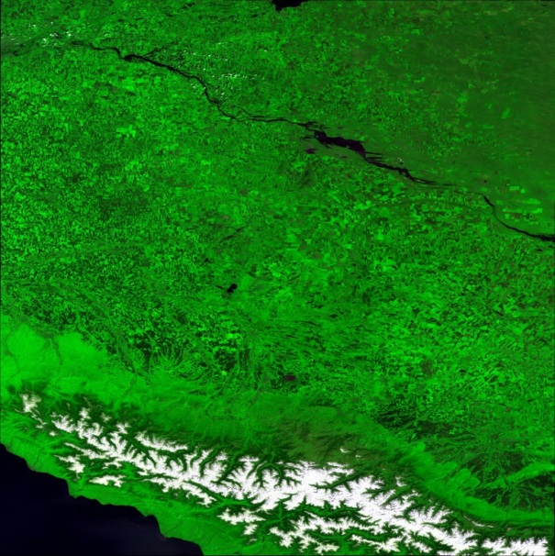
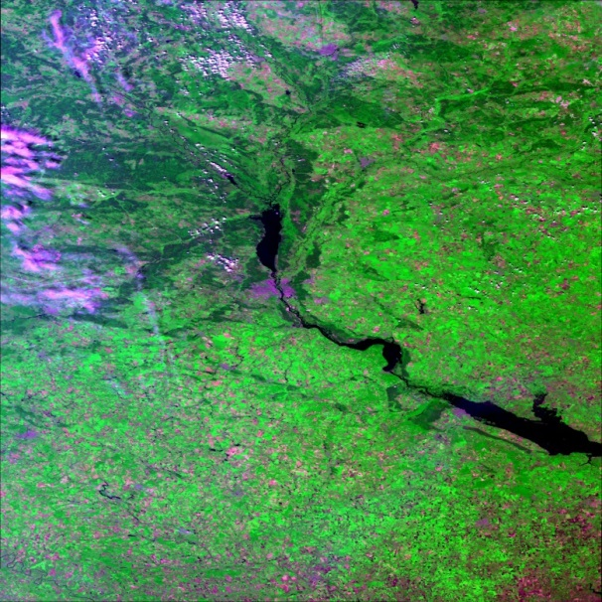
Chinese EO for
Spain Site
Belgium Site
Russia Site
Ukraine Site
Notes:
- This is a group of FY3C MERSI images for European sites.

Slide 13
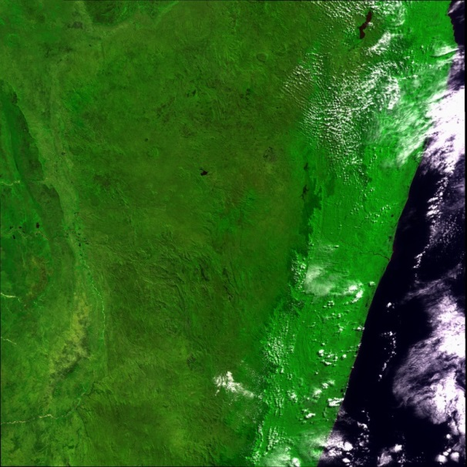
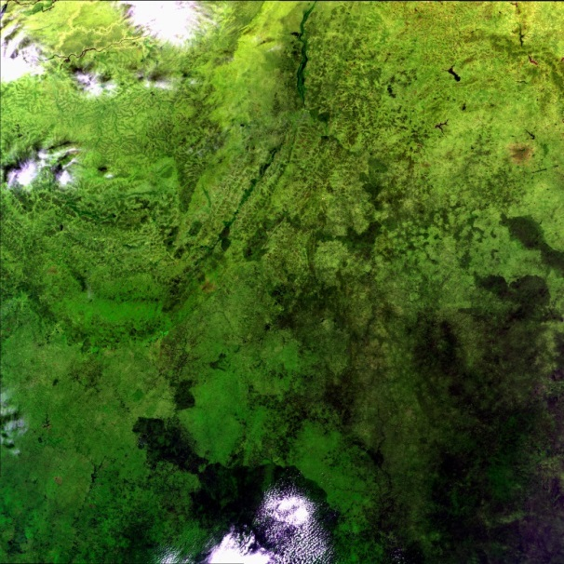
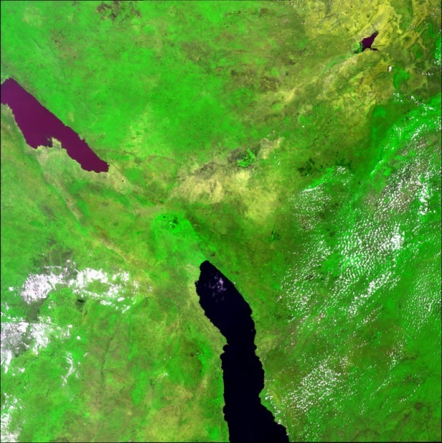
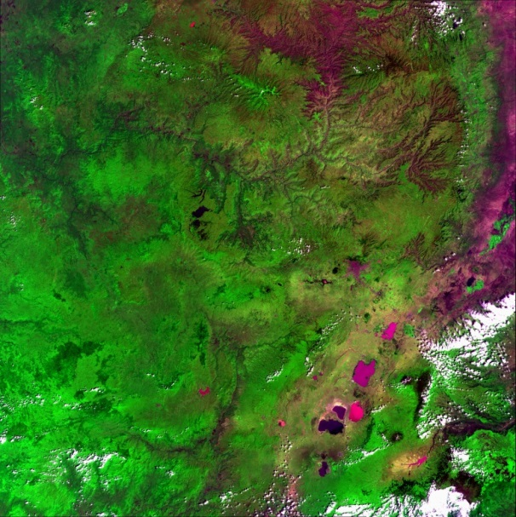
Chinese EO for
Madagascar Site
Burkina Faso Site
Tanzania Site
Ethiopia Site
Notes:
- This is a group of FY3C MERSI images for African sites.

Slide 14
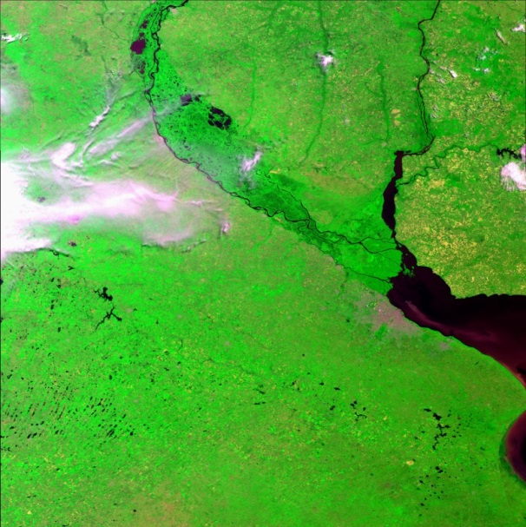
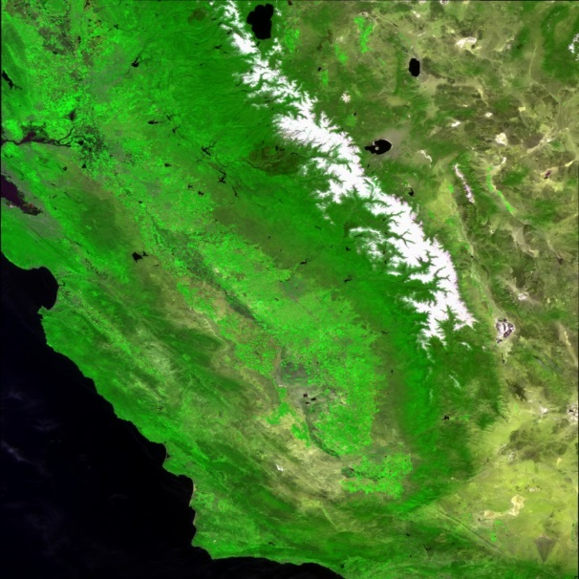
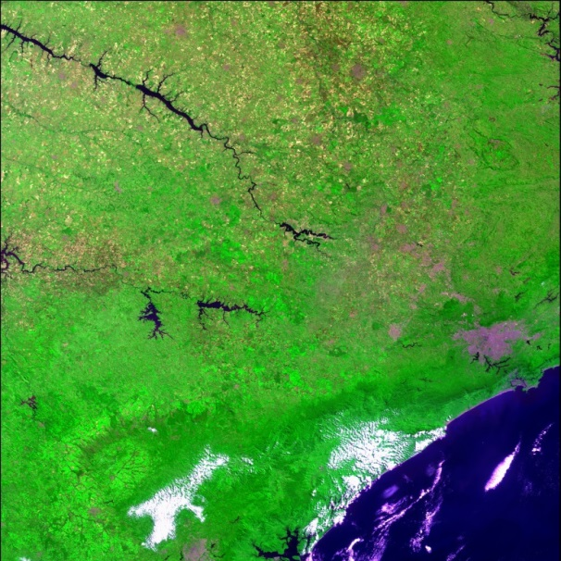
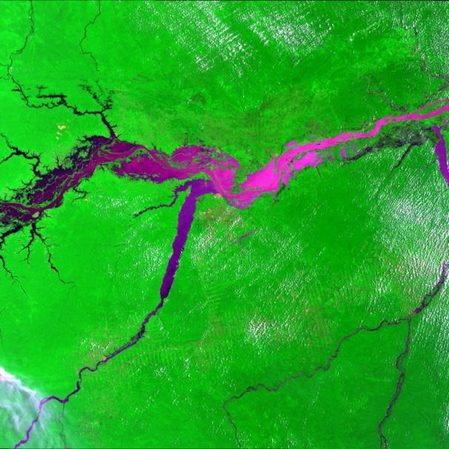
Chinese EO for
Argentina Site
USA Site
Saopaulo Site
Para Site
Notes:
- This is a group of FY3C MERSI images for American sites.

Slide 15
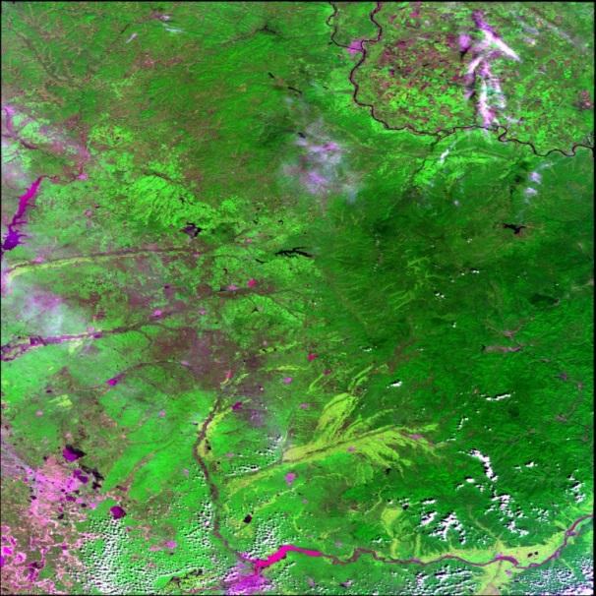
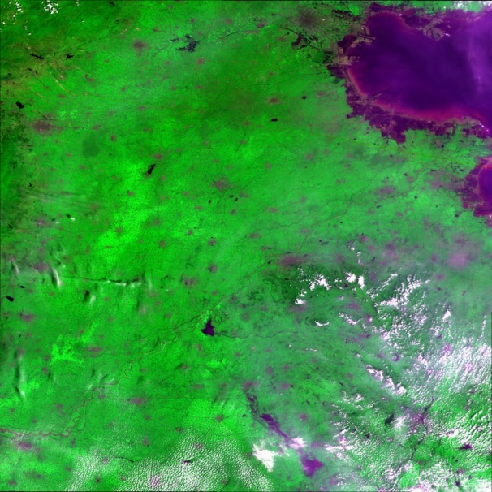
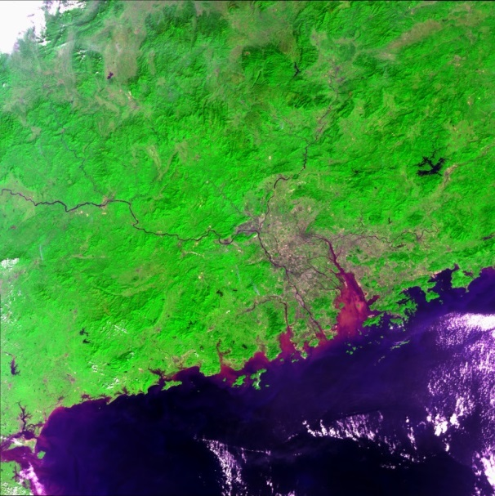
Chinese EO for
Helongjiang Site
Shandong Site
Taishan Site
Notes:
- This is a group of FY3C MERSI images for China sites.

Slide 16
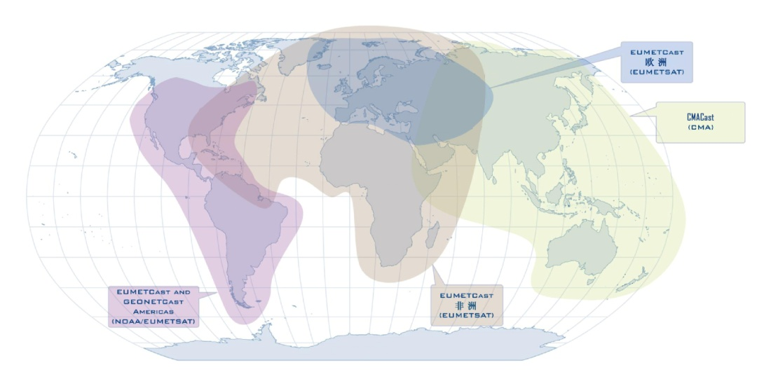
Chinese EO for CB
CMACast is one of components of GEONETCast that is operated by EUMETSAT, CMA, NOAA and others. To facilitate getting the Chinese EO data, CMA has donated CMACast user stations in Asian Pacific region and trained the users to use the Chinese EO data.
Notes:
- Capacity Building is also extremely important for the developing countries.
- In order to promote the use of Chinese satellite data, CMA has developed a communication satellite based data distribution system, CMACast, which is also a part of GEONETCast run by EUMETSAT,CMA,NOAA and others.
- The users with the CMACast user station in Asian and Pacific region may receive the Chinese meteorological satellite data routinely.

Slide 17
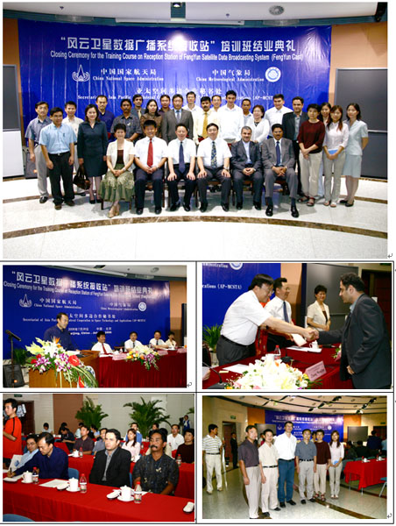
Chinese EO for CB
In 2006, CMACast user station donation to
Bangladesh
Indonesia
Iran
Mongolia
Pakistan
Thailand
And the training workshop held
Notes:
In addition to the users in China, CMA also has promoted the users overseas.
- In 2006, with the supports from China National Space Agency, CMA denoted 6 user stations to Bangladesh, Indonesia, Iran, Mongolia, Pakistan and Thailand
A user training workshop was held thereafter.

Slide 18
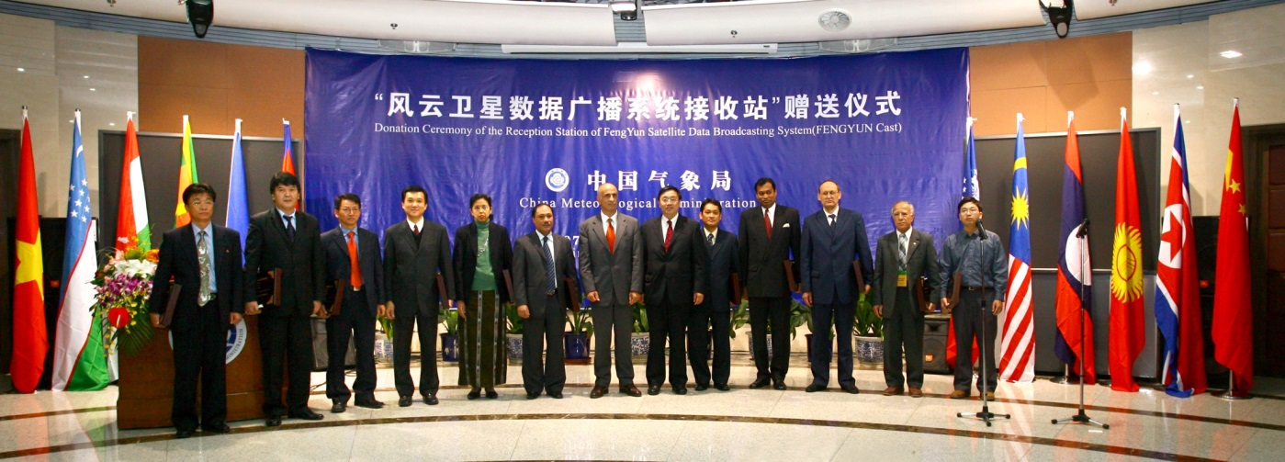
Chinese EO for CB
Kyrgyzstan
Laos
Malaysia
Myanmar
Nepal,
North Korea
Philippines
Sri Lanka
Tajikistan
Turkmenistan
Vietnam
In 2007, countries left received the donation of the CMACast user stations in Beijing and thereafter the training workshop was held
Notes:
- Again in 2007, with the supports from GEO secretariat, CMA denoted 11 user stations to Kyrgyzstan, Laos, Malaysia, Myanmar, Nepal, North Korea, Philippines, Sri Lanka, Tajikistan, Turkmenistan, Vietnam
A user training workshop was held thereafter.

Slide 19
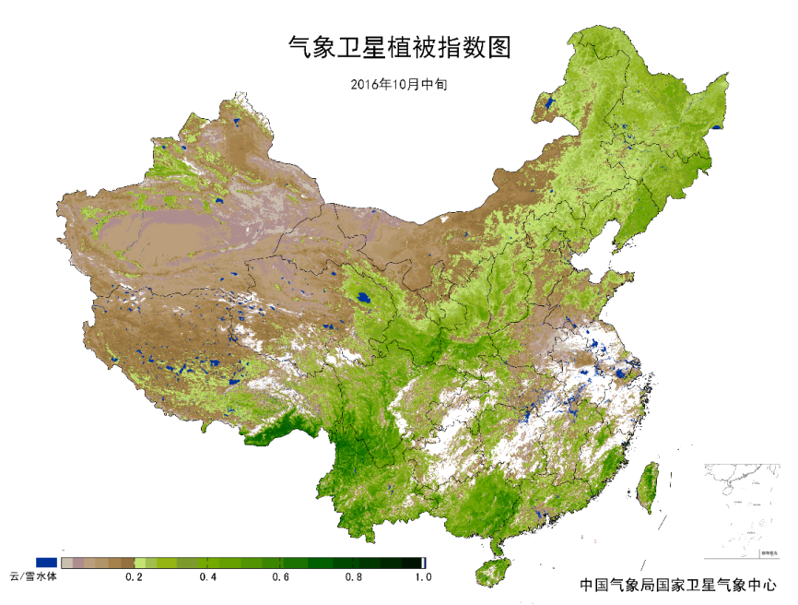
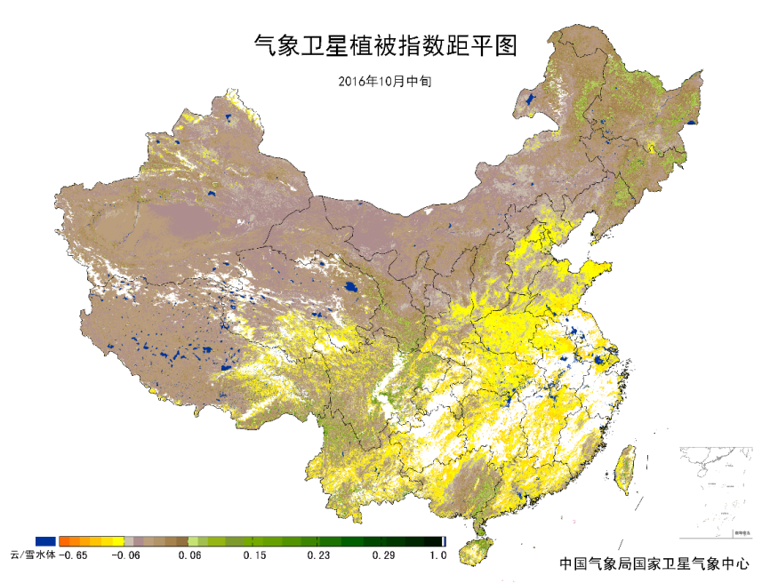
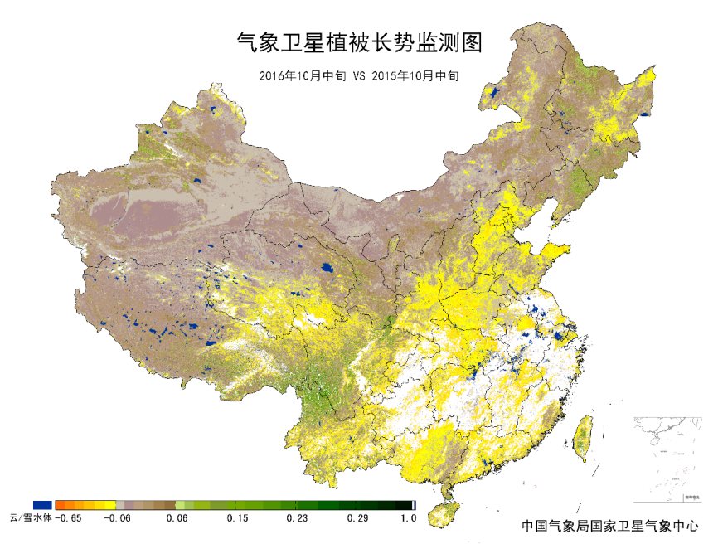
Chinese EO for AG Monitoring
NDVI Map
2nd Decad of Oct.
NDVI departure from the average
2nd Decad of Oct.
NDVI departure from previous year
2nd Decad of Oct.
Notes:
NSMC is also using the FY satellite to monitor the vegetation condition routinely.
This slide shows the vegetation condition in China in the second decal of last month.
The upper left figure is the NDVI map for the middle decad of Oct.
The upper right figure is the abnormal NDVI map between the current NDVI and the multiple year mean at the same decad.
The lower right figure is the abnormal NDVI map between the current NDVI and the previous year mean at the same decad.

Slide 20
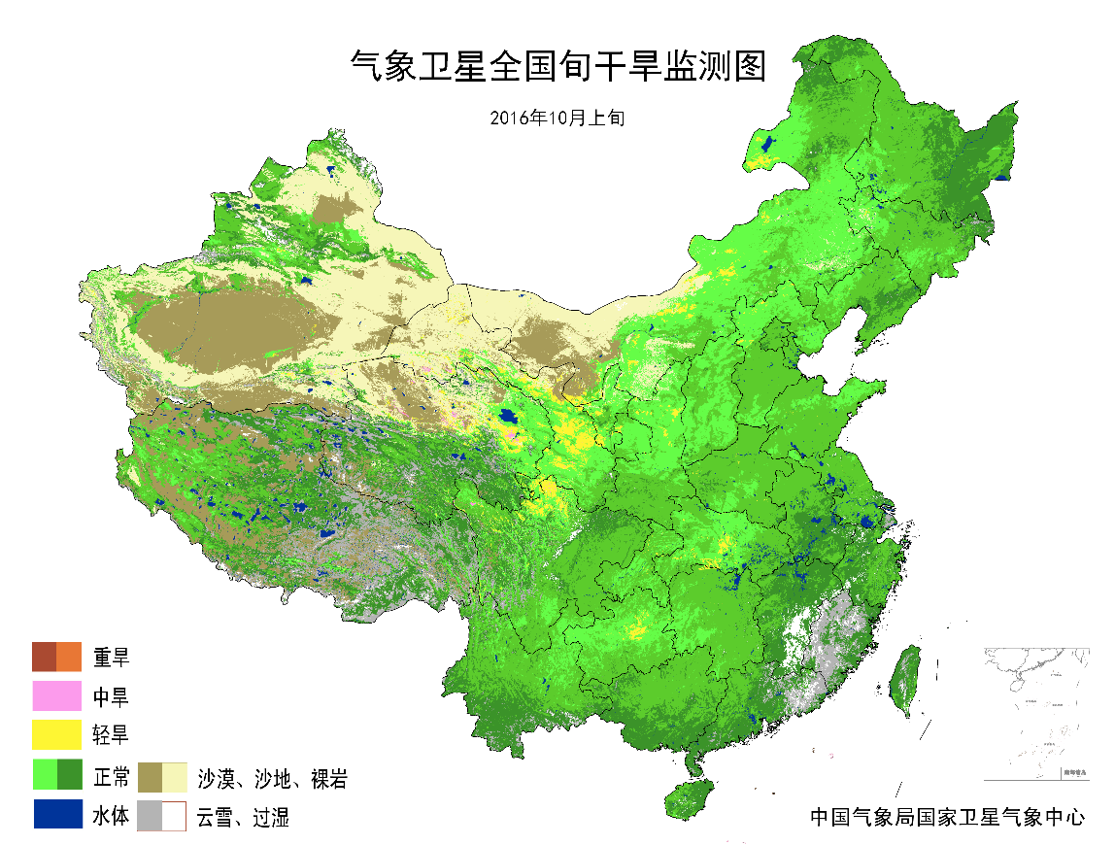
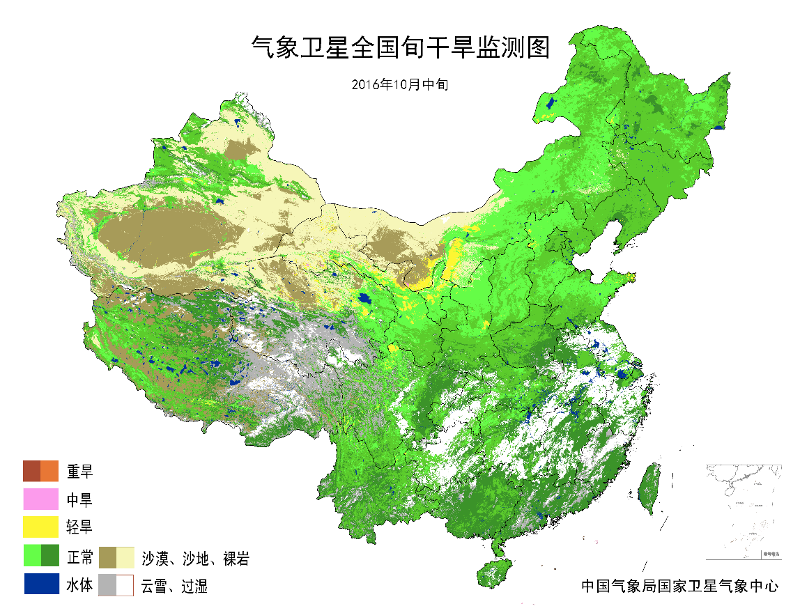
Chinese EO for AG Monitoring
Vegetation Drought Map
1st Decad of Oct.
Vegetation Drought Map
2nd Decad of Oct.
Notes:
this slide shows the drought monitoring with the Chinese satellite data.
The left figure is the drought map for the first decad of Oct.
The right figure is the drought map for the second decad of Oct.

Slide 21
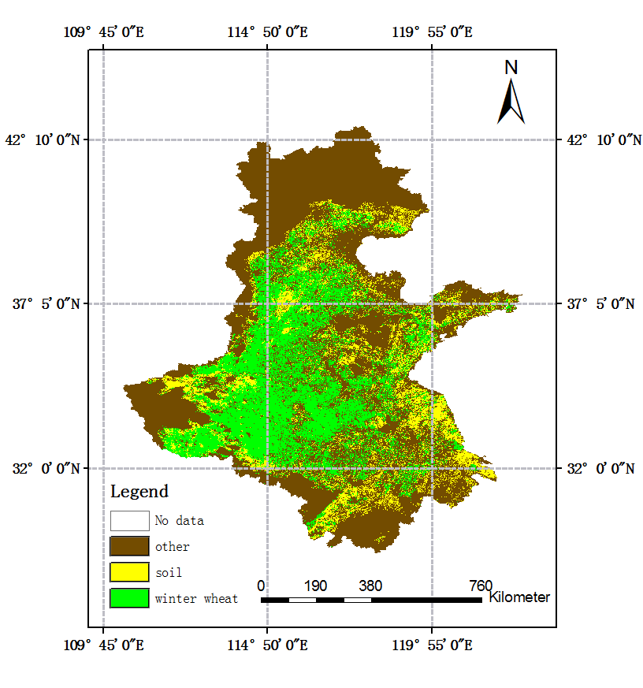
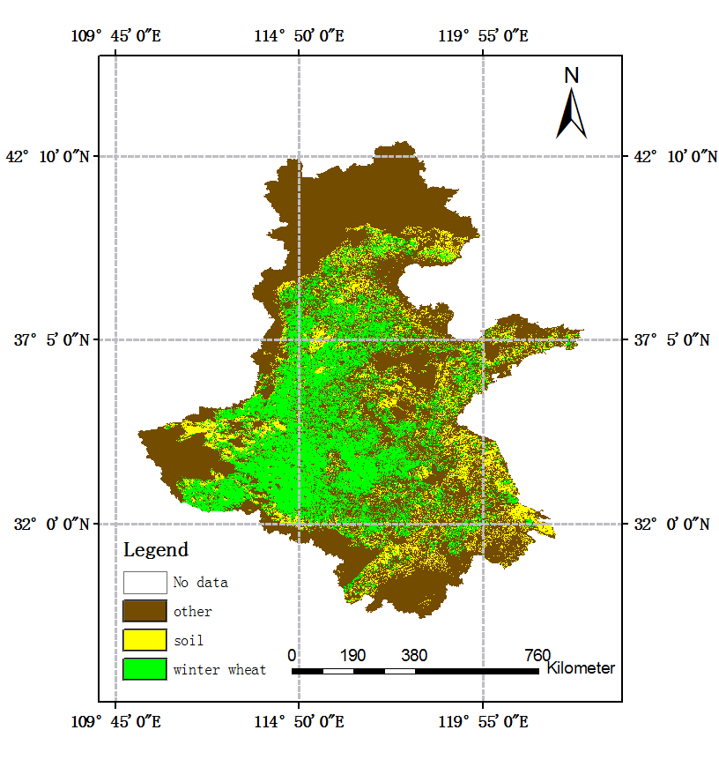


Chinese EO for AG Monitoring
Winter wheat Mapping with MERSI data and 4 algorithms in North China Plain for the growing season 2013/2014
Random forest
Decision tree
Bagging
AdaBoost
Accuracy
91.3%
86.7%
88.6%
90.6%
Notes:
NSMC colleague has used FY3 250m MERSI data to map the winter wheat area in North China Plain.
4 popular methods have been tested for the winter wheat classification.
- Comparative speaking, the random forest got the highest accuracy in comparison with other 3 methods.

Slide 22
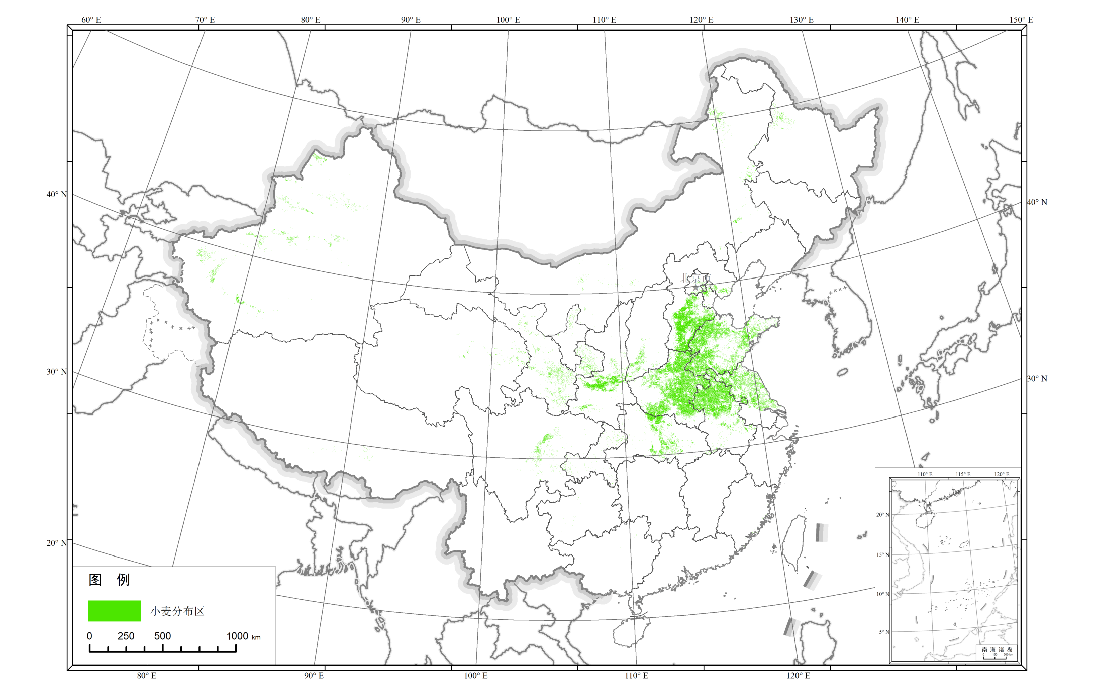
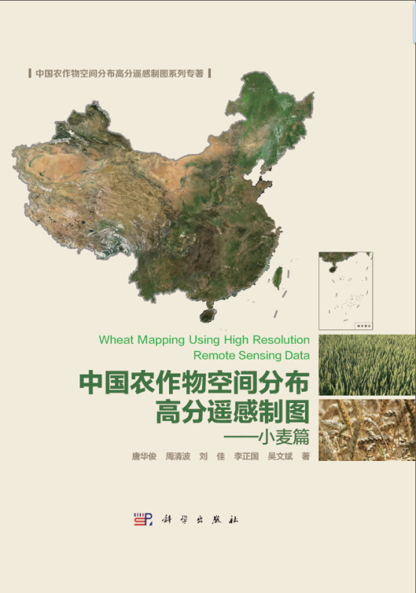
Wheat distribution map 2014

Slide 23
China Agriculture Monitoring with Remote Sensing (CHARMS system in MOA)
Since 1998, run every year
Operational in the whole nation
Monitoring 7 key crops （90%+ crop production）
  Acreage change
  Growth
  Yield & productivity
  Grassland
  Environment & disasters, etc.

Slide 24
System Components
User management and interface
Database sub-System
Standars and protocols
Data processing
(remote sensing and other)
Crop Acreage
Soil moisture
Crop crowth
Crop yield
Agro-disaster
Grassland and livestock
Reporting and information dissemination

Slide 25
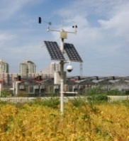
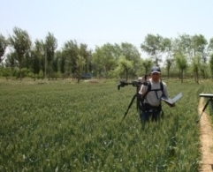
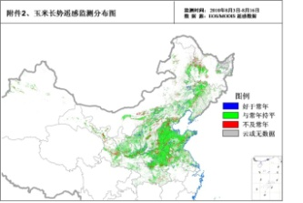
CHARMS structure
Multi-source
information acquisition
Multi-parameter quantitative inversion
Crop parameter inversion
Multi-scale monitoring technology
Agro-environmental parameter inversion
Accuracy assessment
……
Crop acreage monitoring
Crop yield forecasting
Standards &
rules
natural disasters…
Operational monitoring system
Wheat monitoring results
Maize monitoring results
……

Slide 26
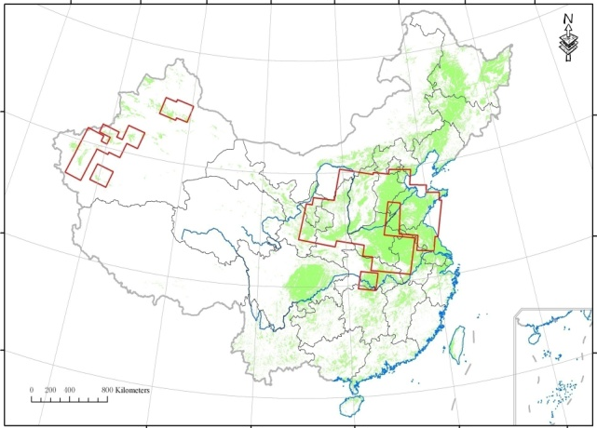
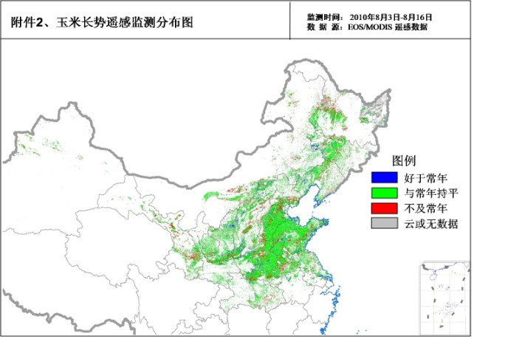
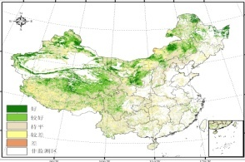
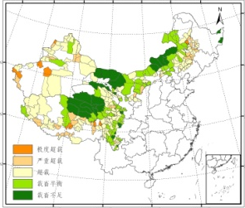
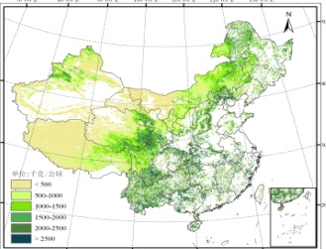
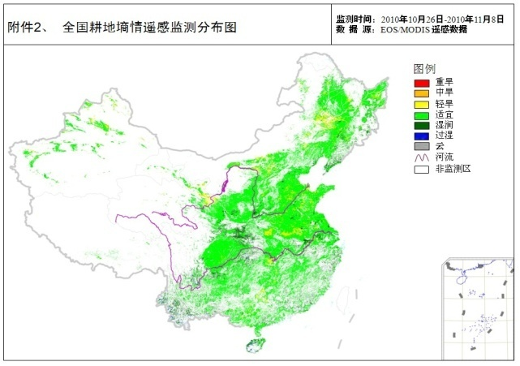
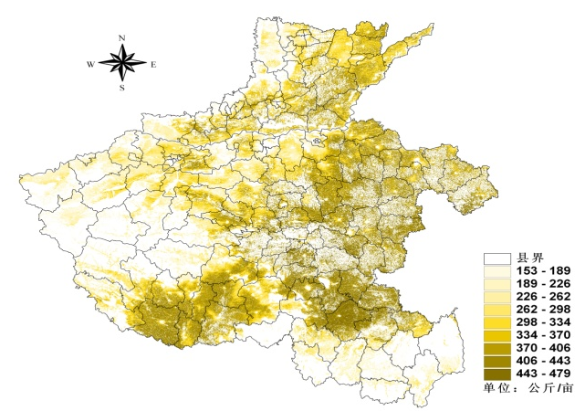
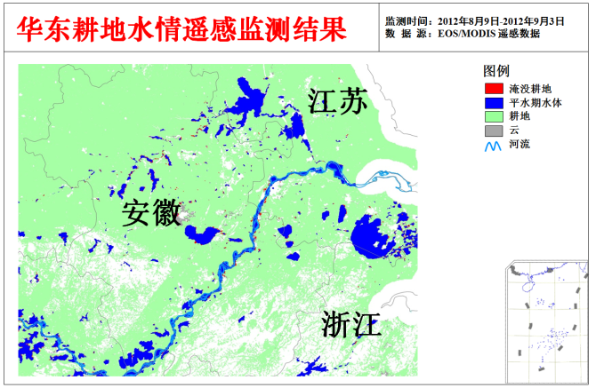
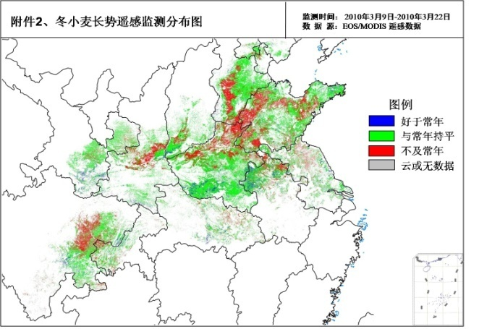


Monitoring Agriculture with Remote Sensing
Grassland
Crop Acreage
Crop Growth
草畜平衡
产草量
Soil Moisture
Yield
Crop Growth
Crop Mapping
土地利用

Slide 27




Wheat Powdery mildew (Hebei, 2014)
Monitoring is conducted by using GF-1 satellite PMS images with spatial resolution of 2m
Monitoring is conducted by using GF-1 satellite WFV images with spatial resolution of 16m

Slide 28


Crop cultivar monitoring
Rice cultivars in Jiansanjiang, 2014
Winter wheat cultivars in Shunyi(2014)
Data：GF-1

Slide 29

Facility Agriculture (Vinyl greenhouse) Handan 2014
Data: GF-1 2m/8m

Slide 30






Chinese EO for AG Monitoring
Monthly global crop growth monitoring with Chinese EO data
Notes:
As NSMC may obtain FY3 global data, so the monthly monitoring of global crop growth condition is in development.
At present, the major crop production countries have been monitored with the Chinese FY satellite data.

Slide 31


Thanks you very much for your attention!
AM
PM

