Slide 1




GEO-XIII Side Event:
Air Quality, Earth Observations, and Health
Lawrence Friedl, USA/NASA and
GEO SDG Initiative Co-Lead
John Haynes, USA/NASA and
GEO Health & Environment
Community Co-Lead

Slide 2
NASA & Air Quality
Decision Support
Policy Issues
Forecast
Research
Sensors & Satellites
Training
GEO Health and
Envir. Community

Slide 3
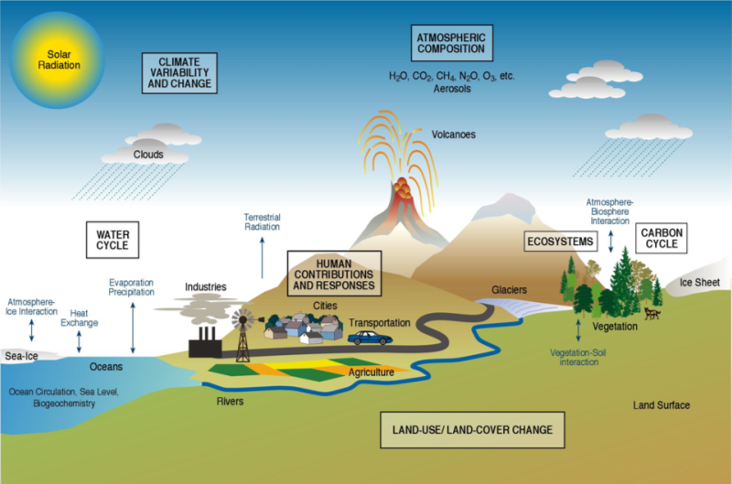


NASA Earth Science
Technology
Flight Missions
Research
Data Systems
Education
Applications
Supports basic and applied research on the Earth system and its processes to advance knowledge and benefit society.
In parallel with research, NASA pursues innovative and practical uses of Earth science data and results to inform decisions and actions.
|‌ 3
Notes:
A paradigm of variability, forcing, response, consequences and prediction.
A Space Program with a comprehensive, broad-based scientific research, technology, and applications element.
A scientific research, technology, and applications program with expertise and access to space.

Slide 4
Health & Air Quality
Objectives:
NASA’s Health & Air Quality Applications Area supports the use of Earth observations in air quality management and public health, particularly regarding infectious disease and environmental health issues.
The area addresses issues of toxic and pathogenic exposure and health-related hazards and their effects for risk characterization and mitigation.
The area promotes uses of Earth observing data and models regarding implementation of air quality standards, policy, and regulations for economic and human welfare.
The Health & Air Quality Applications Area also addresses effects of climate change on public health and air quality to support managers and policy makers in their planning and preparations.

Slide 5
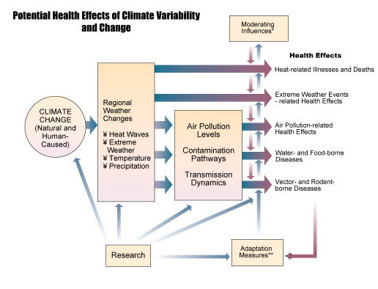
Why Health & Air Quality?
Source: GEO, 2003
Patz et al., 2000
http://www.usgcrp.gov/usgcrp/Library/nationalassessment/healthimages.htm

Slide 6
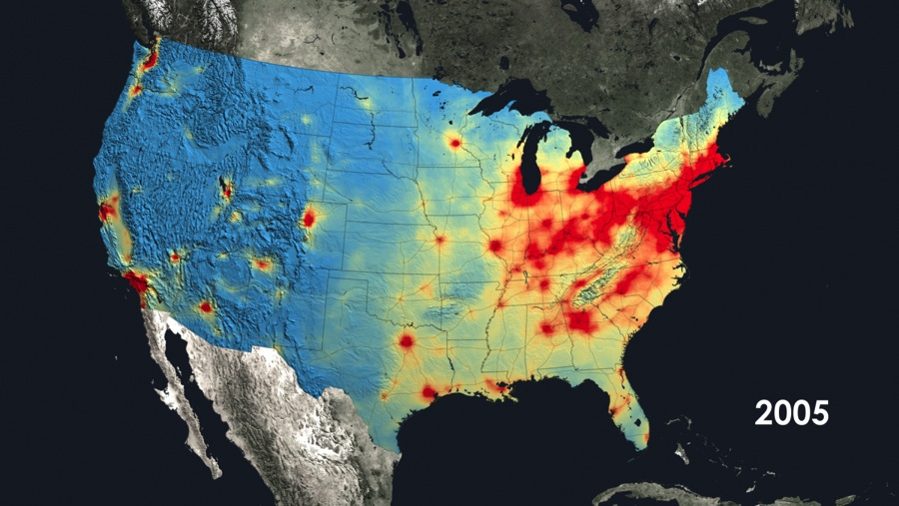
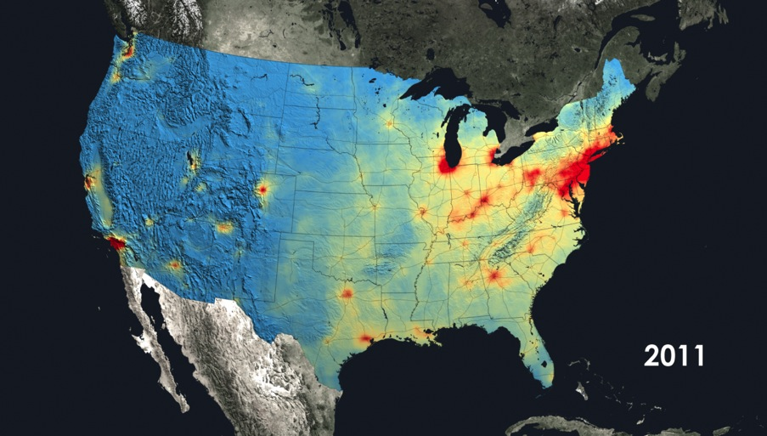
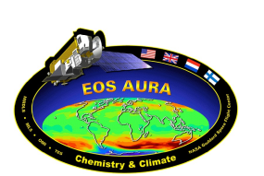
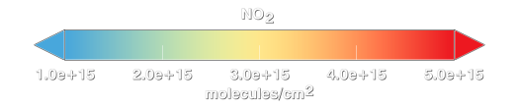
Aura/OMI Shows U.S. Air Quality is Improving
• OMI data show a 30-40% decrease in the pollutant nitrogen dioxide from 2005 to 2011.
• The NO₂ decrease is due to emission control devices on coal-burning power plants and more fuel-efficient cars.
• Use of satellite data by the air quality community, such as by demonstrating the effectiveness of state efforts to improve air quality.
NOx
NOx
Notes:
US NO_{x} emissions have decreased by about 50% since 2000 through a combination of controls on power plants and automobiles. For instance, see http://earthobservatory.nasa.gov/IOTD/view.php?id=83923 for a description of the impact of emission control devices on power plants.
The Ozone Monitoring Instrument (OMI) is on the Aura satellite (http://aura.gsfc.nasa.gov), which just celebrated 10 years since launch.
The OMI NO₂ data shown in the images were produced by the international OMI NO₂ Team (NASA NO₂ PI: Nickolay Krotkov (GSFC, 614) and Dutch PI: Pepijn Veefkind (KNMI, Netherlands)). The data were processed and analyzed by Lok Lamsal (GSFC; 614) and Yasuko Yoshida (GSFC, 614), both of whom were partially funded by the NASA Air Quality Applied Sciences Team (AQAST) via Bryan Duncan (AQAST member). The images were created by the NASA Goddard's Scientific Visualization Studio/T. Schindler.
OMI data also show that sulfur dioxide (SO₂), a precursor to acid rain and sulfate aerosols, has decreased significantly in the US over the Aura record: http://earthobservatory.nasa.gov/IOTD/view.php?id=76571
The NASA Air Quality Applied Sciences Team (AQAST) was created in 2011 by the NASA Applied Sciences Program to serve the needs of US air quality management through the use of Earth Science satellite data, suborbital data, and models. AQAST members have expertise in the wide array of Earth Science tools and data sets available from NASA and other agencies.
For more information on AQAST, please visit http://acmg.seas.harvard.edu/aqast/index.html.

Slide 7
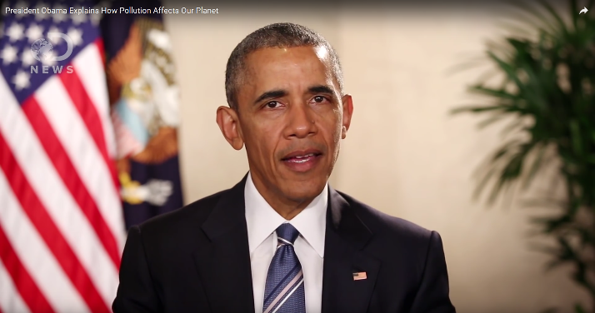
A Presidential Aura:
Obama Talks Pollution and Aura/OMI
April 12, 2016:
President Obama uses OMI NO₂ data to explain how pollution affects our planet:
https://www.youtube.com/watch?v=LKe5FdKInJs
On Apr 12, Dnews released a one minute video on YouTube of President Obama discussing how the Aura satellite and OMI data track global pollution trends and the state of the Earth’s atmosphere.
Obama noted that emissions of nitrogen dioxide have dropped in the U.S. and Europe over the last 25 years by up to 50% thanks to rules protecting the air.
Obama also highlighted how the satellite imagery helps see what actions are working and where additional international efforts are needed.
Notes:
. Dnews is a Discovery Channel initiative focused on unusual “mind-bending stories and perspectives.”

Slide 8

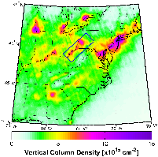
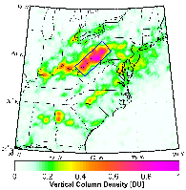
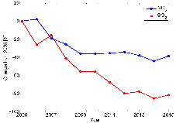
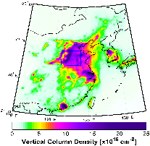
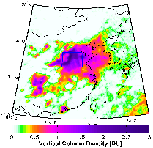
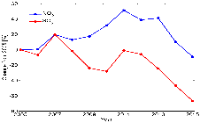
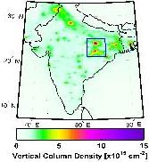
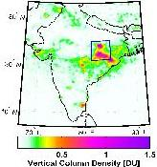
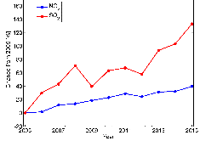
Complex Regional Trends (2005-2015) in NO₂ and SO₂ Pollution
Nick Krotkov, NASA-GSFCand many others
Nitrogen dioxide (NO₂), common pollutant from cars and power plants, and sulfur dioxide (SO₂) from coal-fired power plants.
Over US, NO₂ and SO₂ levels have decreased by 40% & 80%, thanks in large part to new air quality rules
Ohio River Valley and
SW Pennsylvania >>
NO₂
SO₂
NO₂
SO₂
NO₂ pollution over NE China has declined 50% since 2011 peak; now is same level as in 2005.
SO₂ pollution has declined by 80% since 2007 peak; now is 60% less than 2005.
North China Plain >>
Over NE India, where many new coal-fired power plants were built, NO₂ pollution increased by ~40%, while SO₂ pollution increased by 140%
NE India
NO₂
SO₂
Notes:
Ken Jucks

Slide 9


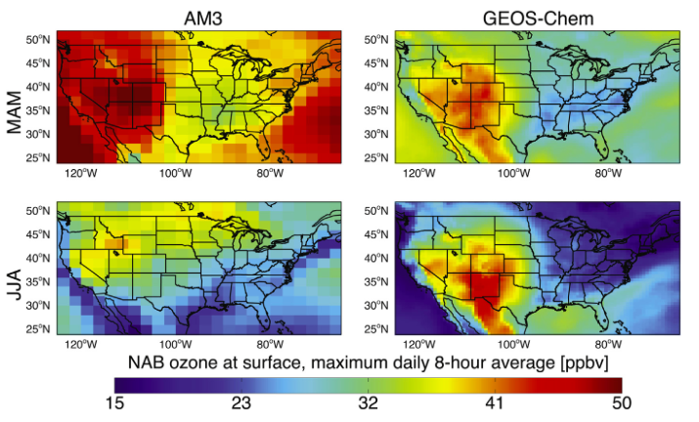




Air Quality Applied Sciences Team:
Quantifying ozone entering from outside the U.S.
In October 2015, EPA lowered the ozone “smog” standard from 75 ppb to 70 ppb.
Worked closely with EPA, Western States, and California districts to quantify how non-U.S. ozone affects air quality in Western U.S.
Work shows that model choice strongly affects background ozone estimate; work offers new insights and tools to policy community
Several AQAST members combined on
this work
Note: If EPA were to set the ozone standard too low and background ozone levels were high enough, then the standard might not be achievable by any means (regardless of technology or control strategies), because all the ozone would be coming from natural sources or sources outside the U.S.
|‌ 9
|‌ 9
Notes:
From an EPA perspective, background ozone comes from natural sources and any sources outside the U.S.
Background ozone is therefore any ozone that the U.S. could not control by regulating sources within its borders.
Background ozone is a greater concern in the West, where it comes from China (especially in spring) and Mexico, than in the East.
Some enters from Canada, which often affects the East and the Northern tier of states, especially in the plumes from forest fires.
EPA regulates ground level ozone concentrations by setting a standard governing the average ozone concentration over eight hours, which EPA recently tightened from 75 parts per billion (ppb) to 70 ppb. The concern is that EPA could lower the standard far enough as to be unachievable by any means. Some ground level ozone, especially in the western U.S., is natural or comes from sources outside the U.S. Therefore, EPA could make it nearly impossible to comply with an ozone standard if it sets the standard so low that ozone from the stratosphere, from foreign countries, or from natural breakdown of compounds in the atmosphere would push ozone concentrations over the standard no matter how strict the emissions controls were on sources within the U.S.
> In other words, if EPA were to set the ozone standard too low and background ozone levels were high enough, then the standard might not be achievable by any means (regardless of “control strategies” or technology), because all the ozone would be coming from natural sources or sources outside the U.S. (i.e., sources beyond the control of States and air districts)
Data analysis techniques have great difficulty in using measurements to determine background ozone. This study found that the choice of model greatly influences the level of background ozone calculated. Background ozone is calculated from models.
References (AQAST connections in bold):
Figure from: Fiore, A.M., J.T. Oberman, M.Y. Lin, L. Zhang, O.E. Clifton, D.J. Jacob, V. Naik, L.W. Horowitz, J.P. Pinto, G.P. Milly, Estimating North American background ozone in U.S. surface air with two independent global models: Variability, uncertainties and recommendations, Atmospheric Environment, 96, 284-300, 2014.
Speakers noted from the Transboundary Ozone Pollution Conference, co-sponsored by the San Joaquin Air Pollution Control District and AQAST (March 2014). AQAST members also have been active at the 2014 LADCO/CenSARA meeting (representing state air agencies across the Upper Midwest for LADCO and Great Plains and lower Midwest for CenSARA), the 2015 Western States Meeting, and will participate in the 2016 LADCO/CenSARA meeting
Selected recent references:
R. Fine, M.B Miller, J. Burley, D. Jaffe, R. B. Pierce, Meiyun Lin, M. S Gustin (2014): Variability and sources of surface ozone at rural sites in Nevada, USA: Results from two years of the Nevada Rural Ozone Initiative. Science of the Total Environment, doi:10.1016/j.scitotenv.2014.12.027.
Huang, M., K. W. Bowman, G. R. Carmichael, M. Lee, T. Chai, S. N. Spak, D. K. Henze, A. S. Darmenov, A. M. da Silva, Improved Western US Background Ozone Estimates via Constraining Non-local and Local Source Contributions using Aura TES and OMI Observations, J. Geophys. Res. Atmos., 120, 3572–3592. doi: 10.1002/2014JD022993.
Lapina, K., D. K. Henze, and J. B. Milford, Impacts of foreign, domestic and state-level emissions on ozone-induced vegetation loss in the U.S., ES&T, in press.
Lee, H.-M., F. Paulot, D. K. Henze, K. Travis, D. J. Jacob, L. H. Pardo, B. Schichtel, Sources of nitrogen deposition in Federal Class I areas in the US, Atmos. Chem. Phys. Discuss., 15, 23089-23130, doi:10.5194/acpd-15-23089-2015, 2015.
Lin, Meiyun, Arlene M. Fiore, Larry W. Horowitz, Andrew O. Langford, Samuel J. Oltmans, David Tarasick, and Harald E. Rieder (2015), Climate variability modulates western US ozone air quality in spring via deep stratospheric intrusions, Nature Communications, 6, 7105, 1-11, doi:10.1038/ncomms8105
Zhang, L., D. J. Jacob, X. Yue, N. V. Downey, D. A. Wood, and D. Blewitt, Sources contributing to background surface ozone in the US intermountain West, Atmos. Chem. Phys., 14, 5295-5309, 2014.

Slide 10
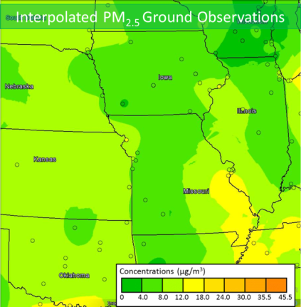
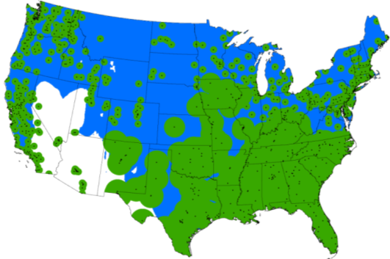
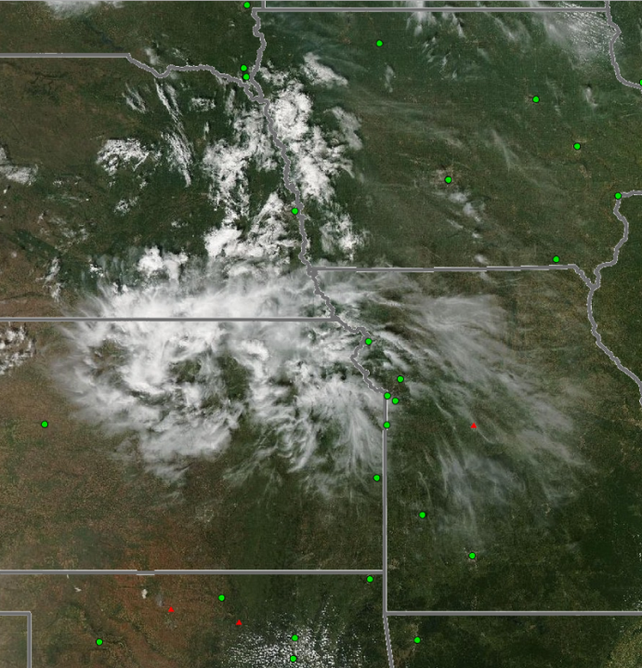
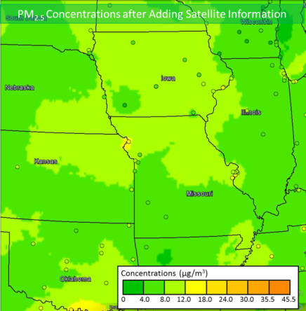

Improving Air Quality Maps with Satellite Data
PM2.5 FROM
GROUND-BASED DATA
GROUND-BASED + SATELLITE
COVERAGE OF AIR QUALITY
Northern Missouri fires
Sept. 4, 2013
SMOKE
MISSING
NE
IA
Green = ground-based PM_{2.5}
Blue = AirNow Satellite-based PM_{2.5}
White = no coverage
PM2.5 GROUND + SATELLITE DATA
SMOKE
KS
MO
SMOKE
INCLUDED
MODIS image
“This is the best tool I have seen so far that integrates satellite data with information from ground monitors.”
Cassie McMahon, Minnesota Pollution Control Agency
Notes:
First Column: If we estimated the concentration of particulate material (PM) from ground monitors (the small dots on the far left figure) the area of coverage would be limited only to the areas shaded green. The MODIS Satellite coverage, shown by the blue areas, helps to fill most of the gaps (but not all) –nearly half of the uncovered population (18.1 million) now have AQ information. Some of the white areas are because the surface albedo is so high that the MODIS retrievals are saddled with large uncertainties.
Second and Third Column: A case study showing the problem (the fire image) , the solution (PM2.5 from ground based data), and NASA’s contribution (PM2.5 from Ground + Satellite Data). In the nominal solution because the ground monitors in this region are very few, the interpolated PM2.5 data shows relatively good Air Quality (AQI of 0 – 4). The addition of satellite data shows that the Air Quality as a result of the Fires is poorer at AQI = 4-8.0; This shows a case where the satellite data has real value in producing an Air Quality Index that actually protects the public from harm by allowing them make decisions that protect their health and wellbeing. If the satellite data were not there, the would be no indication of this poorer air quality.
Yellow box : Testimonial from a user at the Minnesota pollution Control Agency
In the Missouri fires case (see http://www.youtube.com/watch?v=ycYp2-XtoxE) the addition of satellite data leads to identification of poorer air quality by including satellite observations of smoke in an otherwise unmonitored area of Northern Missouri.
Socioeconomic Benefits:
-- The current areas that are “unmonitored” with PM2.5 ground monitors represent 18 million people.
-- If one was to expand the ground monitor network to place a ground monitor in every city with more than 25,000 people in the unmonitored area, it would cost ~$26M (and probably take 5 years) but it would only cover 44% of people in the unmonitored areas.
-- On the other hand, the NASA satellite data can provide PM2.5 data to 82% of people in the unmonitored locations (~14.8M). Since the NASA satellite observations are free and open to EPA and State air quality managers, this capability represents a value of >$26M from a ~1.5M NASA ESD/Applied Sciences project investment.

Slide 11
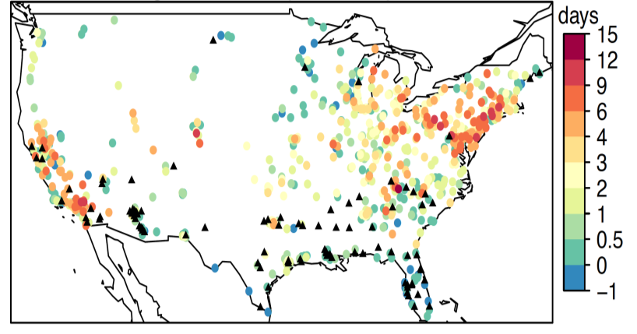
Predicting the frequency of U.S. ozone episodes in the warmer climate of the 2050s
Air Quality Applied Sciences Team
AQAST member Loretta J. Mickley quantified observed relationships between surface ozone and temperature and then applied these relationships to future temperature projections. This study used an ensemble of earth-system models and GEOS-Chem. Through its novel use of observations and large model ensemble, the results are much more robust than previous efforts.
Major findings:
Frequency of ozone episodes increases by 2 days per summer across the US by 2050s due to more frequent heatwaves.
Largest increases in ozone episodes occur in the East and California, as much as 4-9 days per summer.
Climate penalty on US air quality is significant, with consequences for human health.
Change in ozone episode days (> 75 ppb)
by 2050s (due to climate change)
Sites not included in statistical model.
|‌ 11
|‌ 11
Notes:
The NASA Air Quality Applied Sciences Team (AQAST) is a group of 19 members who, along with collaborators, engage with air quality management agencies to broaden the benefit of NASA science, tools, and data for healthy air (www.aqast.org; www.aqast-media.org).
AQAST Co-I Loretta Mickley investigated the effects of climate change on air quality.
Paper: Shen, L., L. J. Mickley and E. Gilleland, Impact of increasing heatwaves on U.S. ozone episodes in the 2050s: Results from a multi-model analysis using extreme value theory, Geophys. Res. Lett., 43, doi:10.1002/2016GL068432, 2016.
Sample media attention:
NBC News, “New study predicts an extra week of bad ozone every year,” http://www.nbcnews.com/health/health-news/new-study-predicts-extra-week-bad-ozone-every-year-n559871
The Nation, “Global leaders agree to set price on carbon pollution,” http://nation.com.pk/international/22-Apr-2016/global-leaders-agree-to-set-price-on-carbon-pollution
Caption for the figure: (as given in the GRL paper)
(a) Mean changes from 2000–2009 to 2050–2059 in ozone episode days due to climate change in the RCP4.5 scenario, as calculated using statistically downscaled projections of daily maximum temperatures from 19 CMIP5 models. (b) The standard deviation of the changes in ozone episode days across the 19 CMIP5 models at each site. The sites where the inclusion of T_{max} does not improve the EVT model for daily MDA8 ozone are denoted by black triangles.

Slide 12
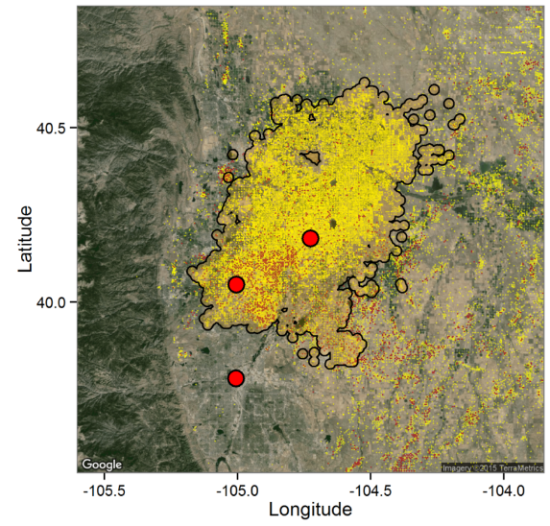
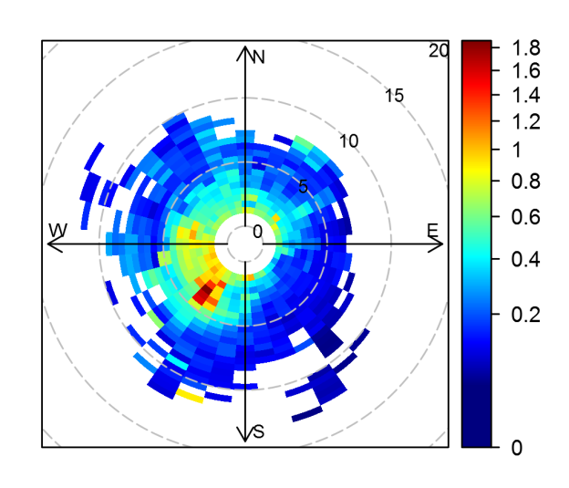


EPA & CO DPHE begin monitoring key air toxic site based on DISCOVER-AQ & AQAST data
Benzene is a toxic chemical, regulated by EPA. It is a byproduct of oil and gas exploration, chemical manufacturing, and cars and trucks.
GSFC & Penn State measured benzene for 3 weeks in July-Aug 2014 while the DISCOVER-AQ P-3 spiraled overhead
EPA “toxic” level for benzene was regularly exceeded, especially at night during flaring and a collapsed boundary layer.
Researchers pinpointed benzene source near fracking “waste pits”
on plot above/right.
EPA and Colorado Department of Public Health and Environment
will start monitoring at this site, based on NASA results.
See next slide for additional details/figure showing that benzene was frequently above toxic limits.
Gas Wells
Waste Pits
BAO
Platteville
Denver
Platteville Mean Benzene (ppbv)
|‌ 12
|‌ 12
Notes:
Reference: H. S. Halliday, A. M. Thompson, A. Wisthaler, D. R. Blake, R. S. Hornbrook, M. Müller, T. Mikoviny,
E. C. Apel, A. J. Hills. Atmospheric benzene observations from a heavily developed oil and gas field in
the Denver Julesburg basin, J. Geophys. Res., doi: 10.1002/2016JD02534729, 2016. (Published, 20 Sept.)
Data Sources: All Data are provided by the NASA Earth Venture DISCOVER-AQ (Deriving Information on Surface Conditions from COlumn and VERtically Resolved Observations Relevant to Air Quality) campaign that consisted of four deployments in prototypically polluted locations: Maryland (2011), San Joaquin Valley & Houston (2013), Denver-Julesburg Basin (2014). All participants and instrumentation are described at the website: discover-aq.larc.nasa.gov. For the July-August 2014 Colorado campaign, besides the Penn State NATIVE & U. Oslo trailers, hydrocarbons were measured by a PT-RMS on the NASA P-3 and by the NCAR C-130 as part of the FRAPPE campaign. Platteville and P-3 hydrocarbons matched perfectly. Canisters from U. Cal-Irvine at Platteville also helped fingerprint the Oil & Gas benzene source, ie there were high pentanes from oil and gas.
Technical Description of Figures:
Upper Figure: On upper plot, each yellow dot is a drill/well site in the “Denver-Julesburg” Oil and Gas Fields. Red dots are waste pits.
Lower Figure: The figure combines the benzene concentrations in ppbv with wind direction of the sampled air. Wind was measured with an instrument on the Penn State NATIVE trailer. The SW segment dominates. Because BAO 25 km SW of Platteville recorded high benzene to the NW, it appears that the source of this benzene was about halfway between the two sampling sites.
Scientific significance, societal relevance, and relationships to future missions: Benzene is a toxic chemical that is a byproduct of oil and gas exploration, chemical manufacture and cars and trucks. The high levels we measured got the notice of EPA and Colorado Dept of Public Health and Environment who had to file reports and who now – thanks to NASA – will start monitoring unhealthy hydrocarbons (“VOC”) at Platteville themselves!
National Institute for Occupational Safety and Health (NIOSH) has recommended exposure limit (REL) for benzene: 0.1 ppm for 10 hours.
61 ppm: odor can be detected by most people
50 ppm for 1 hour: transient neurological effects expected.
4000 ppm for 1 hour: lethal.
EPA Source: https://oaspub.epa.gov/eims/eimscomm.getfile?p_download_id=512648

Slide 13
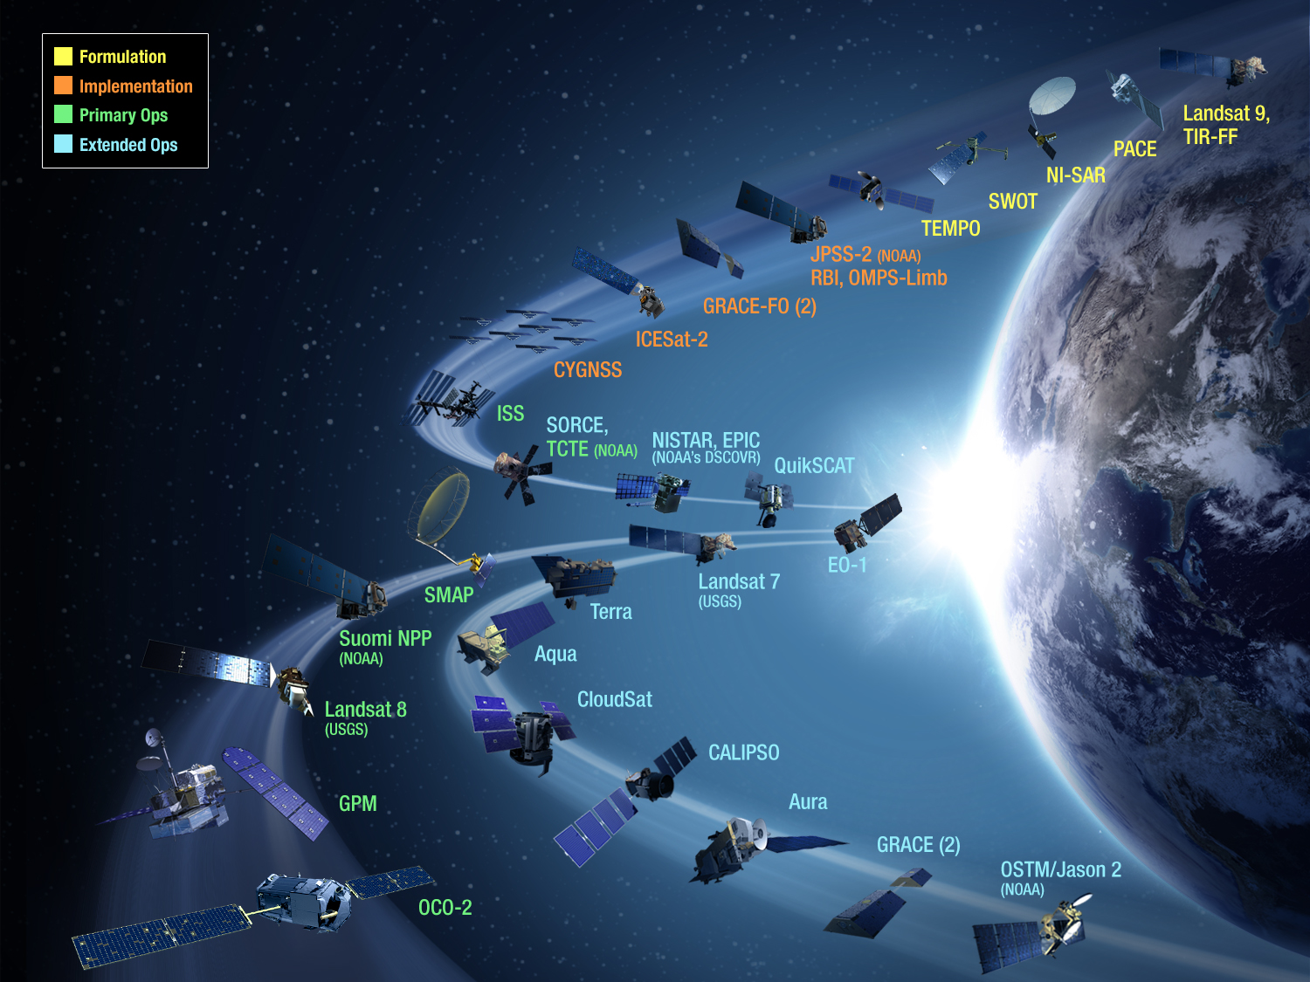
NASA Earth Science:
Current and Upcoming Missions

Slide 14
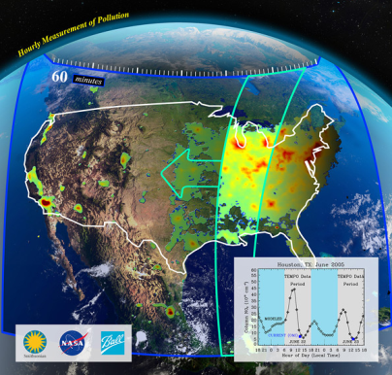
Earth Venture Instrument-1:
Tropospheric Emissions: Monitoring of Pollution (TEMPO)
TEMPO is a pathfinder to using hosted commercial payloads from GEO
Tropospheric pollution observations from Geostationary Orbit
  Ozone, NO₂, and CH₂O.
Forms a global Air Quality constellation in GEO with EU Sentinel 4 and Korean GEMS.
EPA and NOAA are part of the science team.
Instrument delivery in 2017; Launch NLT 2021
PI: Kelly Chance, Smithsonian Astrophysical Observatory
PE: Betsy Edwards; PS: Barry Lefer
Instrument Development: Ball Aerospace
Project Management: LaRC
RY$: 93.2M
Orbit requirements: Geostationary Orbit. Hosted on a commercial communication satellite

Slide 15
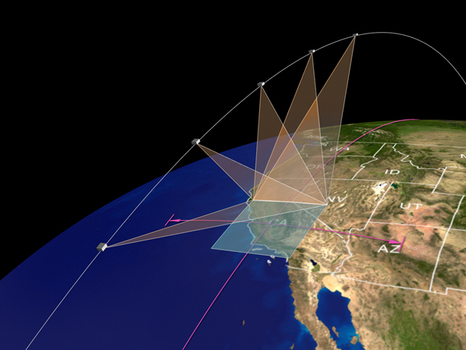
Earth Venture Instrument -3:
Multi-Angle Imager for Aerosols (MAIA)
Selection announced in March 2016
PI: David Diner (JPL); PE: Betsy Edwards
Instrument: Two pushbroom spectropolarimetric cameras (Class C)
Delivery Date: TBD
Stage: Formulation (A)
MAIA uses a twin-camera instrument that will make radiometric and polarimetric measurements needed to characterize the sizes, compositions and quantities of particulate matter in air pollution. As part of the MAIA investigation, researchers will combine MAIA measurements with population health records to better understand the connections between aerosol pollutants and health problems such as adverse birth outcomes, cardiovascular and respiratory diseases and premature deaths.

Slide 16



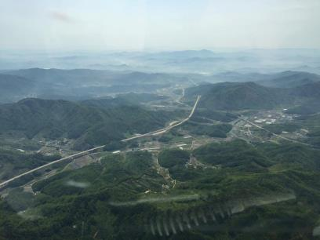


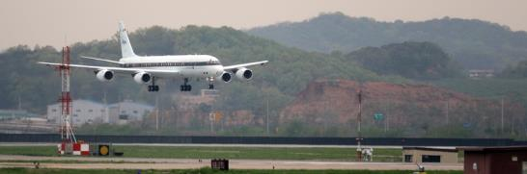
Korean US – Air Quality Field Campaign
April 26, 2016 – June 15, 2016
KORUS-AQ Campaign
Investigate air quality over Korea and the adjacent ocean.
Combines observations from aircraft, satellites, ships and ground stations with air quality models to assess and monitor air quality across urban, rural and coastal areas. Looking at ozone, isoprene, HCHO, SOA, others.
Campaign supports joint efforts on geostationary atmospheric satellite observations (TEMPO, GEMS)
Aircraft:
NASA AFRC DC-8
LaRC UC-12B
Hanseo University B200
Based at Osan Air Base, ROK
May 19: Barry Lefer met Mayor of Seoul to discuss campaign’s preliminary findings and GEMS / TEMPO satellites
12 flights to date,
6 more planned
Notes:
First few weeks of flights monitored mostly emissions transport from China.
Then, high-pressure system set up
Stagnant air
Local emissions/pollution
Seoul 26M people (4th largest city in world)
45% are diesel
Haze is
April – Gobi desert yellow dust plus Beijing and Shanghai
Then, May & June are local sources
One fligiht analyzed five different power plant plumes
Howe did chemistry change as it aged
Off coast of shanghai – fingerprints of the city
Flying through a frontal system – satellites don’t see in clouds, so we want to see what we’re missing
KORUS-AQ is part of the US/Korea/European Tempo/GEMS/Sential 4 pre-cursors
KORUS-OC is coming next (GEO-TAZO)
Koreans have a king air – HCHO
Somewhat it’s the US it teaching them to fly – they used fly at 5K feet (constant pressure altitude) – but mayu have been flying above the boundary layer so not measuring what people are actually breathing
Able to fly on weekends to get point source characterizations
0-3Kfeet may have been available
First science flight had poor coordination – Koreans didn’t show up to the Science planning meeting. First science flights had planes on same track (one north and one south) – the DC-8 moved out of the way. Theyre’ all VFR there.
Koreans showed up to the next science meeting.
Despite months of planning
Never done anything like this – so it’s a fomr of capacity building
Results:
PM10 is a key focus
Korea wants to blame all their pollution
Met with mayor of Seoul – he was asking all about PM10 (which doesn’t have the health effects)
Barry indicated that Seoul’s issue is O3 and PM2.5
Found high levels of toulouene – really good at producing O3 and SOA
The observations found high levels of touluouene
Per capita, they make the most toulouene

Slide 17
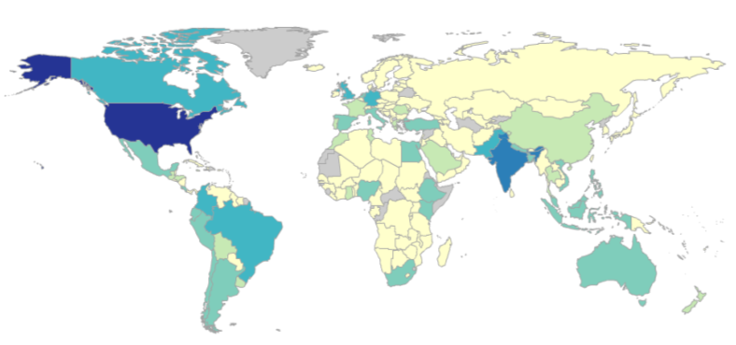
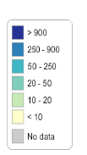
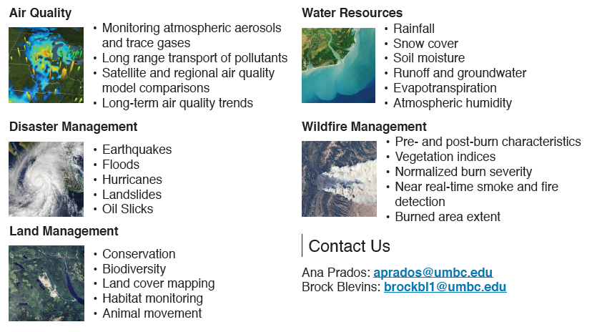
ARSET: Applied
Remote Sensing Training
http://arset.gsfc.nasa.gov
Increase utilization of Earth obs. and models for decision-support through training activities for professionals.
Topics:
Water, disasters, air quality, wildfires, land management, conservation, GPM, snow, drought, NASA data products and portals, and special topics. Health coming in 2016.
Online courses: Live and recorded,
4-6 weeks in length.
In-person training courses:
In a computer lab, 2- 4 days in length.
Train the Trainers: Courses and
training manuals for organizations interested in conducting their own
remote sensing training.
  Impact: Number of Participants by country
  2009 – 2016
Notes:
In 2015, ARSET trained more participants in a single year than ever before – and more participants than in all previous years combined. (2009 was first year of ARSET)
ARSET reached 34 new countries, and a total of 123 countries
Reached participants in all 50 states, as well as D.C. and Puerto Rico, in one year for the first time. (Never before reached state: Hawai’i)
Training Themes include:
Air Quality
Water Resources
Disasters (e.g., flooding)
Ecological Forecasting
Wildfires
NASA Data Products, Portals, Tools
Health (new in 2016)
Specials: Land Management, Drought, Conservation, Snow Products, GPM, …

Slide 18
NASA ARSET Training on Air Quality SDGs
Webinar Series (March 2017):
Satellite Derived Annual PM_{2.5} Data Sets in Support of the United Nations Sustainable Development Goals
Goal 3 – Good Health and Well Being
  Target 3.9; Indicator 3.9.1
    Mortality rate attributed to household and ambient air pollution (mean annual levels of air pollution level (PM_{2.5})
Goal 11 – Sustainable Cities and Communities
  Target 11.6; Indicator 11.6.2
    Annual mean levels of fine particulate matter (e.g. PM_{2.5} and PM₁₀) in cities (population weighted)

Slide 19
Three-Week Webinar Series (Draft Agenda)
Week 1 | Sustainable Development Goals (SDGs) and Air Quality Relevant Satellite Observations
Objectives: | Learn about the SDGs (goals, targets, and indicators) and the satellite data used to calculate air quality indicators 11.6.2 and 3.9.1 How satellite observations can fill data gaps Methodology and applications
Week 2 | World Health Organization (WHO) PM_{2.5} Data Set
Objectives: | Learn about the 2014 PM_{2.5} estimates, created with satellite, surface, and model output data, released by the WHO for indicators 11.6.2 and 3.9.1 Methodology Limitations Data Access
Week 3 | Case Study Analysis
Objectives: | Use the 2014 WHO data set to access indicator data for a city/country Read/Convert the data for a region of interest Complete mapping exercises Analyze differences in spatial patterns by country Apply the concepts learned to generate a time series, once more data becomes available

Slide 20



Work Programme
Purpose
Airnow International: Expanding Networks and Integrating Methods for Air Quality and Health Data (Community Activity)
Copernicus Atmospheric Monitoring Service (CAMS) (Community Activity)
Harmful Algal Bloom (HAB) Early Warning System (Community Activity)
Global Observation System for Persistent Organic Pollutants (GOS4POPS) (Initiative)
Global Observation System for Mercury (GOS4M) (Flagship)
Integrated Information Systems for Health (vector-borne and water-related diseases) (Anticipated activity)
The GEO Health CoP provides a platform for public health, medical, air quality, and other interested communities to support GEO Health Tasks.

Slide 21
UPCOMING EVENTS
Planning an in-person meeting in 2017 with members in conjunction with a larger health event to ensure greater attendance and minimize travel costs.
Launch newly designed website for communication and engagement with members and the greater community.
RECENT EVENTS
Hosted membership-wide telecon to discuss 2017-2018 GEO Work Plan, the 2016 GEO Plenary in November, and on-going regional or global health activities/plans.
Updated Members email listserve for renewed communications.

Slide 22
GEO-XIII Side Event:
Air Quality, Earth Observations, and Health
Back-up Materials

Slide 23
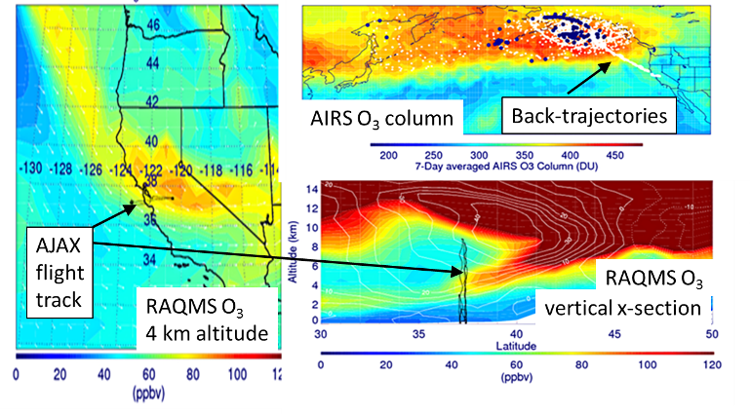
Wyoming Exceptional Event Demonstration
Wyoming DEQ/AQD used RAQMS ozone analyses utilizing Aqua/AIRS data to issue an exceptional event demonstration package to the EPA for an ozone exceedance at Thunder Basin, June 6, 2012. This ozone stratospheric intrusion event was documented by the NASA AJAX flight campaign. EPA accepted in Summer 2014!
R.B. Pierce et al.
Notes:
This summer, the State of Wyoming Department of Environmental Quality/Air Quality Division submitted a document entitled, “Exceptional Event Demonstration Package for the Environmental Protection Agency -- Thunder Basin, Wyoming Ozone Standard Exceedance -- June 6, 2012,” to the US Environmental Protection Agency (US EPA) to demonstrate that surface ozone exceedances were due to an exceptional event associated with a stratospheric intrusion (SI). According to the US EPA, exceptional events are unusual or naturally occurring events that can affect air quality but are not reasonably controllable using techniques that tribal, state or local air agencies may implement in order to attain and maintain the National Ambient Air Quality Standards. AQAST members worked with Wyoming to provide substantiating data. In the exceptional event demonstration package, results from the Real-time Air Quality Modeling System (RAQMS) ozone analyses (utilizing AIRS O3 column measurements) were used to determine the genesis of a stratospheric intrusion (SI) event observed by the NASA Ames Alpha Jet Atmospheric eXperiment (AJAX) over California on June 5, 2012, that led to surface ozone exceedances on June 6, 2012, at the Thunder Basin ozone monitor in NE Wyoming. A final determination by the EPA is pending.

Slide 24

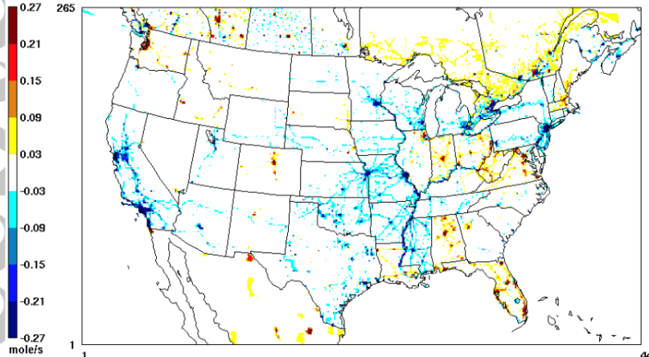

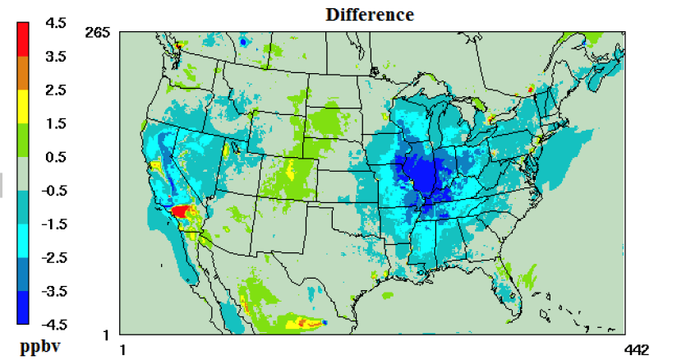
OMI Data Shows 2008 Recession and
Impacts on Air Quality
NO_{x} Emissions Change
New study (October 2016 in GRL) quantifies the impact of the 2008 recession on 2011 air quality
OMI NO₂ data characterized changes in NO_{x} emissions relative to a “business as usual” case (difference shown top right).
These NO_{x} changes led to widespread reductions in ozone (difference shown bottom right)
Study highlights the value of near-real-time satellite data to understand the air quality impacts of socio-economic events
HAQAST member Daniel Tong led the study, along with
AQAST-member Pius Lee (NOAA) and a collaborating team
Ground Level Ozone Change
|‌ 24
|‌ 24
Notes:
Key Points:
1) The 2008 economic recession significantly affected air quality over the United States.
2) It is feasible to combine computer models and ground/space observations to quantify the air quality effect of economic recessions.
3) Timely updates of emission inventories become increasingly important during major socio-economic events for air quality management.
Title: Impact of the 2008 Global Recession on air quality over the United States: Implications for surface ozone levels from changes in NOx emissions
Authors: Daniel Tong1,2,3, Li Pan2,3, Weiwei Chen3, Lok Lamsal4,5, Pius Lee3, Youhua Tang2,3, Hyuncheol Kim2,3, Shobha Kondragunta6, and Ivanka Stajner7
Pius Lee was an AQAST member
http://onlinelibrary.wiley.com/doi/10.1002/2016GL069885/full

Slide 25


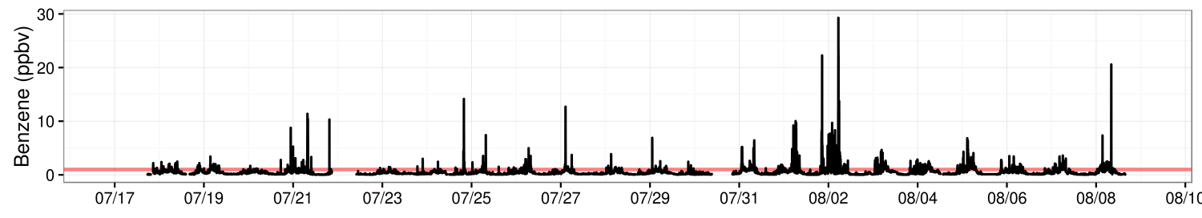
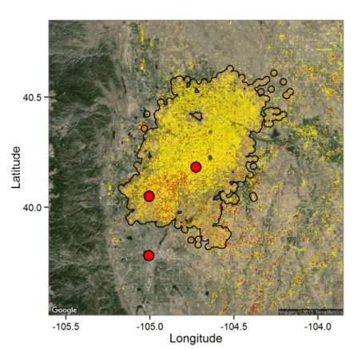


Toxic Benzene Levels & Source Fingerprinting During DISCOVER-AQ
Anne Thompson (GSFC), Hannah Halliday (Penn State), Armin Wisthaler (U. Oslo)
Full Campaign Benzene Time Series at Platteville
Highest concentrations at night:
Shallow boundary layer
This slides goes with the previous one on DISCOVER-AQ and AQAST
Note:
There are several different exposure limits for Benzene, all in the 0-5 ppm range (except for very short term exposures).
0.5 ppm is listed as an OSHA limit for 8 hour occupational exposure; NIOSH recommends an exposure limit of no more than 0.1 ppm for 10 hours.
As the top figure shows, the levels are well above the limits
Red Line = EPA Toxic Limit
PAO Mean Benzene (ppbv)
Gas Wells
Waste Pits
Black outline = Denver-Julesburg
Oil-Gas Basin
BAO
Platteville
Denver
Benzene
Source
At Platteville Atmospheric Observatory, in Oil & Gas fields, GSFC & Penn State operated the U. Oslo PT-RMS to measure benzene for 3 weeks in July-Aug 2014 (UPPER) while the DISCOVER-AQ P-3 spiraled overhead 3x/day. Horizontal “toxic” line is exceeded most at night during flaring & a collapsed boundary layer. Data from NOAA’s Boulder Tower (BAO), with winds at Platteville (SW maximum, red arrow in LOWER LEFT) pinpoint benzene source between PAO and BAO (LOWER RIGHT) where tiny red dots mark fracking “waste pits.” Each yellow dot is a drill/well site in the “Denver-Julesburg” Oil and Gas Fields.
Notes:
Anne M. Thompson, NASA/GSFC, Code 610
E-mail: anne.m.thompson@nasa.gov
Phone: 301-614-5905
Reference: H. S. Halliday, A. M. Thompson, A. Wisthaler, D. R. Blake, R. S. Hornbrook, M. Müller, T. Mikoviny,
E. C. Apel, A. J. Hills. Atmospheric benzene observations from a heavily developed oil and gas field in
the Denver Julesburg basin, J. Geophys. Res., doi: 10.1002/2016JD02534729, 2016. (Published, 20 Sept.)
Data Sources: All Data are provided by the NASA Earth Venture DISCOVER-AQ (Deriving Information on Surface Conditions from COlumn and VERtically Resolved Observations Relevant to Air Quality) campaign that consisted of four deployments in prototypically polluted locations: Maryland (2011), San Joaquin Valley & Houston (2013), Denver-Julesburg Basin (2014). All participants and instrumentation are described at the website: discover-aq.larc.nasa.gov. For the July-August 2014 Colorado campaign, besides the Penn State NATIVE & U. Oslo trailers, hydrocarbons were measured by a PT-RMS on the NASA P-3 and by the NCAR C-130 as part of the FRAPPE campaign. Platteville and P-3 hydrocarbons matched perfectly. Canisters from U. Cal-Irvine at Platteville also helped fingerprint the Oil & Gas benzene source, ie there were high pentanes from oil and gas.
Technical Description of Figures:
Upper Figure: Time-series of benzene from the U. Oslo PT-RMS at the Platteville Atmospheric Observatory where GSFC and Penn State measured other pollutants continuously: ozone, NO/NOy, CO, SO2 and launched ozonesondes for boundary layer height. There is no “safe” level of benzene so 1 ppbv (part-per-billion) is the red line. Benzene at night often exceeded 10 ppbv.
Lower Figures: The figure on the left combines the benzene concentrations in ppbv with wind direction of the sampled air. Wind was measured with an instrument on the Penn State NATIVE trailer. The SW segment dominates. Because BAO 25 km SW of Platteville recorded high benzene to the NW, it appears that the source of this benzene was about halfway between the two sampling sites.
Scientific significance, societal relevance, and relationships to future missions: Benzene is a toxic chemical that is a byproduct of oil and gas exploration, chemical manufacture and cars and trucks. The high levels we measured got the notice of EPA and Colorado Dept of Public Health and Environment who had to file reports and who now – thanks to NASA – will start monitoring unhealthy hydrocarbons (“VOC”) at Platteville themselves!

Slide 26
ROSES 2015 A.46 Selections
Announced July 2016
Health and Air Quality Applied Sciences Team (HAQAST)
First meeting on November 3-4 at Emory U. in Atlanta, GA

