Slide 1
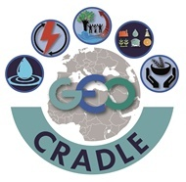
Fostering regional cooperation and roadmap for GEO and Copernicus implementation in N. Africa, Middle East, and the Balkans The Regional Data Hub Haris KONTOES, Research Director, National Observatory of Athens, Project Coordinator GEO-XIII Plenary, 7-10 November 2016, St. Petersburg, Russian Federation
Funded under H2020 - Climate action, environment, resource efficiency and raw materials
ACTIVITY: Developing Comprehensive and Sustained Global Environmental Observation and Information Systems
CALL IDENTIFIER: H2020 SC5-18b-2015 Integrating North African, Middle East and Balkan Earth Observation capacities in GEOSS
Project GA number: 690133
Total Budget: 2,910,800.00 €

Slide 2
GEO-CRADLE
… is a unique EU funded Coordination Action running at regional level,
… is looking at the N. Africa, Middle East, and the Balkan territories;
It seeks to identify common needs, create synergies, and integrate capacities,
Fosters the regional cooperation and integration of monitoring capabilities and networks, and scientific skills
Proposes/sets up large scale regional initiatives based on the Earth Observation (space based and in-situ) for addressing societal priorities in different thematic aspects such as Adaptation to Climate Change, Access to Raw Materials, better exploitation of the renewable Energy resources, and Food Security
Objectives
Promote the uptake of EO services and data in response to regional needs
Support the effective integration of existing Earth Observation Capacities in the region
Facilitate the engagement of the complete ecosystem of EO stakeholders in the region
Enhance the participation in and contribution to the implementation of GEOSS and Copernicus in North Africa, Middle East and the Balkans
Objectives

Slide 3
Thematic Areas
Adaptation to Climate Change (ACC)
Improved Food Security – Water Extremes Management (IFS)
Access to Raw Materials (ARM)
Access to Energy (SENSE)

Slide 4
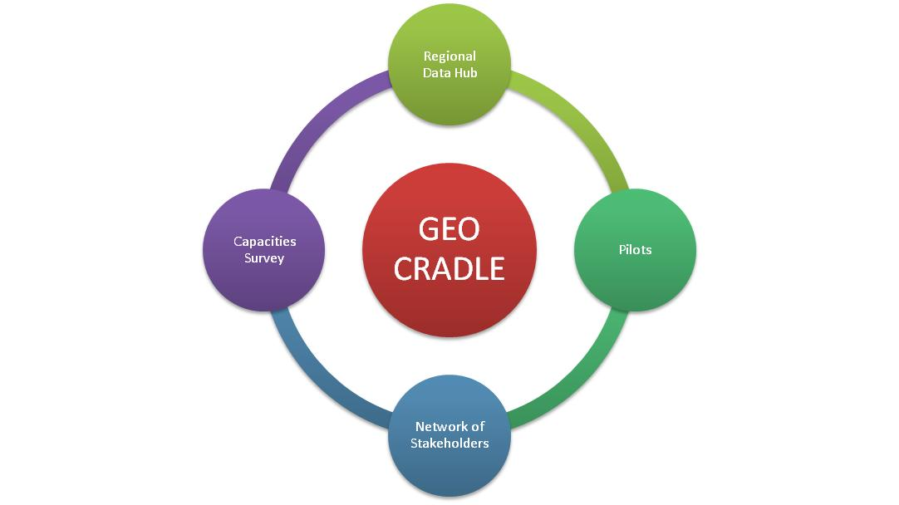
The Project Pillars
Notes:
The project is underpin on four pillars. Everything we do is based upon the integrated and coordinated use of the existing capacities at regional level, either observation or research, data processing, and human capacities. The project builds for the first time the so called GEO-CRADLE network of stakeholder that is a forum facilitating the know how exchange and the team up process at regional level. GEO-CRADLE assesses through feasibility pilot studies the maturity of the regions to run larger scale projects that meet local common needs, and makes suggestions for the initiation of such projects and initiatives. Last but not least it creates the so called RDH for which I ‘ m going to speak from this point and on.

Slide 5
The Concept of Regional Data Hub (RDH)
“one-stop-shop” for RoI specific data/information/knowledge access for EO players, service providers, and end users.
Data Portals, Databases and Links to be mapped or linked to the RDH
All data sources are collected from the inputs of the Stakeholders at the GEO-CRADLE survey and desk research

Slide 6
Requirements for the Data Sources
“one-stop-shop” for RoI specific data/information/knowledge access for EO players, service providers, and end users.
The Data Portals need to fulfil two requirements in order to be mapped or linked to the Regional Data Hub:
the quantity of the data and metadata that are relevant to both the geographic extent of the RoI and the Thematic Areas of the GEO-CRADLE Project.
the quality of the data and the metadata regarding both the compatibility of the data to the GEOSS APIs and GCI, and the existence of corresponding metadata.

Slide 7
Number of identified portals per Thematic Area and RoI
a/a | Adaptation to Climate Change | Improved Food Security & Water Extremes Management | Access to Raw Materials | Access to Energy | Total Number of Portals per RoI (unique)
North Africa | 0 | 1 | 1 | 0 | 2
Middle East | 5 | 3 | 2 | 4 | 6
Balkans | 8 | 8 | 3 | 5 | 14
Total Number of Portals per Thematic Area | 13 | 12 | 5 | 9
Key Findings
In ME there are countries with no evidence at all of any open data activity, and some other countries that have created limited sections of open data in stand by mode
In NA open data concepts remains limited; data are focused on statistics; the data format is not facilitating the data reuse; there is a need for generating new data using open standards; lack of funds for developing the technical/ connectivity infrastructures
In BA there is a diversity in cultures and infrastructures; there are numerous portals with open and free data; others publish data only for viewing using the mother tongue

Slide 8
Portals/datasets developed/operated by the Stakeholders
a/a | Institute | Country | Link | Data Policy | Data Type | Thematic Area | Information
1. | National institute of R&D for opt/el | ROMANIA | RADO | Free | .jpg | Climate | Meteo/Climatic, Atmospheric Profiling
2. | World Radiation Center | SWITZERLAND | EBAS | Free for non-commercial & scientific use. | .nas (NASA-Ames) | Climate, Energy | Atmospheric Profiling
3. | Public Power Corporation | GREECE | Hydroscope | License restricted, fee applies. | .hts files of timeseries. | Energy | Meteo/Climatic, Hydrometric/ Water Quality
4. | Center of Satellite Communication & Remote Sensing | TURKEY | Tarbil | View-only. Authentication required | Maps with data/metadata | Climate, Food | Meteo/Climatic
5. | National Observatory of Athens | GREECE | Sentinel Mirror Site | Free and Open | Sentinel 1: SAR data, Sentinel 2: optical data | Climate, Food, Energy | Space-borne
6. | The Cyprus Institute | CYPRUS | Geological Survey | Free and License Restricted | Unknown | Climate, Food, Energy | Meteo/Climatic
7. | Ministry of Labour, Welfare & Social Ins | CYPRUS | Air Quality | View-Only | graphs in .png format | Climate | Meteo/Climatic
8. | TÜBİTAK UZAY | TURKEY | Gezgin | Restricted | Unknown | Food, Climate | Unknown
9. | Faculty of Physics, Uni of Belgrade | SERBIA | HyMeX | Authentication required | models | Climate | Geospatial data

Slide 9
Portals/links returned from inventorying and desk research
a/a | Country | Portals/Sites | Data Policy | Data Type | Thematic Area | Information
1. | CYPRUS | Geological Survey | Free and License Restricted | KML,JSON,CSV etc | Climate, Raw Materials, Food, Energy | Atmospheric, Climatic, Geospatial data etc.
2. | POLAND | Central geological Db | Free and open | .shp | Raw materials, Food | Geological data, metadata
3. | FYROM | Soil information system | Only view | maps | Raw Materials, Food | Land, Soils, pH, Hill shades
4. | ISRAEL | Meteorological services ltd | Restricted - needs authentication to view and download data |  | Climate, Food, Energy | Meteo, Soil, Rain etc.
5. | REP of SRPSKA | GEOportal | Partially free for view Partially Restricted - needs authentication to view maps |  | Food | E-cadastre, network of GPS /GNSS stations
6. | ALBANIA | GEOportal | Only view | maps | Food, Raw materials, Energy | Land use, Mineral and Energy resources etc.
7. | KOSOVO | GEOportal | Only view | maps | Food | Geospatial data, Orthoimagery
8. | BOSNIA & HERZ | GEOportal | - | WMS, WFS, WCS | Food, Raw materials | Geospatial data, Orthoimagery
9. | MONTENEGRO | GEOportal | Only view | maps | Food | Geospatial data
10. | CROATIA | GEOportal | Only view | Maps, network | Climate, Food, Raw materials, Energy | Geospatial data, Orthoimagery, Soil, Minerals, Energy.
11. | SLOVENIA | Portal | Inspire Metadata system | metadata | Climate, Food | Geospatial data, Orthoimagery

Slide 10
Portals/links returned from inventorying and desk research
a/a | Country | Portals/Sites | Data Policy | Data Type | Thematic Area | Information
12. | ROMANIA | a. ACASA by NIEP b. EIDA data & services provided by National Institute of Earth Physics | In Romanian In Romanian | - | Climate, Food | Geospatial data
13. | SERBIA | a. GIS - JP "Vojvodinašume“ Company b. Geodetic Authority c. Geological Information System (Ministry) d. GEOportal | View only View only In Sebian, Free and open In Serbian, View only maps and metadata for download in pdf files | maps maps xml, json | Climate, Food, Raw materials, Energy | Geospatial data, Orthoimagery, Climatological data, Hydrological data, etc
14. | MOROCCO | CGMS | In French. Authentication needed to access maps | - | Climate, Food | Geospatial data
15. | North Africa Countries | ISRIC - World Soil Information | Minimum charge - COFUR principles | wms | Climate, Food | Soil, Geological data
16. | Mediterranean Countries | Mediterranean Db-HyMeX Db | Authentication Required | - | Climate, Food, Raw materials | Atmospheric data, Geological data, Geospatial data, Hydrological data etc.

Slide 11
First Mockups of the Regional Data Hub

Slide 12
First Mockups of the Regional Data Hub cont’d
Notes:
To access and query the data, the user has to select first the thematic priority area. So, all the inserted data, and links to existing portals will be first classified and grouped according to the thematic area they belong. They will be also mapped using a list of keywords (that are used as additional filters in the data querying process) that are representative to the information content of the data, such as meteo, atmospheric parameters, water quality, geodetical/geodesy, satellite images, etc.

Slide 13
First Mockups of the Regional Data Hub cont’d
Notes:
Once the user is entered into the thematic area tab, he will be able to navigate through all the Data Base records, or submit queries by defining the geographic criteria, and/or adding several filters as previously mentioned, and / or using some search about criteria.

Slide 14
High Level Architecture of Regional Data Hub

Slide 15
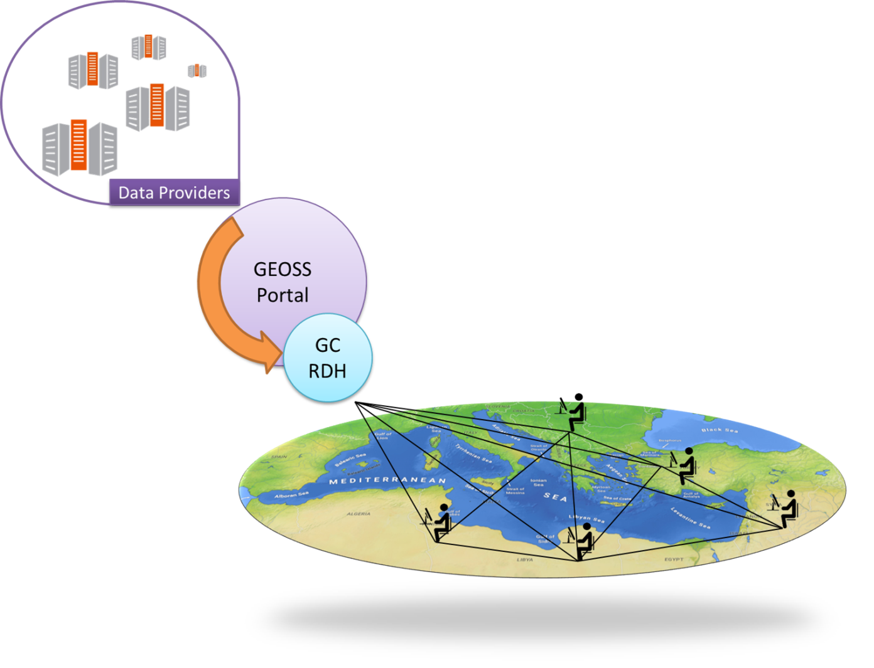
Regional Data Hub – Connection with GEOSS Portal
GEO CRADLE Regional Data Hub (GC-RDH) is going to provide its users with a transparent discovery and access mechanism of the GEOSS portal’s resources!
This mechanism will heavily rely on the GEO Discovery and Access Broker ( DAB ) APIs which is a middleware component in charge of interconnecting the heterogeneous and distributed capacities contributing to GEOSS; part of the GEOSS Common Infrastructure (GCI) since November 2011.

Slide 16
Regional Data Hub – Connection with GEOSS Portal (a deeper insight)
Building Blocks
GEO DAB APIs
DKAN software
Objectives
Enable machine -to-machine communication with GEOSS portal (GEO DAB APIs)
Provide user friendly UI to the GC RDH user for discovering and accessing GEOSS resources in transparent mode (DKAN).
Workflow
User searches for resources.
GC RDH forwards user request to GEO DAB using the GEO DAB APIs. Three GEO DAB APIs are going to be utilized (DAB JavaScript, DAB REST and CKAN when it is released
Fetch GEOSS resources through the Data Mapper module of GC RDH in order to properly convert them on the fly in the DKAN schema.
Display results in the GC RDH UI as implemented in the DKAN infrastructure.

Slide 17
Why DKAN?
DKAN was identified by U.S. Project Open Data as a “ready-to-use” tool.
DKAN offers:
A powerful administration panel.
A fully customizable page layout.
An extraordinary faceted search engine and UI that allows the users to make the optimal discovery of resources.
A highly modular architecture that can be easily extended by everyone with modules that support missing functionalities.
APIs enabling machine to machine communication.
Moreover DKAN:
Is open source.
Is built upon PHP, Drupal and CKAN. PHP powers a significant percentage of web pages and Drupal powers an estimated 2% of the Internet as a whole.
Has an active and wide community of users and developers.

Slide 18
Why GEOSS Portal?
One of the main objectives of GEO-CRADLE; to showcase the added value of applications built upon GEO DAB APIs
Plethora of resources: 140 brokered sources, 70.441.318 GEOSS Data Core elements (source http://www.geodab.net/blank)
High degree of interoperability: supports several service interfaces (e.g. OpenSearch, OAI-PMH, OGC WPS, etc.)
Provides a big data challenge

Slide 19
شكرا

