Slide 1
Experience in geomagnetic data processing on the territory of Russian Federation
A. Rybkina
Geophysical Center of the Russian Academy of Sciences (Moscow, Russia)

Slide 2
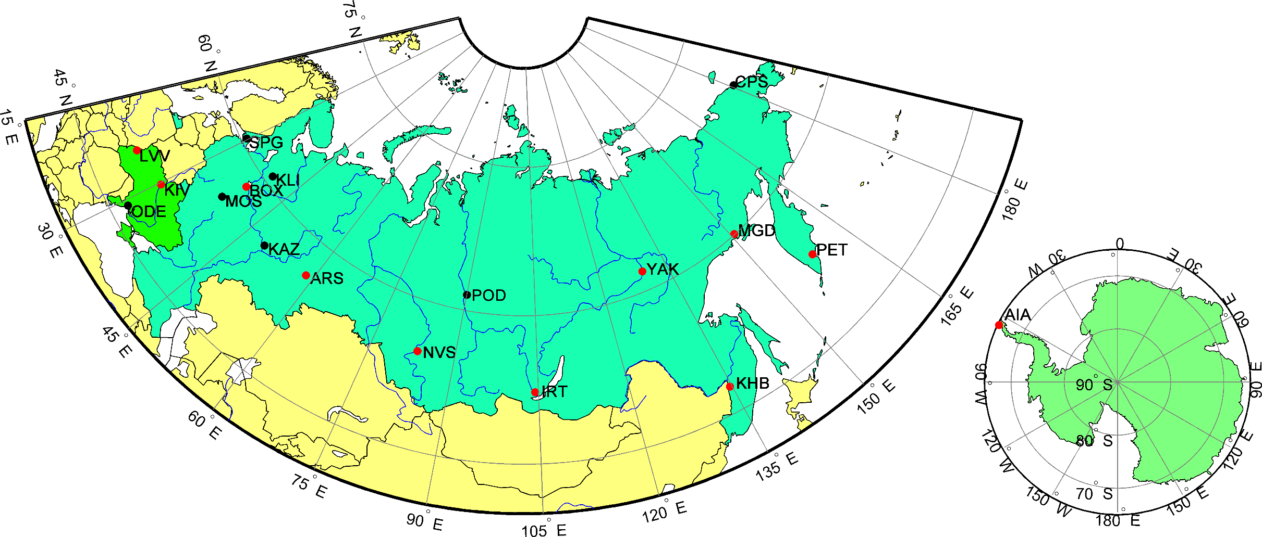
Russian-Ukrainian Geomagnetic Data Center
11 INTERMAGNET observatories
7 developing observatories
Geomagnetic
Data Center,
GC RAS (Moscow)
2
Notes:
2

Slide 3
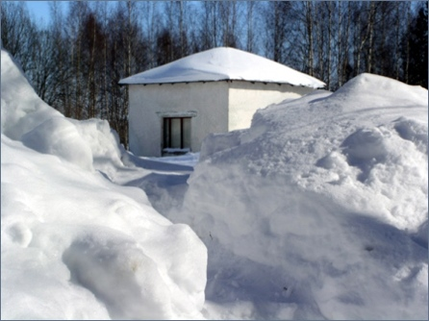
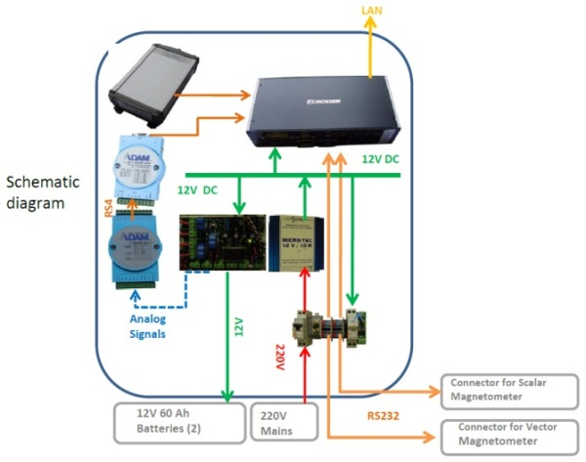
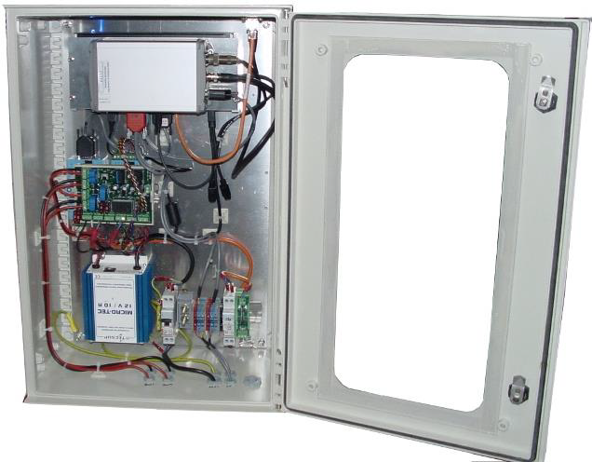
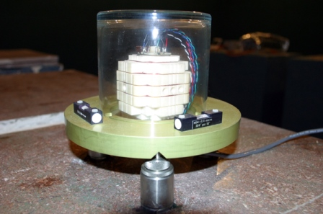
“Borok” observatory (BOX)
IPE RAS jointly with GC RAS and IPGP (France)
Director of observatory:
Dr. S.V. Anisimov
Transition to 1-sec data registration
Notes:
3
Совершенствуются датчики (1мин – 1сек) и системы сбора

Slide 4
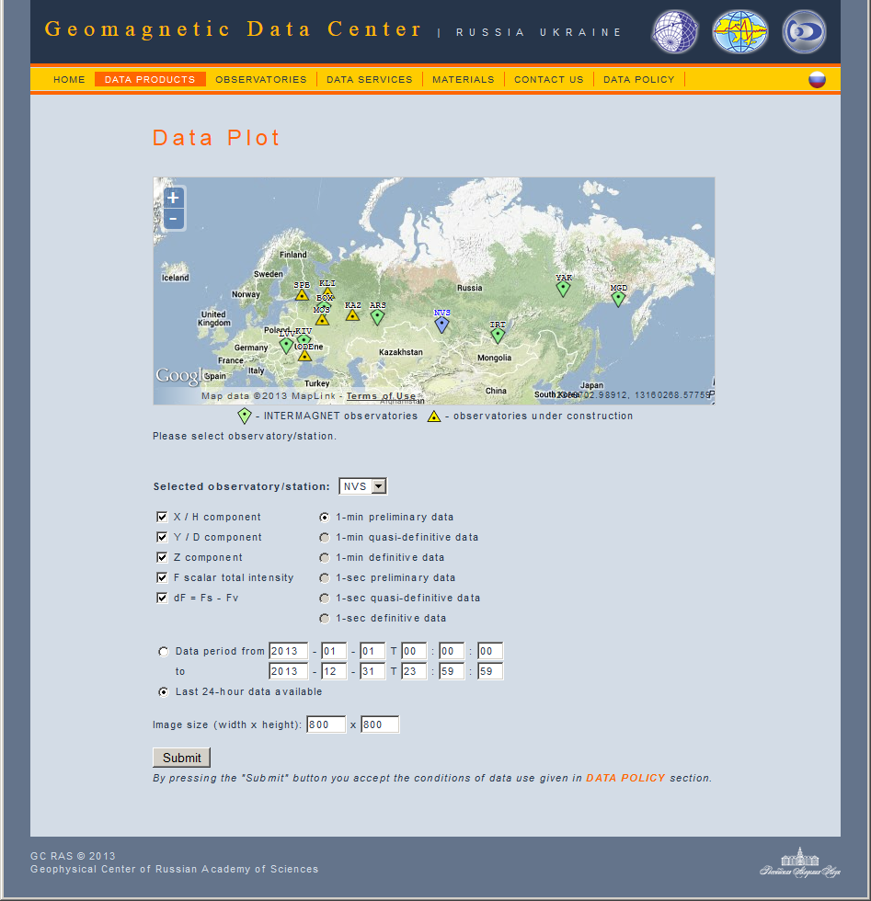
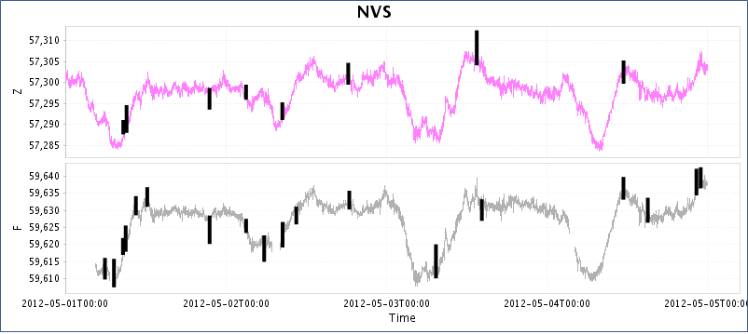
Interactive data access and automated data processing
Digital data with recognition results
IAGA-2002 format
CSV format
Plots containing recognition results
4 days
http://geomag.gcras.ru/
1 day
Notes:
4

Slide 5
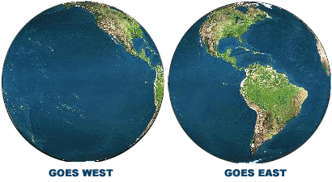
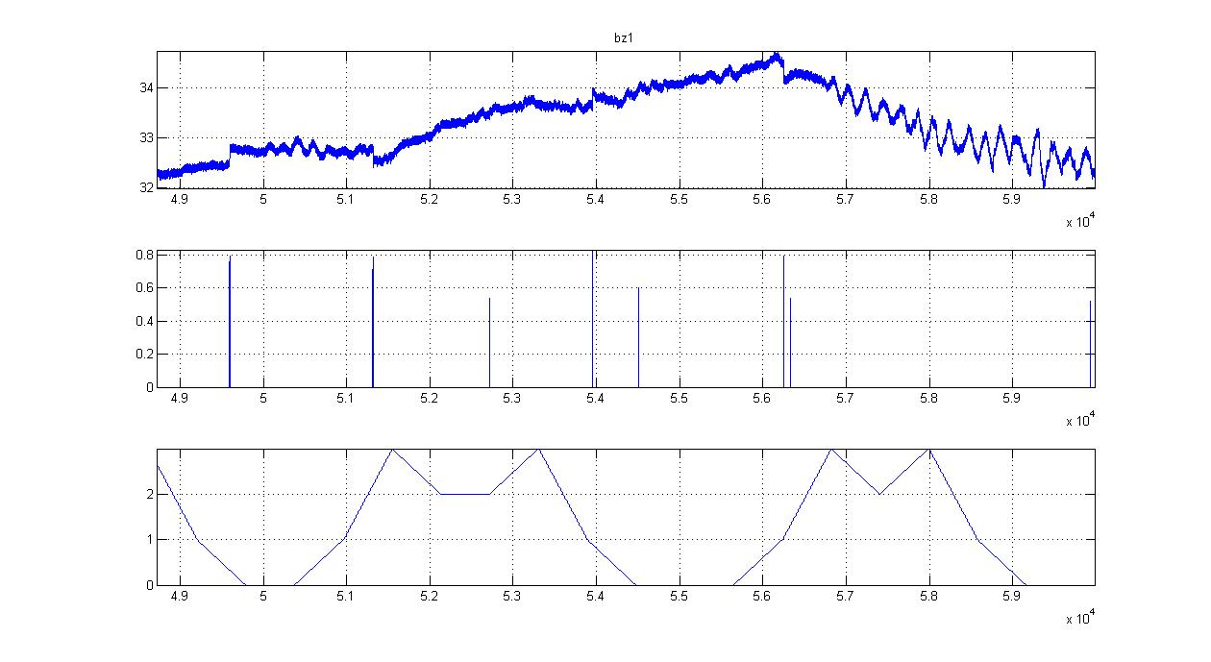
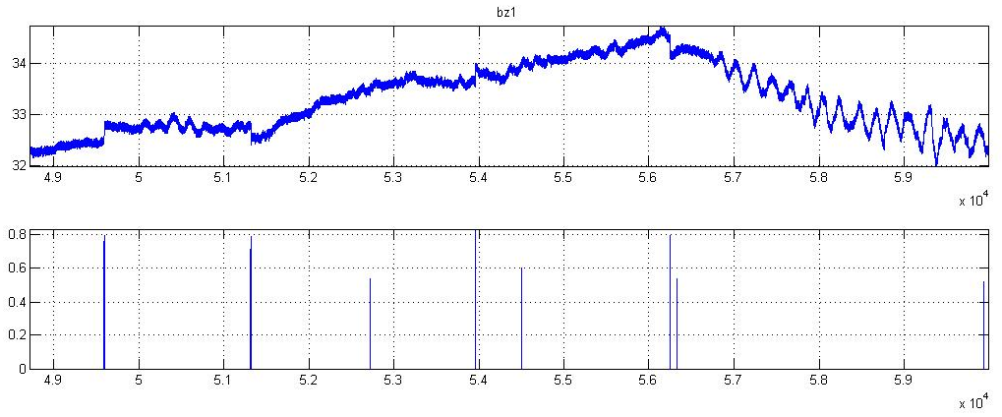
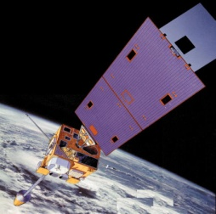
Recognition of jumps in satellite data.
Selecting measure of jumpiness threshold
Measure of jumpiness
0.6
~ 1.5 hours

Slide 6
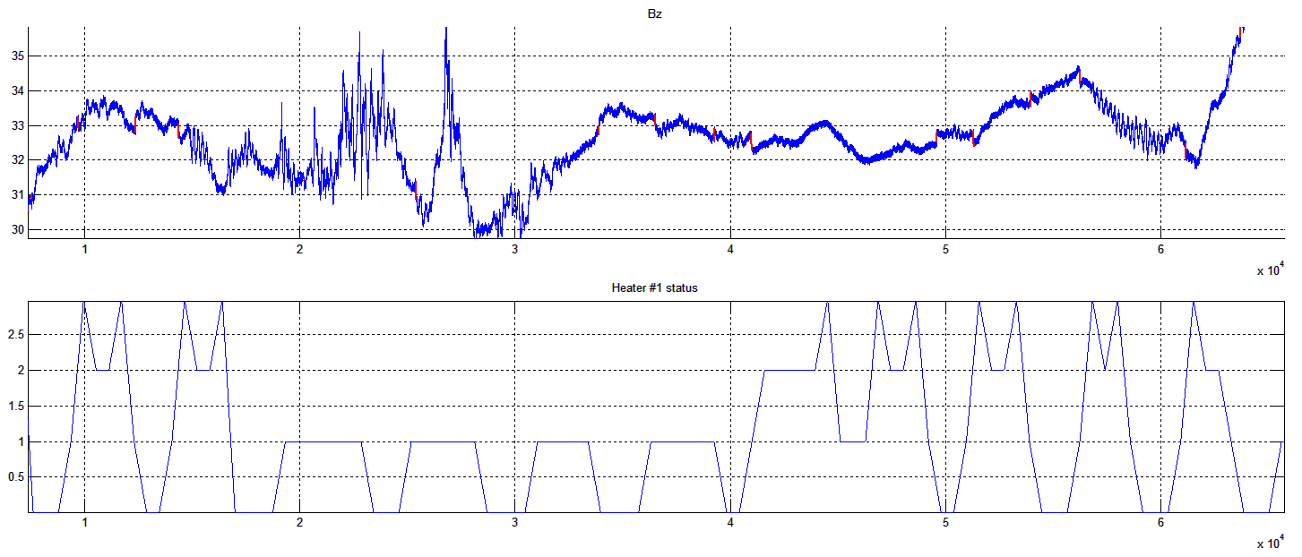
Recognition of jumps in satellite data. Partial correlation with heater switches
~ 8 hours
6
Notes:
6

Slide 7
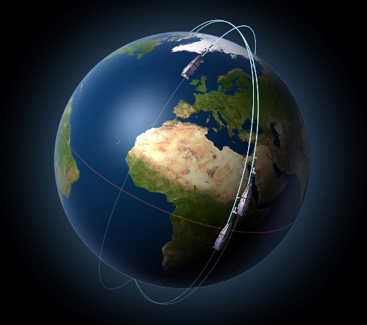
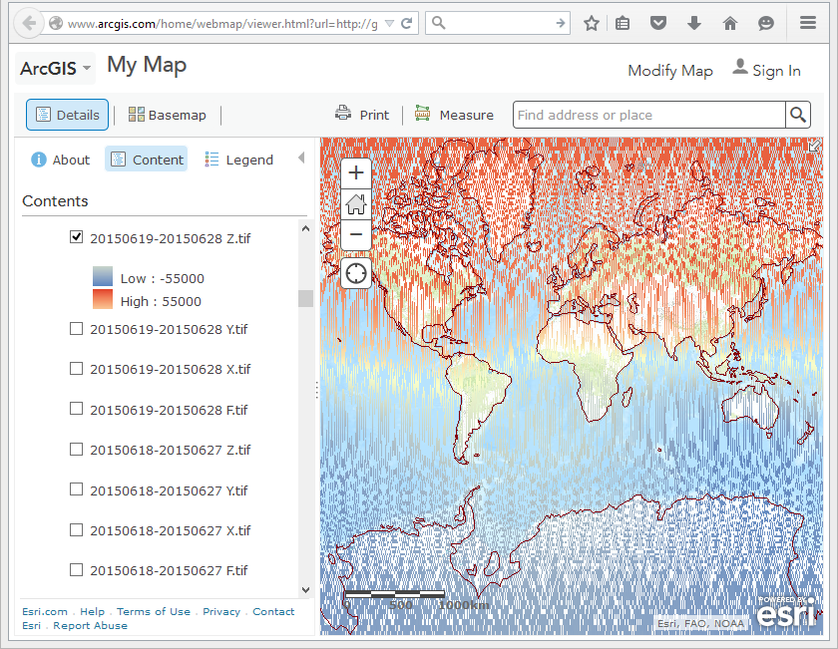
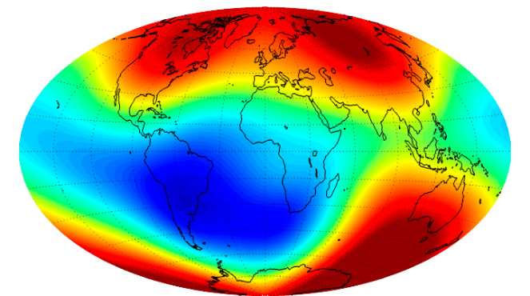
Magnetic field monitoring using GIS
(to be done)
Swarm satellite constellation
Level-2 Swarm products
(e.g., MCO_SHA_2F)
Core field model
Updated every 3 months
1-sec data for 10 days from 3 satellites (NED, F)
Time shift of 1 day
3-day delay
4 raster layers per day
Each layer contains 2 592 000 measurements
Raster grid resolution is 2048х1024 pixels
Monitoring near real-time change of external field
Notes:
Как система

Slide 8
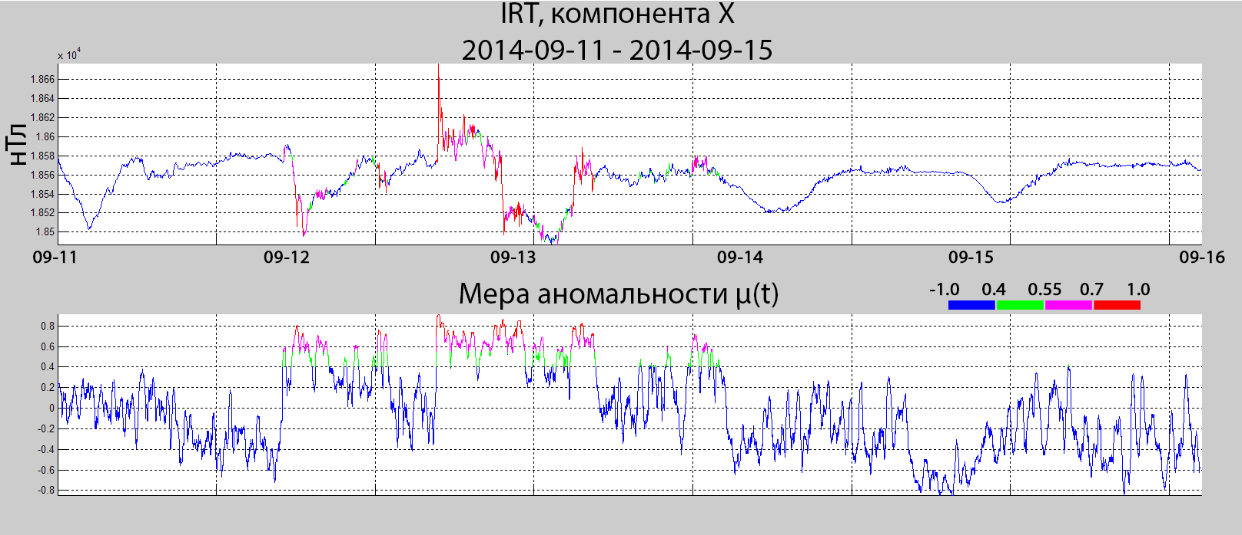
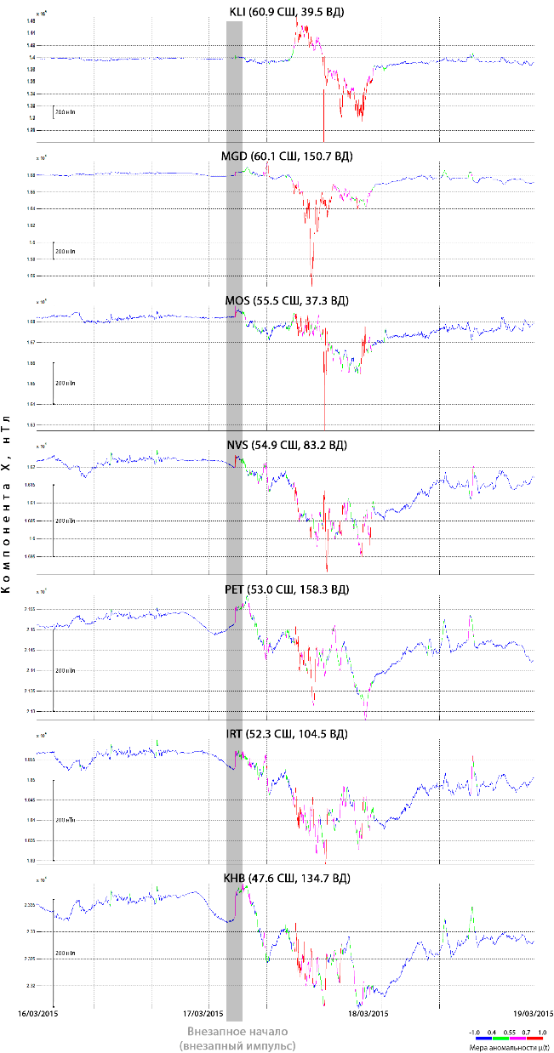
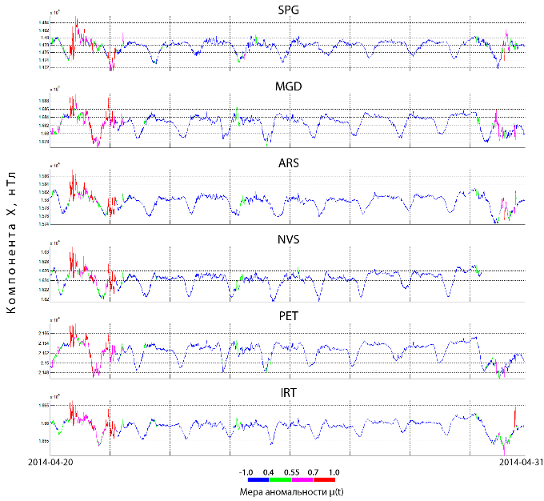
Quasi real-time monitoring of magnetic activity over the Globe
8

Slide 9
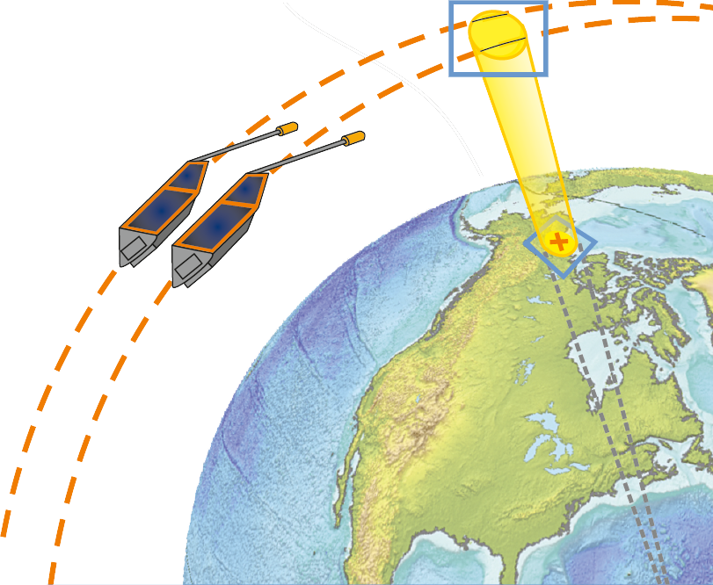
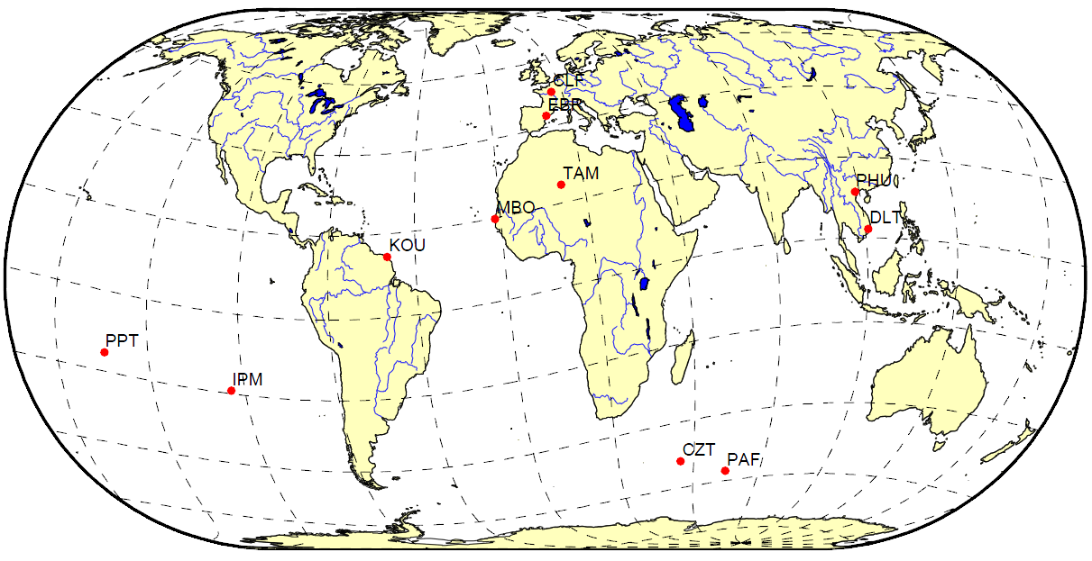
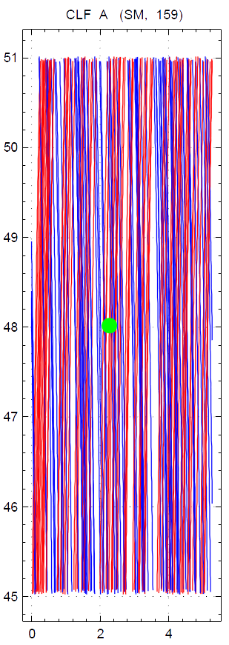
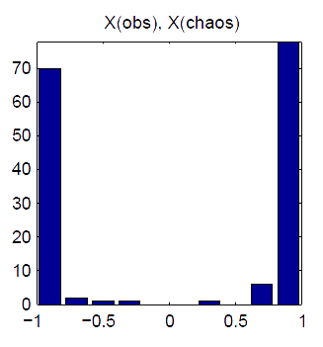
Combined processing of satellite and on-ground observations
Correlation results in
Solar Magnetic Coordinates
Degrees
Passes
11 observatories:
1 second sampling rate
Quasi-definitive data availability
1 year period after Swarm launch
Correlation coefficient
Degrees
159 passes of Swarm-A over CLF observatory during 1 year
S-N passes
N-S passes
Notes:
9

Slide 10
ORBUS software visualisation

Slide 11
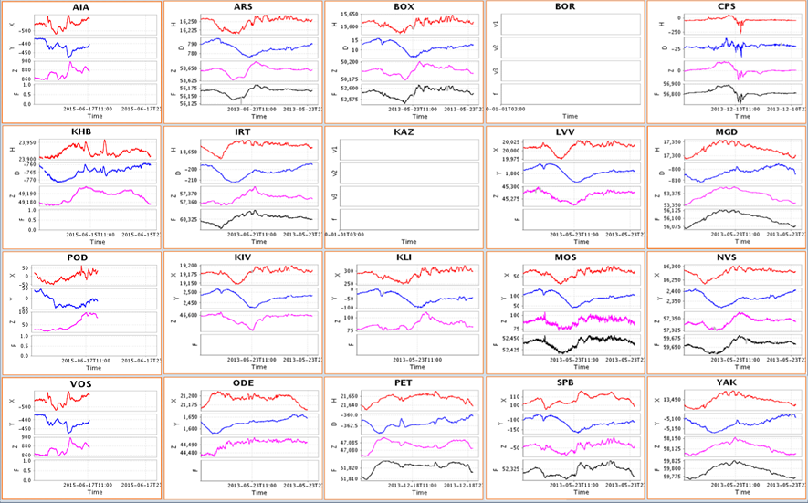
Chief, Rybkina Alena
Thank you!
a.rybkina@gcras.ru
Supported by the grant 14.607.21.0058
11
Notes:
11

