Slide 1
TOWARDS OPEN EARTH OBSERVATIONS DATA POLICIES PROGRESSES, CHALLENGES AND SUPPORT TOOLS 3. Challenges in Implementing Data Sharing Principles Gunter Schreier Earth Observation Center DLR GEO-XIII PLENARY WEEK, ST PETERSBURG, RUSSIA FEDERATION 7 NOVEMBER 2016

Slide 2
EO Data: The traditional Entities
Owner
Operator
User
Mission owner
Data policy
Funding entity
Mission operator
Ground segment
Data distribution
Value extration
Algorithms
Data handling
Processing

Slide 3
EO Data: A new player
New domain
Owner
Mission
Operator
Data
Mana ger
User
Mission owner
Data policy
Funding entity
Mission operator
Ground segment
Data hosting
Computing
Value chains
User Communities
Value use
Algorithms

Slide 4
The Data Owner – „return of investment“
Public/Government
Pure science objectives
Enhance commercialisation
Private/Companies
Revenue by data sales/ Anchor tenant
Revenue by „value“
NewSpace
Security restrictions
Owner

Slide 5
The Mission Manager – make it happen
Spacecraft operations
Data Acquisition
On-demand or always-on
Data/Product Processing
Selected or all
Data Distribution
Media → Internet bandwidth
Data Archive
Long term data preservation
Mission
Operator
NEW
APPROACHES COMING

Slide 6
The Data Manager – the „all digital“ solution
Mission data hosting/ always on-line
Selected/ rolling archive or all data
Remote Processing/ Cloud
Infrastructure as a Service
EO Platform as a Service
Protect or share user algorithms
User management
Manage rights and quotas
Know users, their needs and algorithms
… to improve → ?
Data
Mana ger

Slide 7
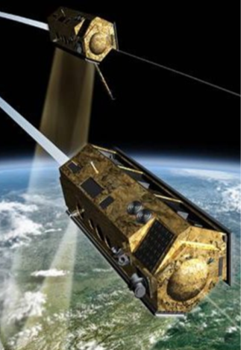
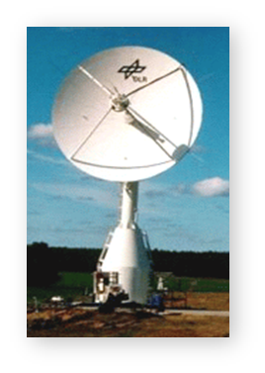
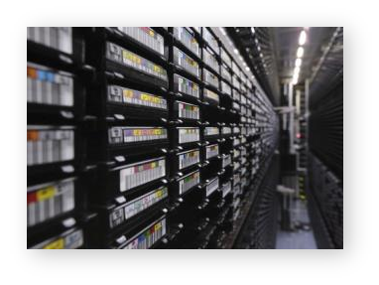
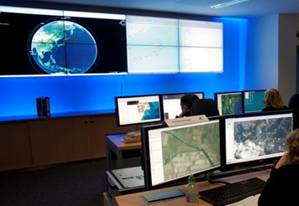
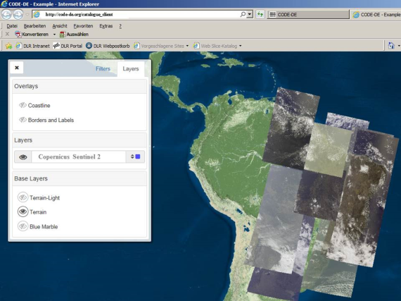
DLRs Experience
Owner full, PPP, …
Operator Own and third party missions Mission & Ground Ops
Data Manager Portals, Data Access, Cloud Computing (Copernicus)
User Science, Atmosphere, maritime & Emergency Services

Slide 8
Challenges for Data Sharing
Return of investment – more than just data sales
Works for govt‘ (e.g. Landsat, Copernicus), would it work for commercial missions?
Satellites are still not a technical commodity. They cost money, effort and operations
Can „operational big systems“ and „NewSpace“ co-exist?
EO data is digital, including all the value chain
Role of digital giants (e.g. AGFA) vs. „traditional“ players. How would data sharing be affected?
Is there a new „role model“ for the „User“?

